Slide 1
Maneras de preguntar cómo estás
HOW ARE YOU TODAY?
I´M FINE: ESTOY BIEN
I´M GREAT: ESTOY GENIAL
I´M NOT GOOD: NO ESTOY BIEN
HOW DO YOU FEEL TODAY?
I FEEL HAPPY: ME SIENTO FELIZ
I FEEL SURPRISE: ME SIENTO SORPRENDIDO
I FEEL BAD: ME SIENTO MAL
I FEEL SLEEPY: ME SIENTO SOMNOLIENTO
(CON SUEÑO)

Slide 2
AT THE ZOO
UNIT 1

Slide 3
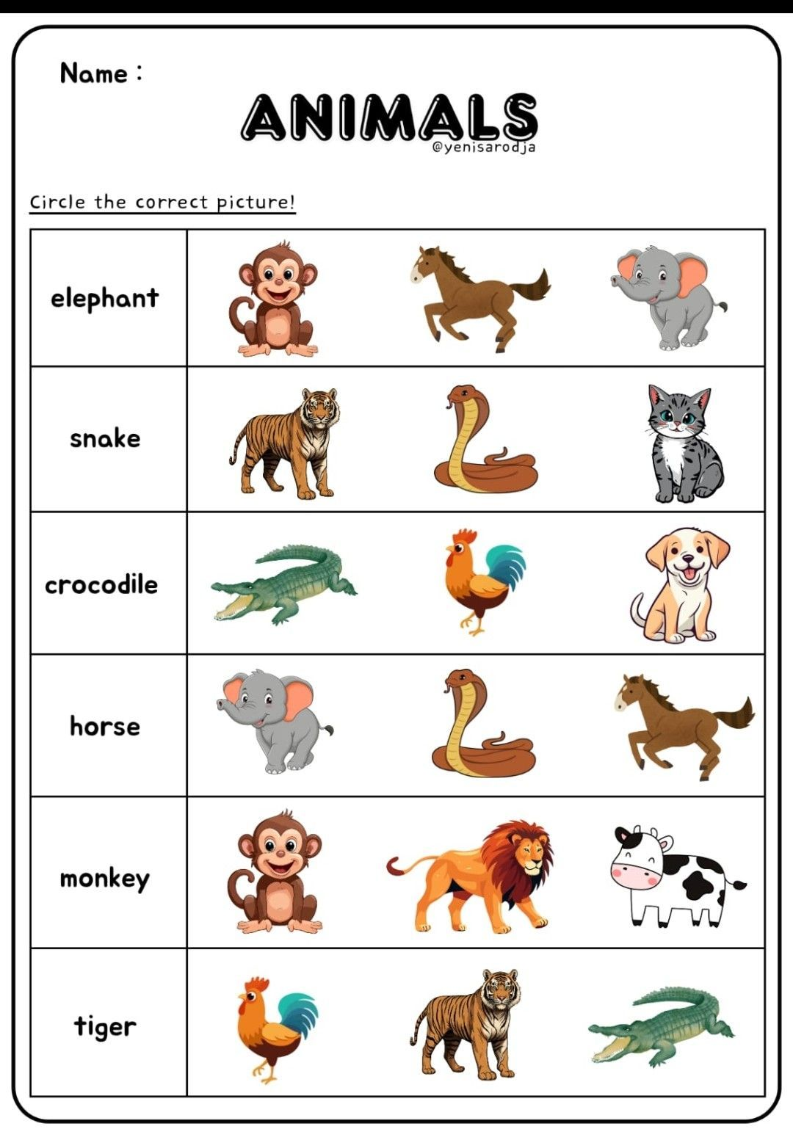


Slide 4
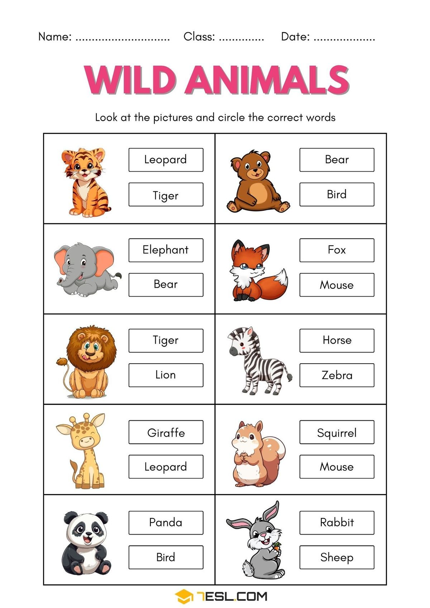


Slide 5
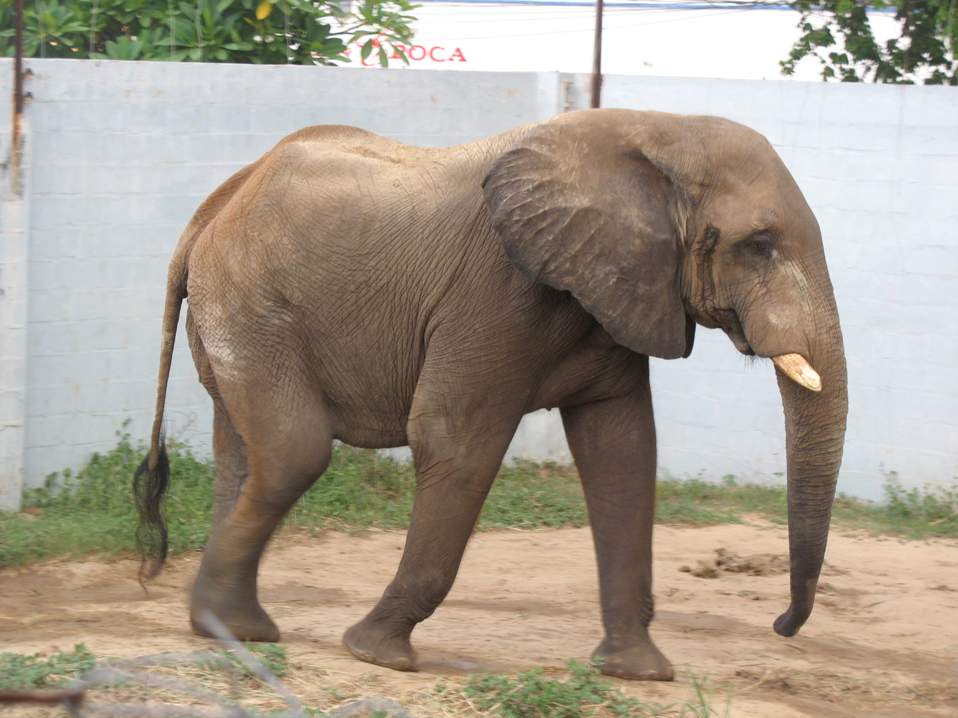
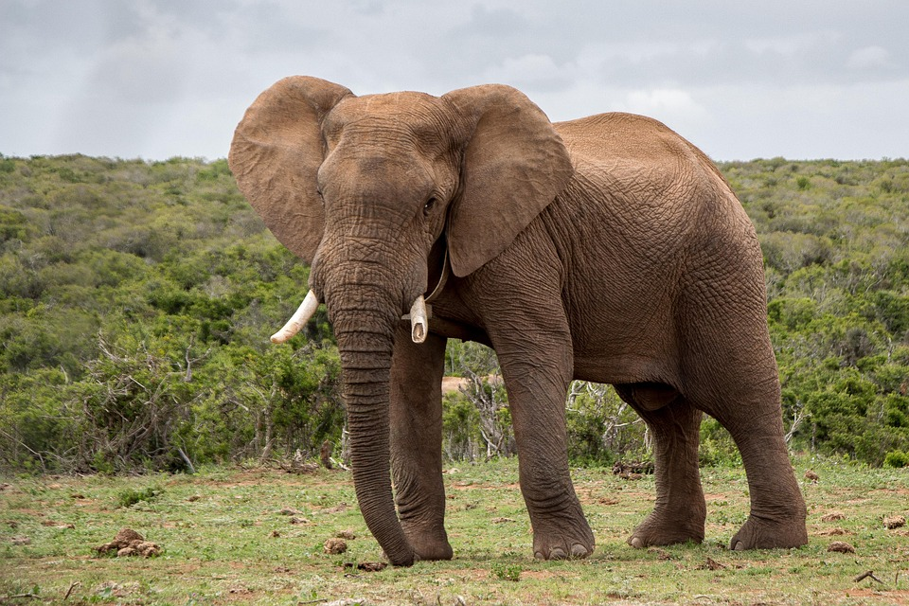
Read and complete
a. This animal is grey and has big ears: elephant
b. This animal has black and white stripes: zebra
c. This animal is funny and similar to humans: monkey
d. This animal is long and moves on the ground: snake
e. This animal is slow, green and brown: turtle

Slide 6
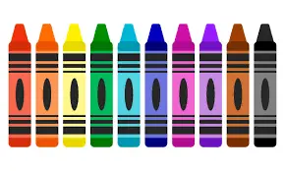
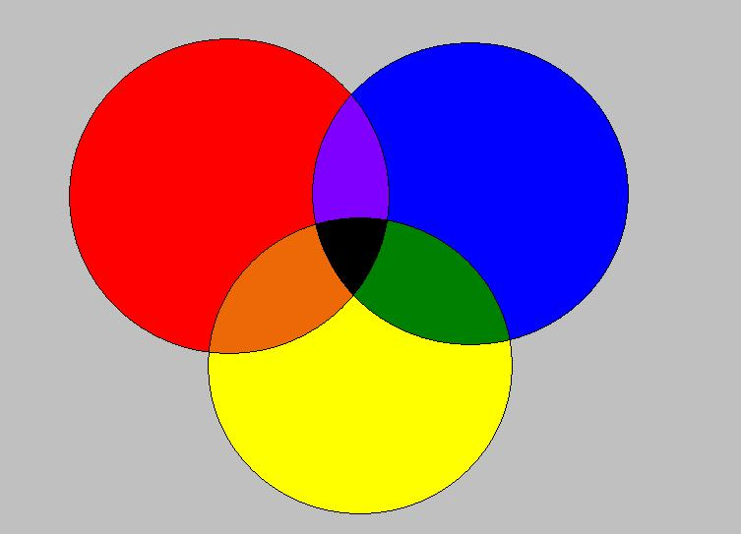
Answer:
a. What color is the ocean? _blue_________________
b. What color is a carrot? ___orange_____________
c. What color is an elephant? ___grey________________
d. What color is a frog? _green_______________
e. What color is a tomato? __red_____________________

Slide 7
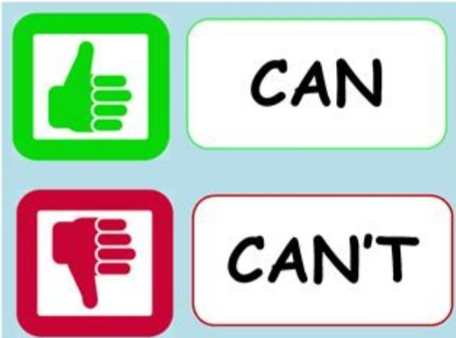
Can / can’t

Slide 8
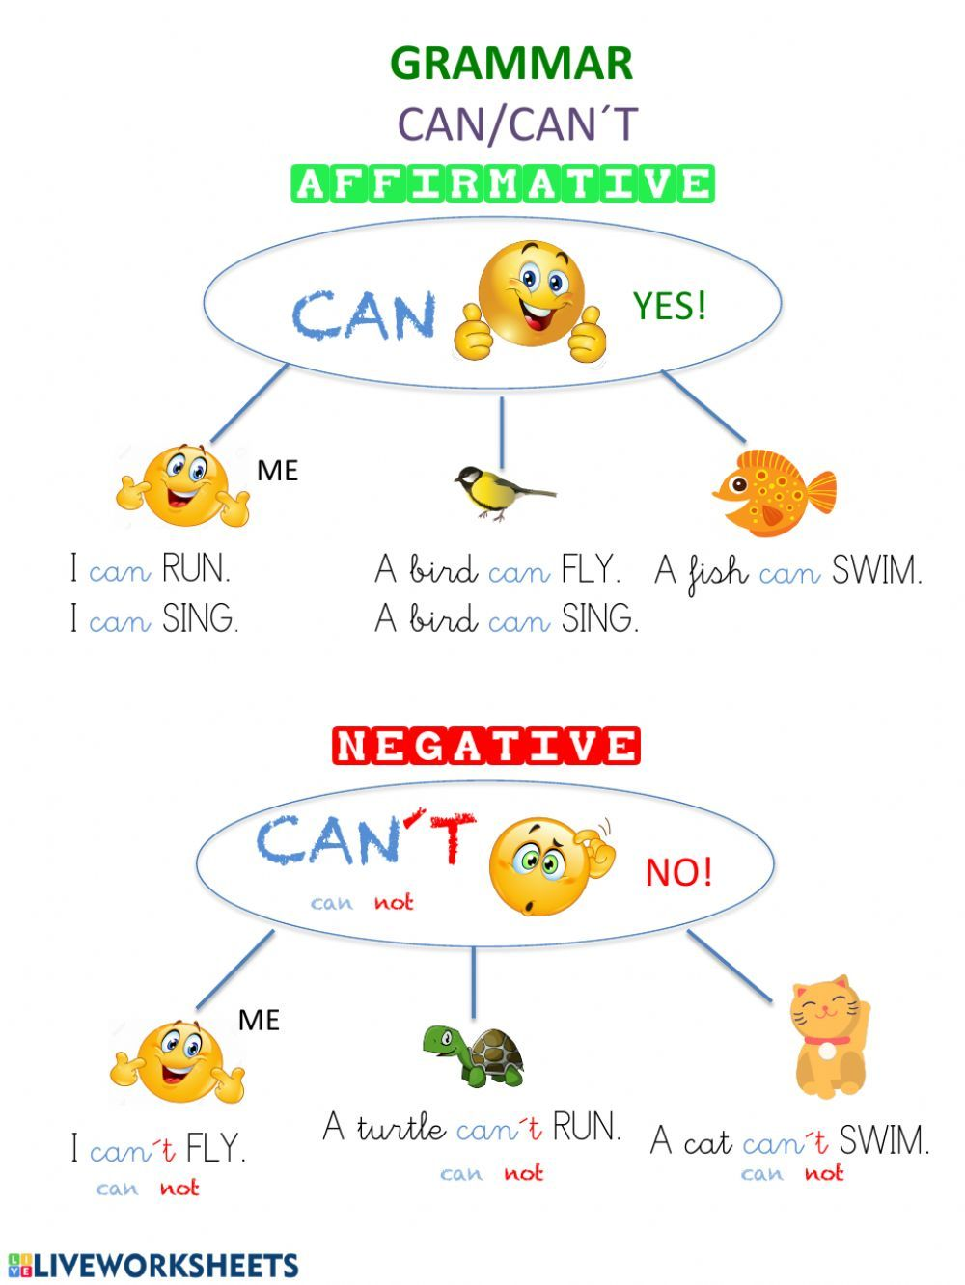
Can / can’t

Slide 9
https://www.youtube.com/watch?v=EzQ6Ag16rJk
https://www.youtube.com/watch?v=13T-YqxNcHc
https://www.youtube.com/watch?v=_Ir0Mc6Qilo&list=RD_Ir0Mc6Qilo&start_radio=1 echa

Slide 10
VOCABULARY
RUN FAST= CORRER RÁPIDO
JUMP = SALTAR
FLY = VOLAR
SWIM = NADAR
CLIMB TREES = ESCALAR ÁRBOLES
DANCE = BAILAR
WALK = CAMINAR

Slide 11
