Slide 1
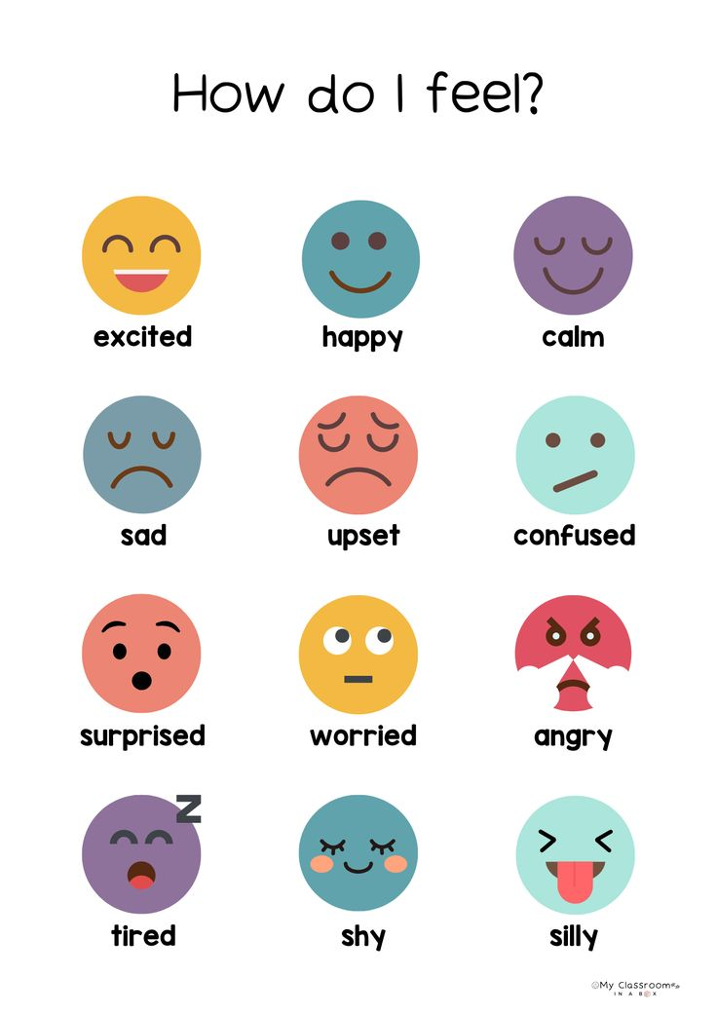

Slide 2
FEELINGS AND OPINIONS

Slide 3
Vocabulary – Match the feeling
1. Match the emotion with the correct definition.
Happy
Angry
Excited
Bored
Nervous
Proud
Sad
Surprised
Sorprendido
Feliz
Triste
Enojado
Orgulloso
Emocionado
Nervioso
aburrido

Slide 4
Vocabulary – Match the feeling
1. Match the emotion with the correct definition.
Happy
Angry
Excited
Bored
Nervous
Proud
Sad
Surprised
Positive
Happy
Excited
Proud
surprise
Negative
angry
Bored
Nervous
sad

Slide 5
2. Complete the sentences
Use the correct feeling word.
happy – nervous – bored – excited – angry – proud
I feel __happy________ when I get good grades.
She is ___nervous_______ because she has a big test today.
They are _excited_________ to go on vacation.
He feels __bored________ when he watches the same movie again.
My mother is _angry_________ because the room is messy.
We feel _proud_________ when our team wins a game.

Slide 6
3. Expressing opinions: Complete the sentences with your own opinion.
I think soccer is __________________.
In my opinion, school is __________________.
I believe homework is __________________.
I think English is __________________.
In my opinion, weekends are __________________.

Slide 7
💡 Expresiones útiles para enseñar:
Feelings
I feel happy. / I am happy / she feels / he feels
I feel nervous. / I am nervous / she is nervous / they are nervous
I feel excited.
Opinions
I think…
In my opinion…
I believe…

Slide 8
4. Writing – Short answer
Answer using feelings and opinions.
How do you feel when you have a difficult test?
What do you think about sports at school?
How do you feel when you spend time with friends?
What do you think about learning English?

Slide 9
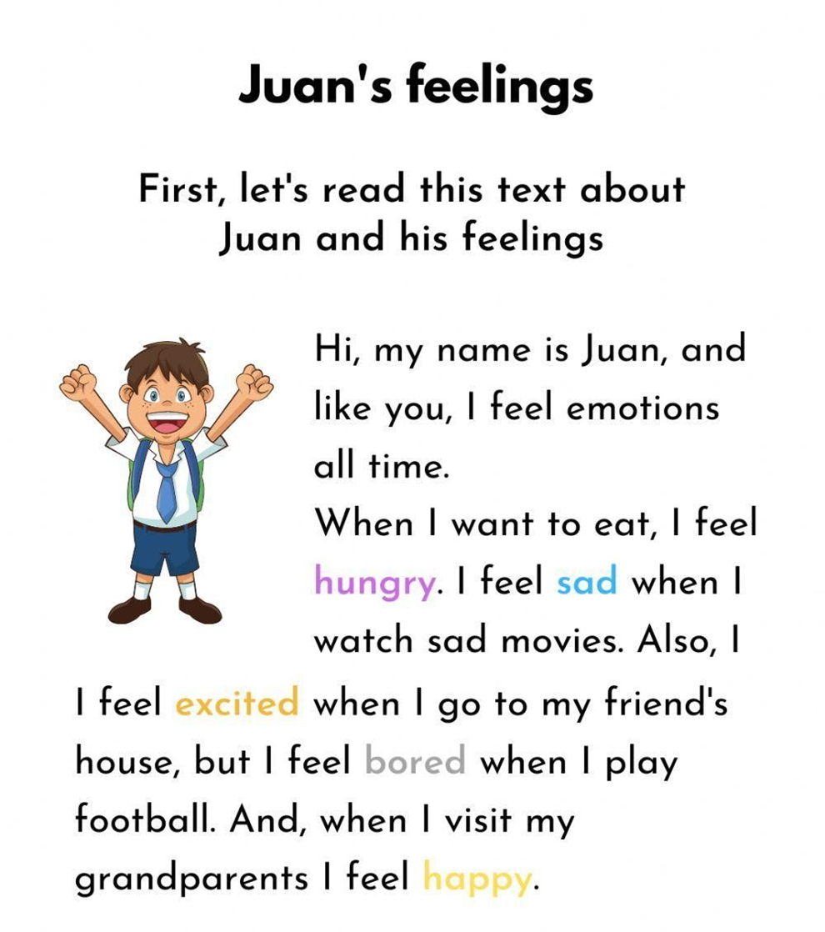
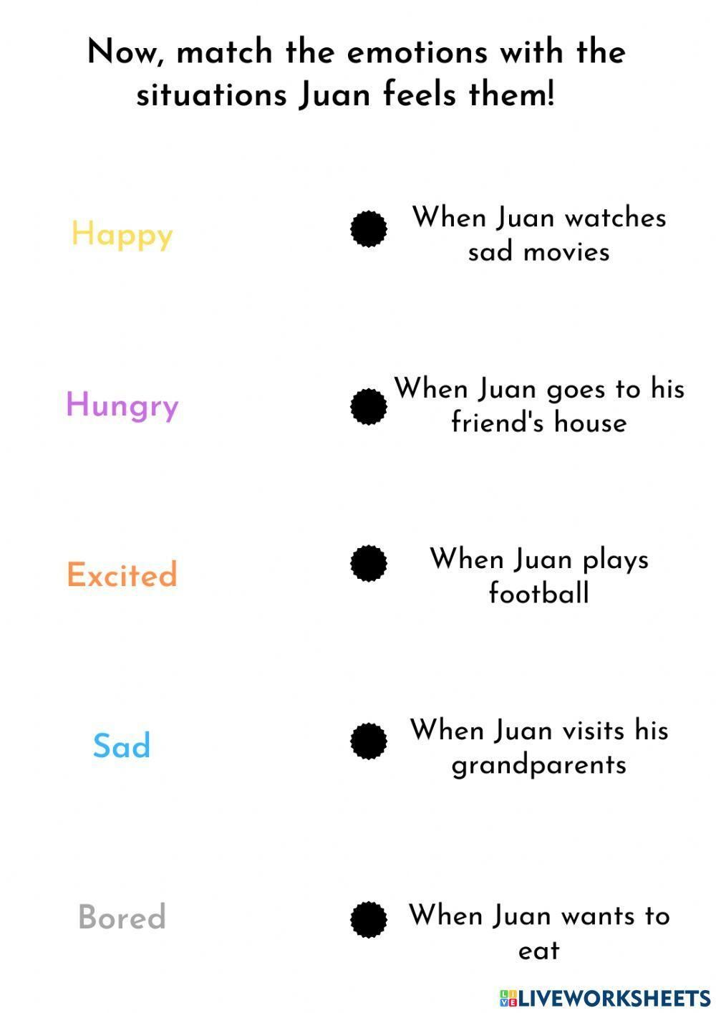

Slide 10
Now answer the questions about Juan
Why does Juan feel emotions all the time?
Does Juan feel emotions all the time? (Yes/No)
Can you remember a time when you felt like Juan? What emotion did you feel?
Why do you think Juan feels excited when he goes to his friend’s house?
Which of Juan’s feelings do you feel the most often?

Slide 11
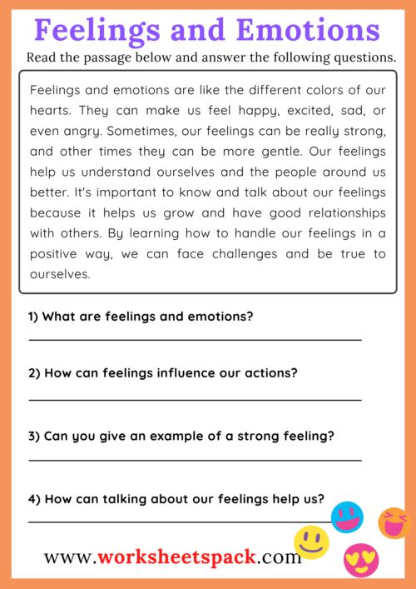

Slide 12
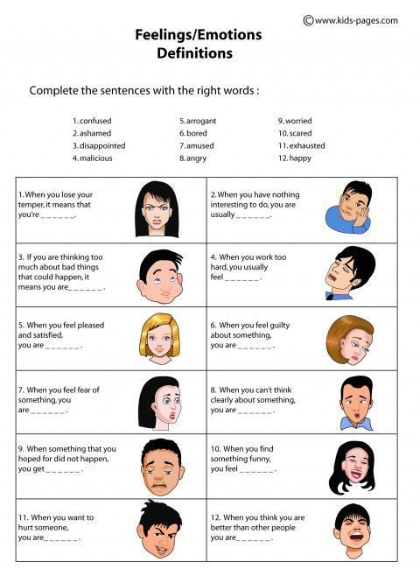

Slide 13
