Slide 1
“HOW DO YOU FEEL?
UNIT 1

Slide 2
Objetivo
Los estudiantes serán capaces de:
Expresar emociones
Hablar de enfermedades simples
Preguntar y responder cómo se sienten

Slide 3

Vocabulary (Feelings & Illnesses)
Feelings (emociones):
happy 😊 → feliz
sad 😢 → triste
tired 😴 → cansado/a
scared 😨 → asustado/a
angry 😠 → enojado/a
Illnesses (enfermedades):
headache → dolor de cabeza
stomachache → dolor de estómago
cold → resfriado
fever → fiebre
cough → tos
Broken arm → brazo roto
Runny nose nariz húmeda
Sore thoat → dolor de garganta
Toothache → dolor de dientes
Cut → corte

Slide 4
ADVICE
Get some rest! = ¡Descansa!
I hope you get better soon! = ¡Espero te mejores!

Slide 5
ESTRUCTURA
How do you feel?
I feel happy he/she feels happy
I feel bad he/she feels bad
I am happy he/she is happy
I am bad he/she is bad
What’s the matter? (¿qué pasa? / ¿cuál es el problema?)
I have a cold he/she has a coll
I have a headache he/she has a headache

Slide 6
Link del video
https://www.youtube.com/watch?v=5xZYFPJ0fps
(para abrir, seleccionar el link, apretar el botón derecho del mouse y luego elegir “abrir hipervínculo”)

Slide 7
READ THE TEXT AND ANSWER THE QUESTIONS
Questions
How does Tom feel?
He feels sick
What does he have?
He has a headache and a cough
Is he at school?
No. He is at home
Who helps him?
His mom
Tom is at home today. He feels sick. He has a headache and a cough. He is tired and sad. His mom gives him medicine and he rests.

Slide 8
Choose the correct answer
1“I have a stomachache” means:
a) Tengo dolor de cabeza
b) Tengo dolor de estómago
c) Tengo fiebre
2“She has a cold” means:
a) Ella está feliz
b) Ella tiene resfriado
c) Ella tiene dolor
3“I feel sick” means:
a) Me siento enfermo
b) Me siento feliz
c) Me siento fuerte
4“He has a fever” means:
a) Él tiene tos
b) Él tiene fiebre
c) Él tiene sueño

Slide 9
Choose the correct answer
5“I have a cough” means:
a) Tengo tos
b) Tengo frío
c) Tengo hambre
6“She feels tired” means:
Ella está enojada
b) Ella está cansada
c) Ella está asustada
7“He feels sad” means:
Él está feliz
b) Él está triste
c) Él está enfermo
8“I feel happy” means:
Estoy enfermo
b) Estoy feliz
c) Estoy cansado

Slide 10
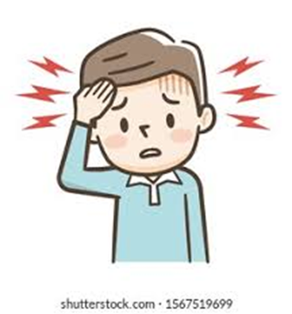
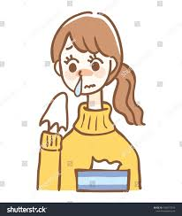
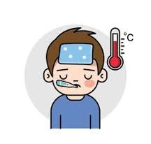
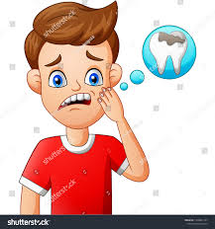
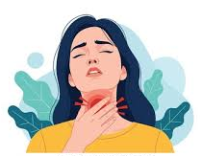
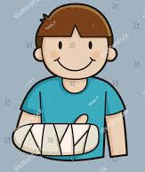
Look at the picture and complete the sentence:
I have a _headache________
She has a ___runny nose___________
He has a _fever_________
He has a __toothache_____________
She has a _sore throat_______
He has a broken arm__________
What’s the matter?

Slide 11
Ejercise: Make sentences with feelings and illness
Ex: I feel bad, because I have a cold
I feel bad, because I have a cut
I feel tired, because I have a headche
I feel bad, because I have a cough

Slide 12
Reading Activity
Text: “A Sick Day”
Lucy is a student. Today she is not at school because she feels sick. In the morning, she wakes up and feels very tired.
She also has a headache and a fever. Her mom checks her temperature and gives her some medicine. Lucy stays in bed and drinks tea. She watches TV and rests all day. In the afternoon, she feels a little better, but she still has a cough. Her mom tells her to sleep early so she can feel better tomorrow.

Slide 13
MULTIPLE CHOICE
1Why is Lucy not at school?
Because she is happy
b) Because she feels sick
c) Because she is playing
2What does Lucy have in the morning?
A cold and hunger
b) A headache and a fever
c) A cough and happiness
3What does her mom give her?
Food
b) Medicine
c) Toys
4What does Lucy do during the day?
She goes to school
b) She plays outside
c) She rests and watches TV
5How does Lucy feel in the afternoon?
Worse
b) The same
c) A little better

Slide 14
Write true or false
. True or False
Lucy goes to school. ___
She feels tired. ___
She has a fever. ___
She plays with friends. ___
She watches TV. ___

Slide 15
Answer the questions
Short Answers
How does Lucy feel in the morning?
What does her mom do?
What does Lucy drink?
Does she feel better later?

