Slide 1
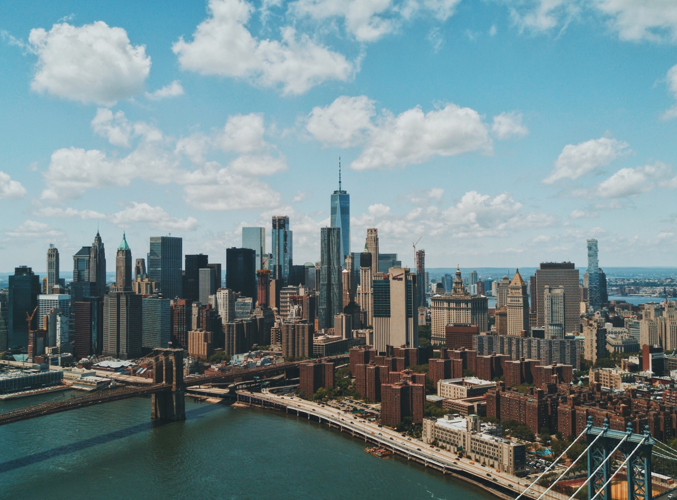
Globalization and communication

Slide 2
GLOBALIZATION
What does globalization mean? We always hear this word on TV and read about it in newspapers. It means the world is now a village – the global village. The world has become smaller. Of course, the world did not shrink and it isn’t a village. Because of better transport, the Internet and more trading between countries, it is easier to do business. Japanese car makers have factories in Thailand; American computer companies employ thousands of people in China. That’s globalization. And don’t forget the millions of call centre jobs in India that workers in America and Europe used to do. Globalization also means it is easier to work in another country. Is globalization a good or bad thing? That’s a difficult question to answer.

Slide 3
GLOBALIZATION
1.- What examples can you find of globalization? __________________________________________________________
_ 2.- What kind of positive/negative effects does it have for you or your community? __________________________________________________________
3.- How is globalization affecting you or your community? __________________________________________________________

Slide 4
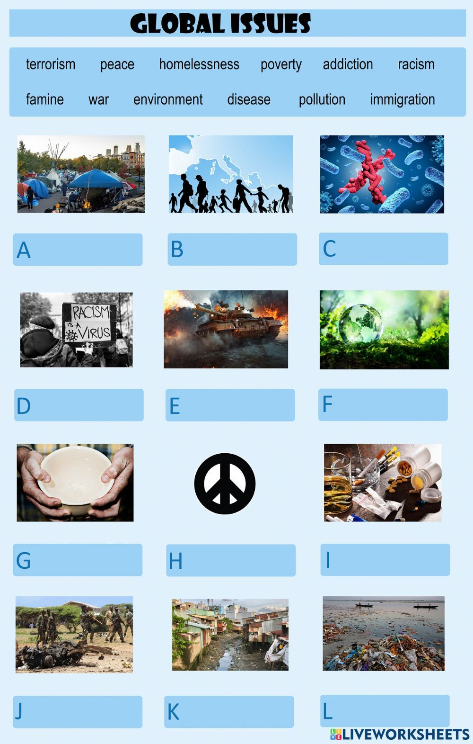

Slide 5
TERRORISM = terrorismo
PEACE = paz
HOMELESSNESS = sin hogar
POVERTY = pobreza
ADDITION =adicción
FAMINE = hambruna
POLLUTION = CONTAMINACIÓN
RACISM = racismo
WAR: guerra
Environment = medio ambiente
DISEASE= enfermedad
IMMIGRATION = emigración

Slide 6
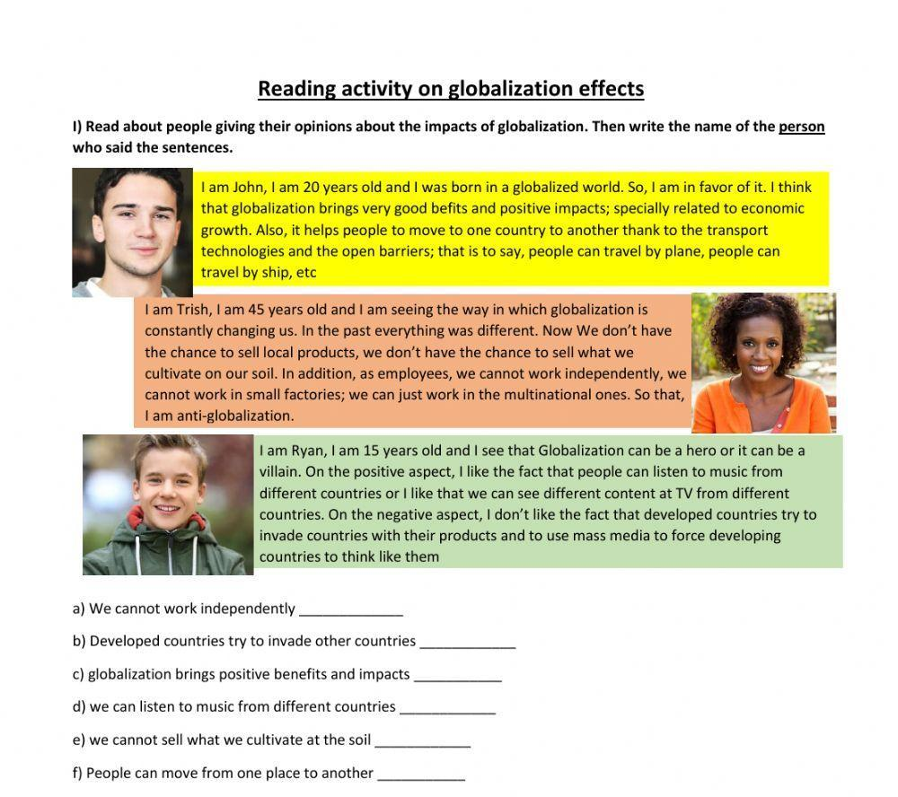

Slide 7
EXAMPLES OF PERSONAL OPINIONS:
Axel: In my opinion, Globalization can bring us positive and negative things. Positive things like better communication between people at any time, and negative like ambient pollution and global warming
Martina: In my opinion, globalization is great because I can listen to music from other countries, watch series from all over the world, and even get help with my homework from people who are far away (online classes).

Slide 8
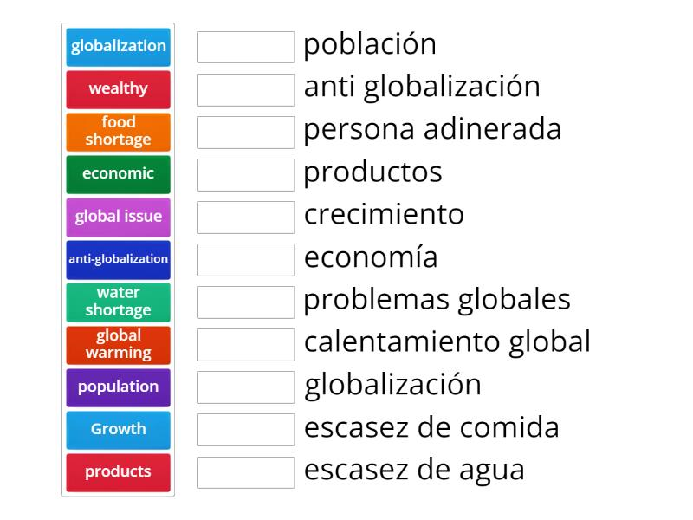
Population
Anti globatization
wealthy
products
growth
economic
Global issue
Global warming
globalization
Food shortage
Water shotage

Slide 9
Links of educational exercises on the web
https://wordwall.net/es/resource/54649784/globalization
https://wordwall.net/es/resource/54566473/unit-1-globalization-and-communication-vocabulary

