Slide 1
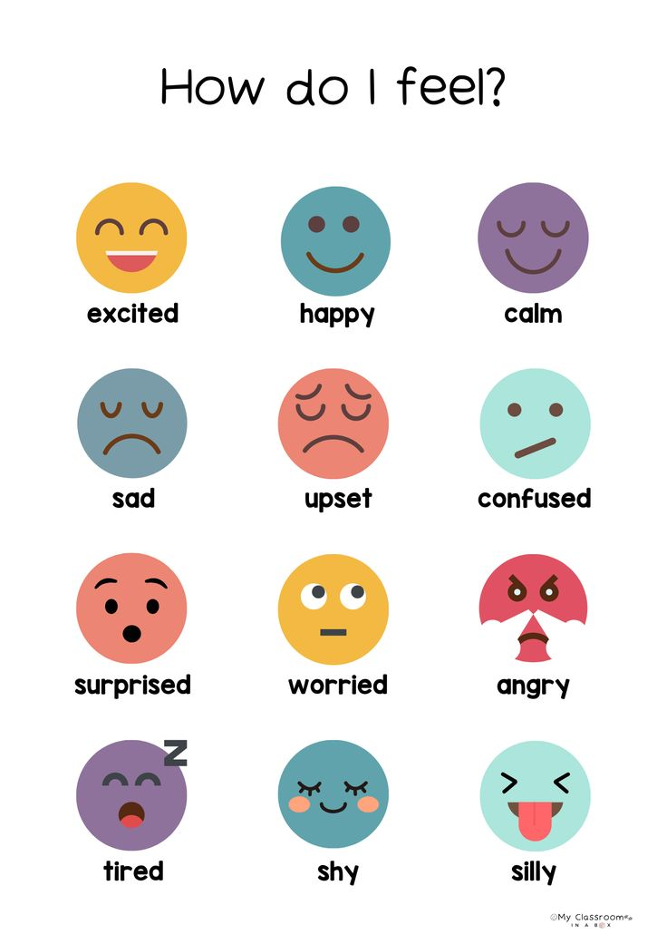

Slide 2
FEELINGS AND OPINIONS

Slide 3
Vocabulary – Match the feeling
1. Match the emotion with the correct definition.
Happy
Angry
Excited
Bored
Nervous
Proud
Sad
Surprised
Sorprendido(a)
Feliz
Triste
Enojado(a)
Orgulloso(a)
Emocionado(a)
Nervioso(a)
Aburrido(a)

Slide 4
Vocabulary – Match the feeling
1. Match the emotion with the correct definition.
Happy
Angry
Excited
Bored
Nervous
Proud
Sad
Surprised
Positive
Happy
Excited
Proud
surprise
Negative
angry
Bored
Nervous
sad

Slide 5
2. Complete the sentences
Use the correct feeling word.
happy – nervous – bored – excited – angry – proud
I feel __happy________ when I get good grades.
She is ___nervous_______ because she has a big test today.
They are _excited_________ to go on vacation.
He feels __bored________ when he watches the same movie again.
My mother is _angry_________ because the room is messy.
We feel _proud_________ when our team wins a game.

Slide 6
3. Expressing opinions: Complete the sentences with your own opinion.
I think soccer is __________________.
In my opinion, school is __________________.
I believe homework is __________________.
I think English is __________________.
In my opinion, weekends are __________________.

Slide 7
💡 Expresiones útiles para enseñar:
Feelings
I feel happy. / I am happy / she feels / he feels / he is happy /she is happy
I feel nervous. / I am nervous / she is nervous / they are nervous
I feel excited.
Opinions
I think…
In my opinion…
I believe…

Slide 8

To be verb
I am
You
We are
They
He
She is
it

Slide 9
4. Writing – Short answer
Answer using feelings and opinions.
How do you feel when you have a difficult test?
I feel … because
What do you think about sports at school?
I think sports are good because
How do you feel when you spend time with friends?
I feel excited, because
What do you think about learning English?
I think English is very important for our life

Slide 10
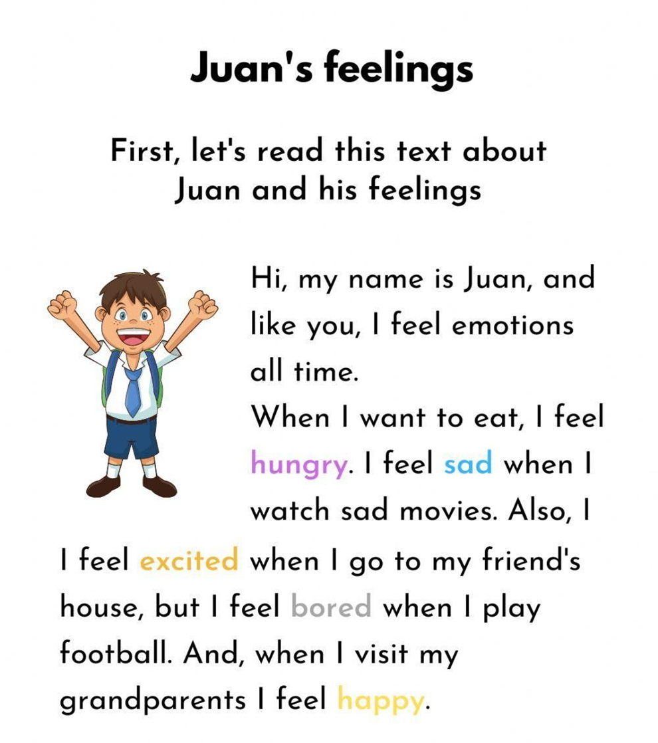
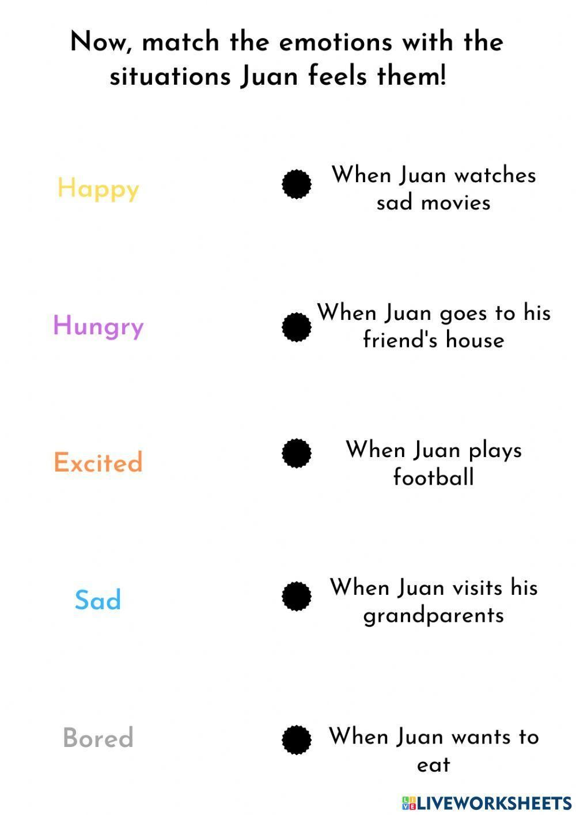

Slide 11
Now answer the questions about Juan
Why does Juan feel emotions all the time?
Because Juan is human and all humans feel emotions
Does Juan feel emotions all the time? (Yes/No)
yes
Can you remember a time when you felt like Juan? What emotion did you feel?
I remember yesterday I felt hungry when I saw the food that my mom was cooking
Why do you think Juan feels excited when he goes to his friend’s house?
Because he wanna play
he wants to play
I think because is very excited
Which of Juan’s feelings do you feel the most often?
Hungry
Calm
Happy

Slide 12
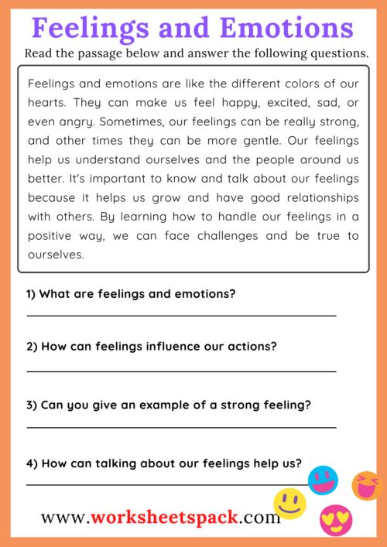
Vocabulary
Strong: fuerte
Gentle: suave, amable, dulce
Grow: crecer
Relationships: relaciones
Handle: manejar

