Slide 1
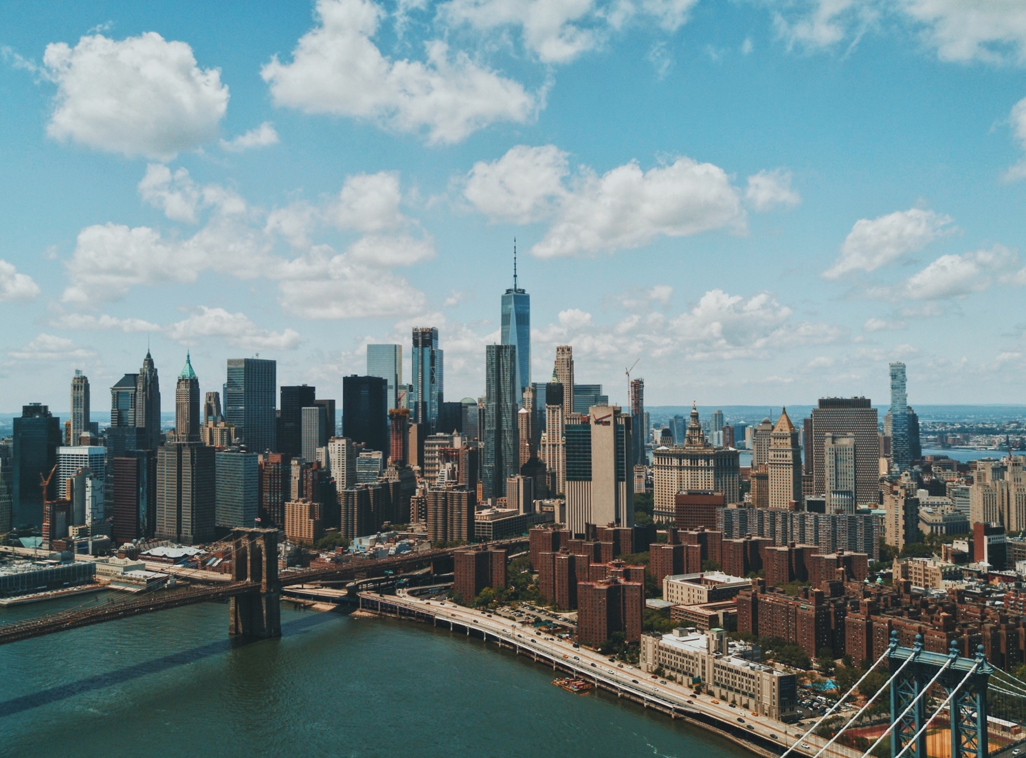
Globalization and communication

Slide 2
GLOBALIZATION
What does globalization mean? We always hear this word on TV and read about it in newspapers. It means the world is now a village – the global village. The world has become smaller. Of course, the world did not shrink and it isn’t a village. Because of better transport, the Internet and more trading between countries, it is easier to do business. Japanese car makers have factories in Thailand; American computer companies employ thousands of people in China. That’s globalization. And don’t forget the millions of call centre jobs in India that workers in America and Europe used to do. Globalization also means it is easier to work in another country. Is globalization a good or bad thing? That’s a difficult question to answer.

Slide 3
GLOBALIZATION
1.- What examples can you find of globalization? __________________________________________________________
_ 2.- What kind of positive/negative effects does it have for you or your community? __________________________________________________________
3.- How is globalization affecting you or your community? __________________________________________________________

Slide 4
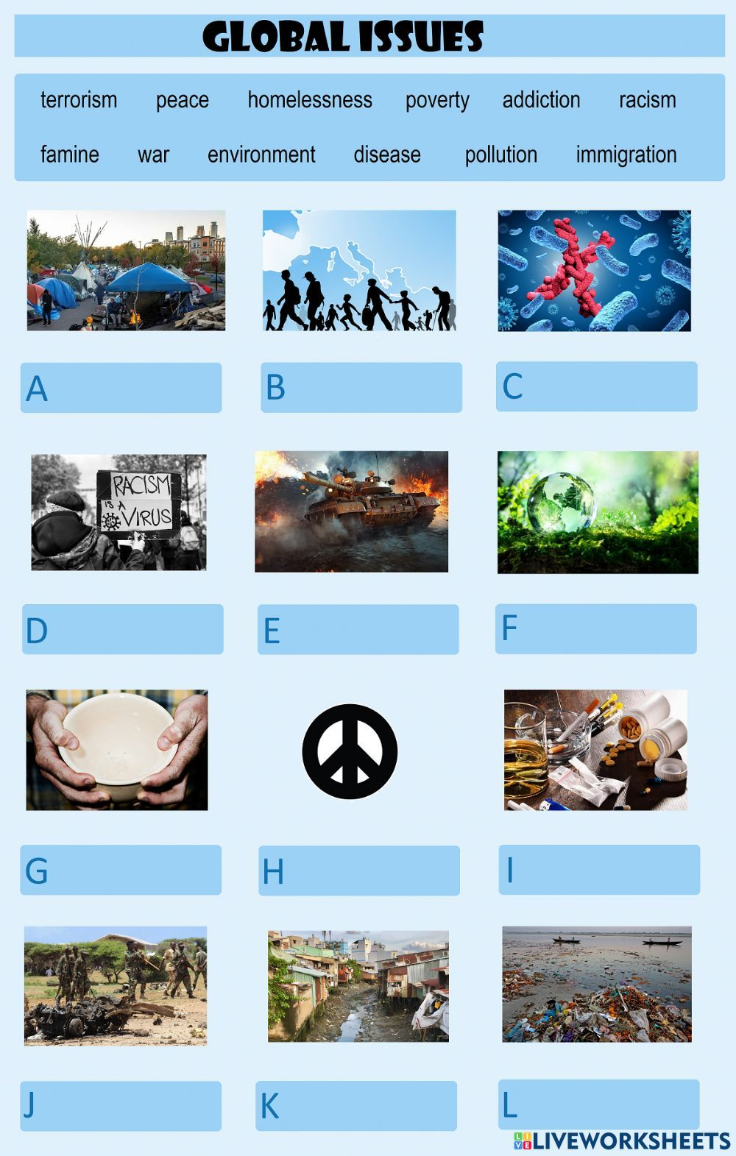

Slide 5
TERRORISM = terrorismo
PEACE = paz
HOMELESSNESS = sin hogar
POVERTY = pobreza
ADDITION =adicción
FAMINE = hambruna
POLLUTION = CONTAMINACIÓN
RACISM = racismo
WAR: guerra
Environment = medio ambiente
DISEASE= enfermedad
IMMIGRATION = emigración

Slide 6
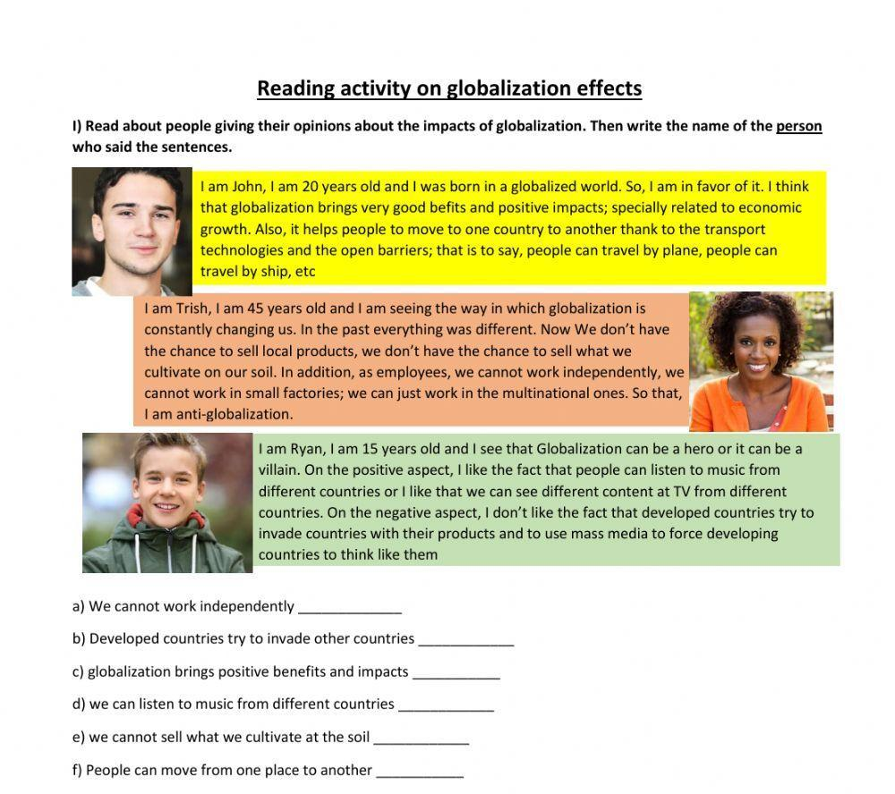

Slide 7
EXAMPLES OF PERSONAL OPINIONS:
Axel: In my opinion, Globalization can bring us positive and negative things. Positive things like better communication between people at any time, and negative like ambient pollution and global warming
Martina: In my opinion, globalization is great because I can listen to music from other countries, watch series from all over the world, and even get help with my homework from people who are far away (online classes).

Slide 8
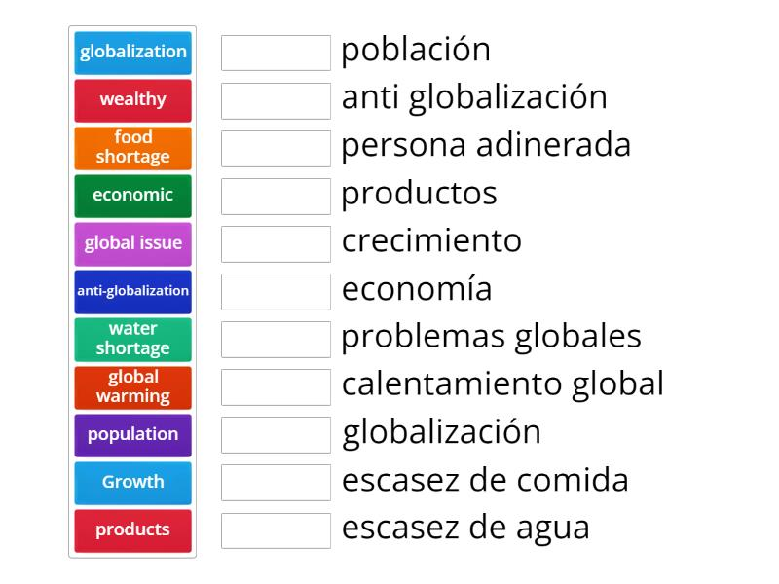
Population
Anti globatization
wealthy
products
growth
economic
Global issue
Global warming
globalization
Food shortage
Water shotage

Slide 9
Links of educational exercises on the web
https://wordwall.net/es/resource/54649784/globalization
https://wordwall.net/es/resource/54566473/unit-1-globalization-and-communication-vocabulary

Slide 10
What does globalization mean? We _______________________ word on TV and read about it in newspapers. It means the _______________________ village – the global village. The world has become smaller. Of course, _______________________ not shrink and it isn’t a village. Because of better transport, the Internet _______________________ between countries, it _______________________ business. Japanese car makers have factories in Thailand; American computer companies employ thousands of people in China. That’s globalization. And don’t forget _______________________ call centre jobs in India that workers in America and Europe _______________________. Globalization also means _______________________ work in another country. Is globalization a good _______________________? That’s a difficult _______________________.

Slide 11
Present perfect tense
Acciones iniciadas en el pasado y que continúan en el presente
They haven't lived here for years.
She has worked in the bank for five years.
We have had the same car for ten years.
Cuando se hace referencia a un periodo temporal inacabado
I have worked hard this week.
It has rained a lot this year.
We haven't seen her today.
Acciones reiteradas en un periodo inespecífico, entre el pasado y el presente.
They have seen that film six times
It has happened several times already.
We have eaten at that restaurant many times.

Slide 12
Present perfect tense
Acciones concluidas en un pasado muy reciente (+just)
Have you just finished work?
I have just eaten.
We have just seen her.
Has he just left?
Cuando la dimensión temporal no es relevante o conocida
Someone has eaten my soup!
Have you seen 'Gone with the Wind'?
She has studied Japanese, Russian, and English.

Slide 13

Present perfect tense
I
You He
We Have She Has
They It

Slide 14
Walk= caminar
Walked pasado simple
Walked pasado participio
Have not = haven’t
Has not= hasn’t

Slide 15
Afirmativa | Negativa | Interrogativa
I have walked | I haven't walked | Have I walked?
You have walked | You haven't walked. | Have you walked?
He, she, it has walked | He, she, it hasn't walked | Has he, she, it walked?
We have walked | We haven't walked | Have we walked?
You have walked | You haven't walked | Have you walked?
They have walked | They haven't walked | Have they walked?

Slide 16
Link of educational didactic exercise
https://wordwall.net/es-ar/community/present-perfect

