Slide 1
LINK CANCIÓN DE SALUDO
https://www.google.com/search?q=canciones+inglesas+para+ni%C3%B1os+saludos+en+ingl%C3%A9s+letra&rlz=1C1AVFB_enCL895CL895&oq=canciones+inglesas+para+ni%C3%B1o&aqs=chrome.0.0i512j69i57j0i512j0i22i30l7.11958j0j15&sourceid=chrome&ie=UTF-8#fpstate=ive&vld=cid:f00acd33,vid:gghDRJVxFxU,st:0

Slide 2
Maneras de preguntar cómo estás
HOW ARE YOU TODAY?
I´M FINE: ESTOY BIEN
I´M GREAT: ESTOY GENIAL
I´M NOT GOOD: NO ESTOY BIEN
HOW DO YOU FEEL TODAY?
I FEEL HAPPY: ME SIENTO FELIZ
I FEEL SURPRISE: ME SIENTO SORPRENDIDO
I FEEL BAD: ME SIENTO MAL
I FEEL SLEEPY: ME SIENTO SOMNOLIENTO
(CON SUEÑO)

Slide 3
AT THE ZOO
UNIT 1

Slide 4
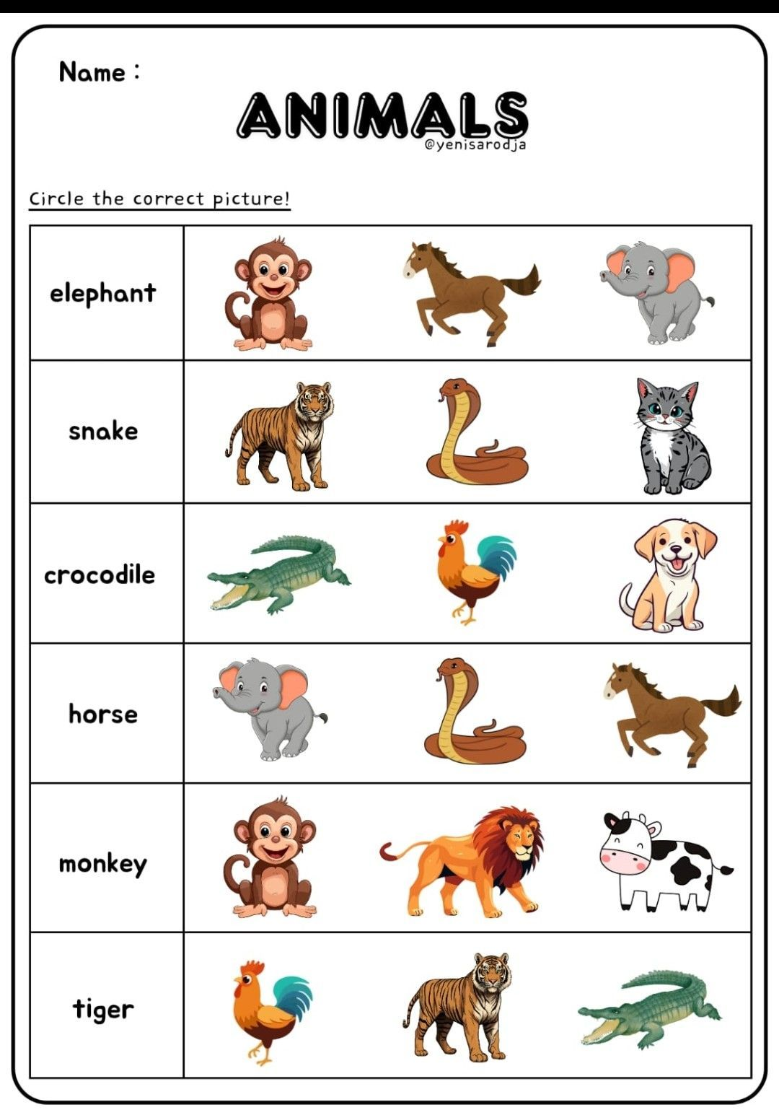


Slide 5
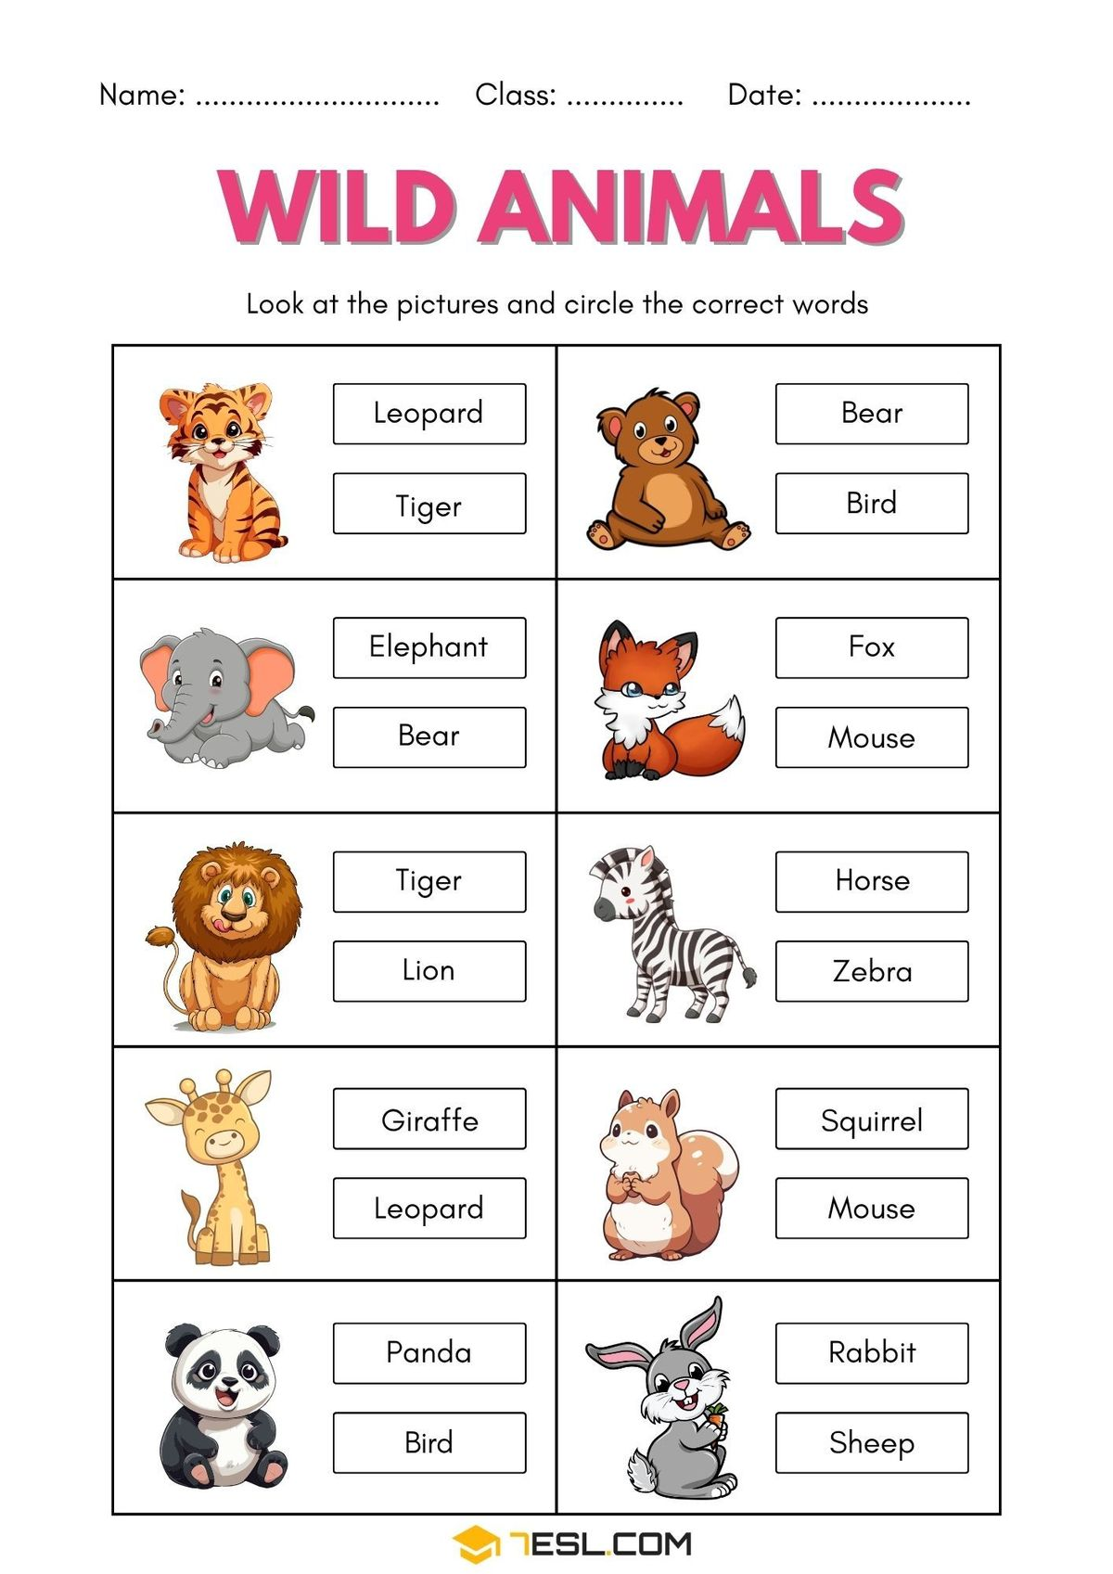


Slide 6
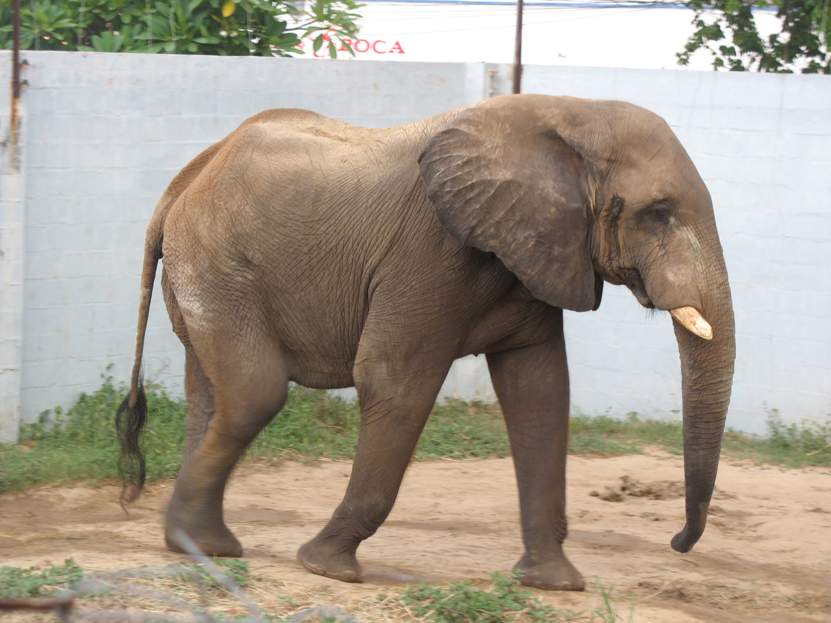
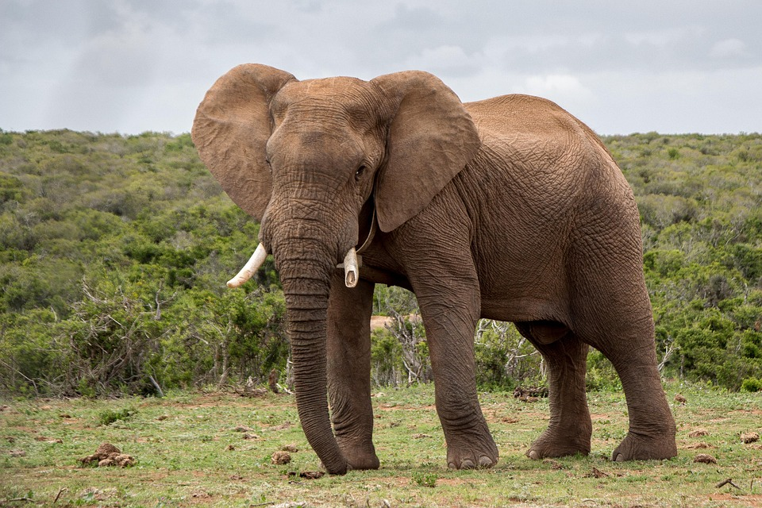
Read and complete
a. This animal is grey and has big ears: elephant
b. This animal has black and white stripes: zebra
c. This animal is funny and similar to humans: monkey
d. This animal is long and moves on the ground: snake
e. This animal is slow, green and brown: turtle

Slide 7

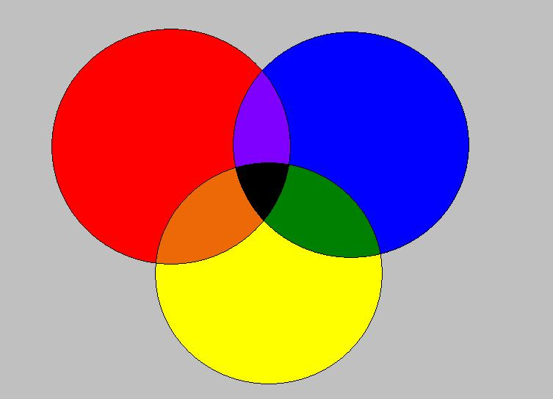
Answer:
a. What color is the ocean? _blue_________________
b. What color is a carrot? ___orange_____________
c. What color is an elephant? ___grey________________
d. What color is a frog? _green_______________
e. What color is a tomato? __red_____________________

Slide 8
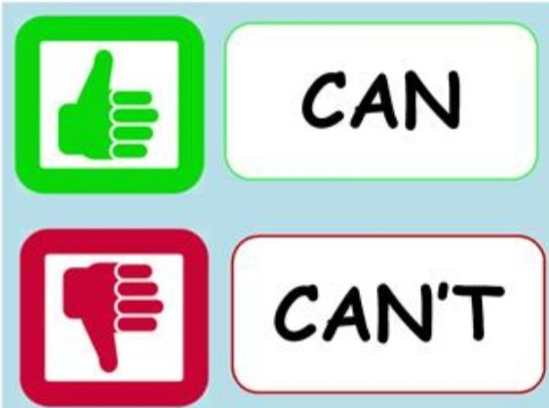
Can / can’t

Slide 9
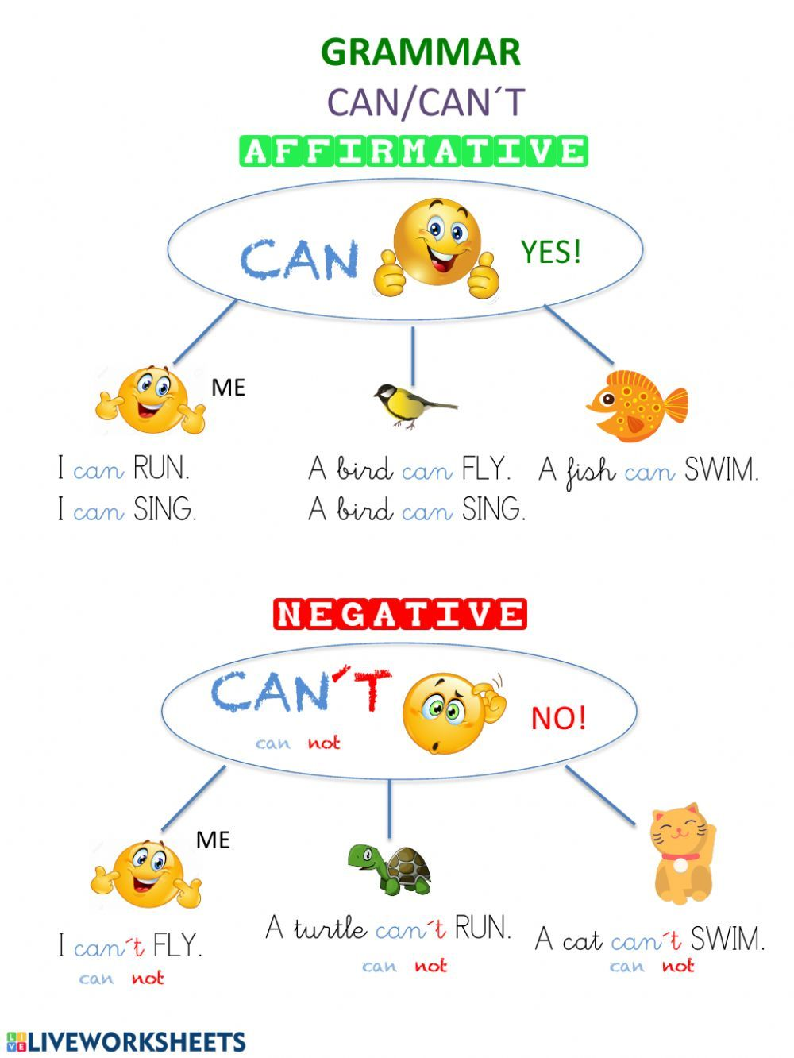
Can / can’t

Slide 10
Ejercicio didáctico en wordwall, pero antes veremos:
Vocabulary (wordwall: cuestionario, abre cajas, reordenar)
Cow: vaca
Bird: pájaro
Sheep: oveja
Dog: perro (a)
Bee: abeja
Duck: pato
Chicken: pollo
Donkey: burro, asno

Slide 11

RUN FAST= CORRER RÁPIDO
RUN = CORRER
JUMP = SALTAR
FLY = VOLAR
SWIM = NADAR
CLIMB TREES = ESCALAR ÁRBOLES
CLIMB = ESCALAR
DANCE = BAILAR
WALK = CAMINAR
TALK = HABLAR

Slide 12
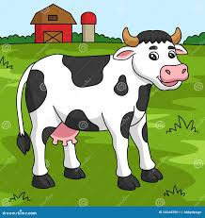

Estructura (juego en wordwall):
Can a cow fly?
¿puede una vaca volar?
Yes, it can
Si, si puede
No, it can´t
No, no puede

Slide 13

Link del ejercicio didáctico
https://wordwall.net/es/resource/7196984/english/can-cant-farm-animals echa

Slide 14

Links de videos Can – Can’t
https://www.youtube.com/watch?v=EzQ6Ag16rJk echa
https://www.youtube.com/watch?v=13T-YqxNcHc echo
https://www.youtube.com/watch?v=_Ir0Mc6Qilo&list=RD_Ir0Mc6Qilo&start_radio=1 echa

Slide 15

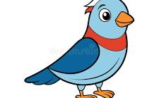

Vocabulary animals
Fish = pez
bird = pájaro
Kangaroo: canguro

Slide 16
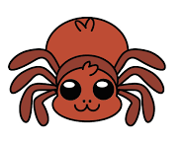
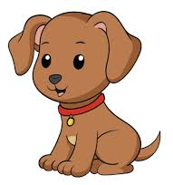
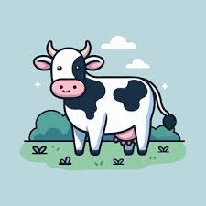
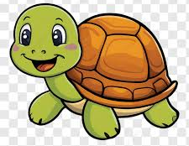


Vocabulary animals
Dog = perro Spider = araña
turtle= tortuga Cow = vaca
Cat = gato Penguin = pingüino

Slide 17
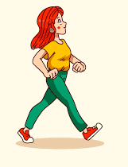
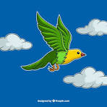
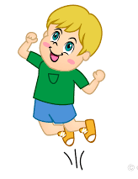
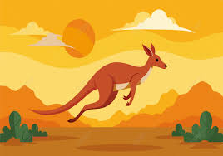
Vocabulary actions
Walk : caminar
Fly: volar
Jump: saltar

Slide 18

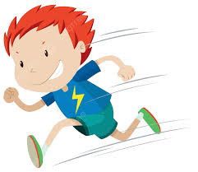
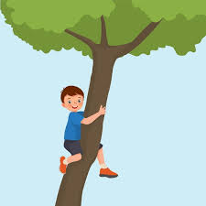
Vocabulary actions
Tweet: piar
Run fast: correr rápido
Climb trees: escalar árboles

Slide 19
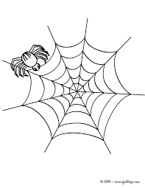
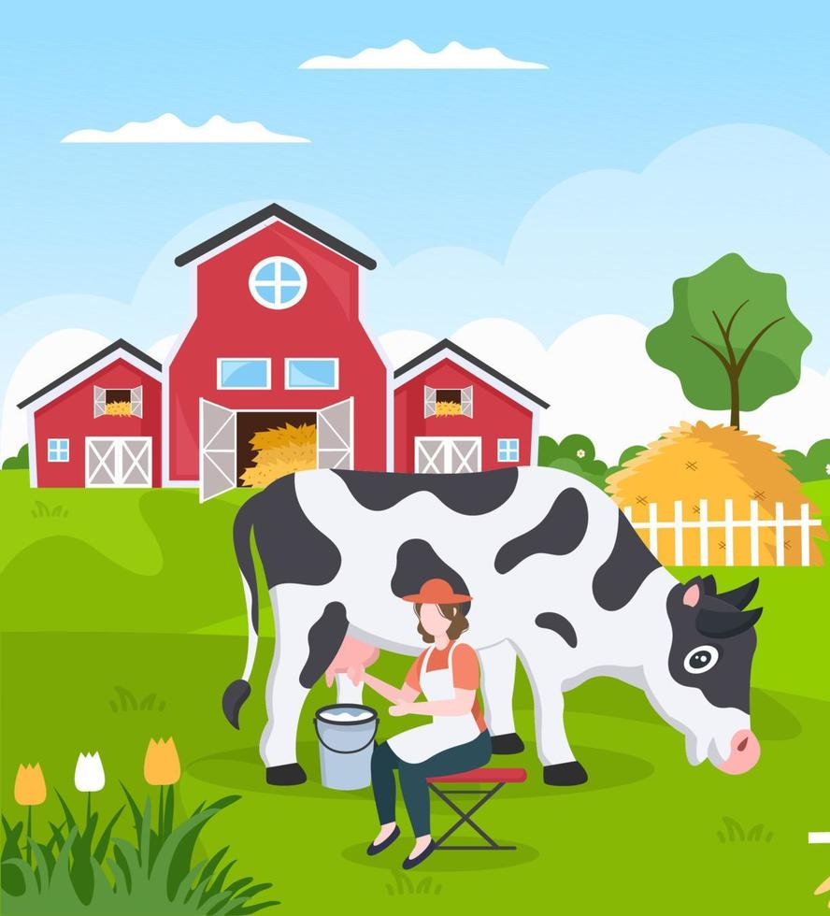
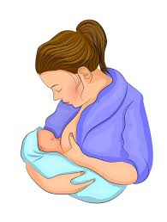
Vocabulary actions
Make webs: hacer telarañas
Produce milk: producir leche

Slide 20
