Slide 1
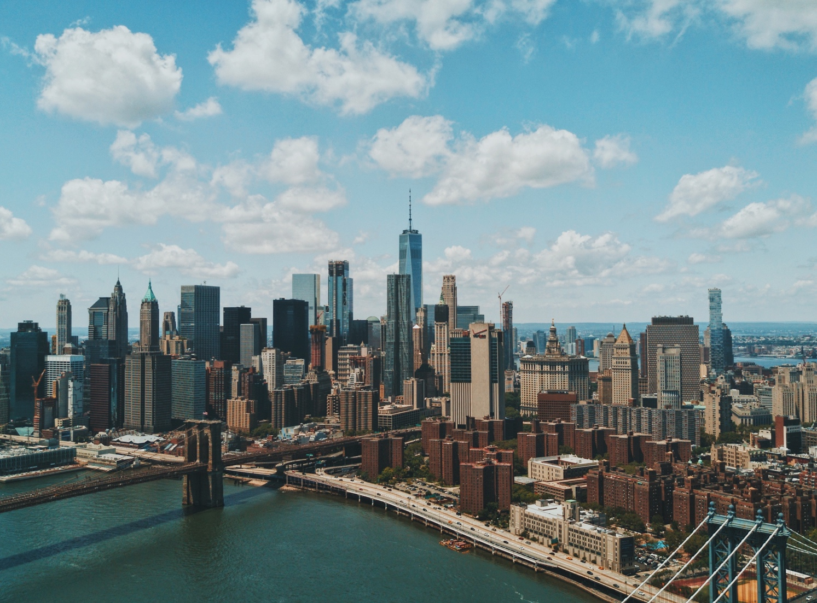
Globalization and communication

Slide 2
GLOBALIZATION
What does globalization mean? We always hear this word on TV and read about it in newspapers. It means the world is now a village – the global village. The world has become smaller. Of course, the world did not shrink and it isn’t a village. Because of better transport, the Internet and more trading between countries, it is easier to do business. Japanese car makers have factories in Thailand; American computer companies employ thousands of people in China. That’s globalization. And don’t forget the millions of call centre jobs in India that workers in America and Europe used to do. Globalization also means it is easier to work in another country. Is globalization a good or bad thing? That’s a difficult question to answer.

Slide 3
GLOBALIZATION
1.- What examples can you find of globalization? __________________________________________________________
_ 2.- What kind of positive/negative effects does it have for you or your community? __________________________________________________________
3.- How is globalization affecting you or your community? __________________________________________________________

Slide 4
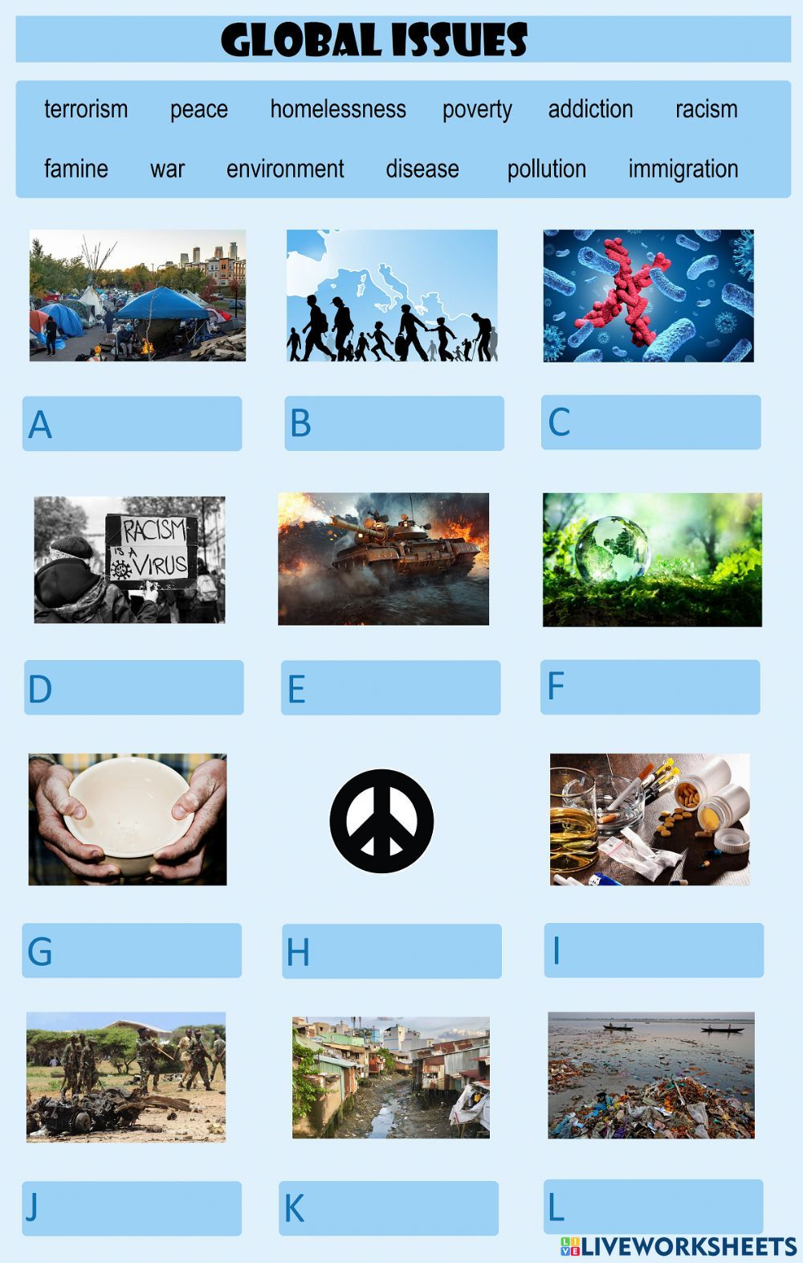

Slide 5
TERRORISM = terrorismo
PEACE = paz
HOMELESSNESS = sin hogar
POVERTY = pobreza
ADDITION =adicción
FAMINE = hambruna
POLLUTION = CONTAMINACIÓN
RACISM = racismo
WAR: guerra
Environment = medio ambiente
DISEASE= enfermedad
IMMIGRATION = emigración

Slide 6
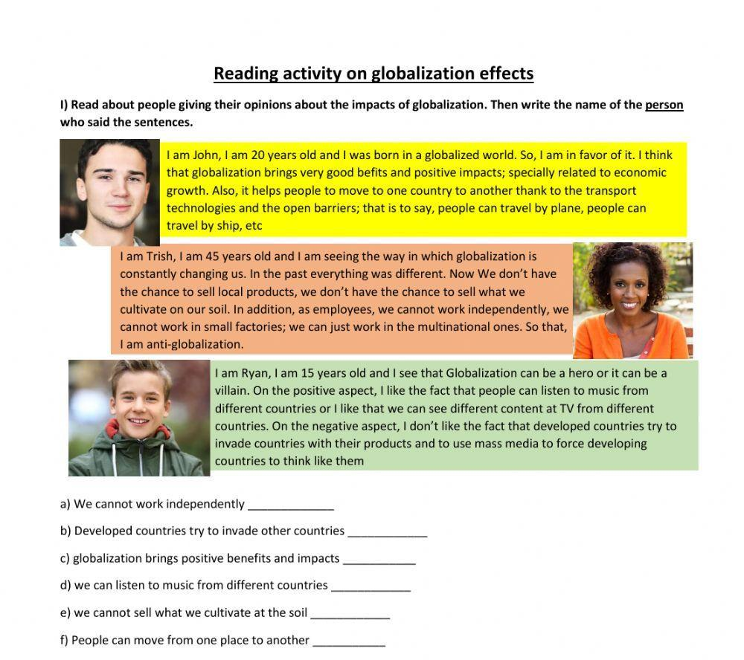

Slide 7
EXAMPLES OF PERSONAL OPINIONS:
Axel: In my opinion, Globalization can bring us positive and negative things. Positive things like better communication between people at any time, and negative like ambient pollution and global warming
Martina: In my opinion, globalization is great because I can listen to music from other countries, watch series from all over the world, and even get help with my homework from people who are far away (online classes).

Slide 8
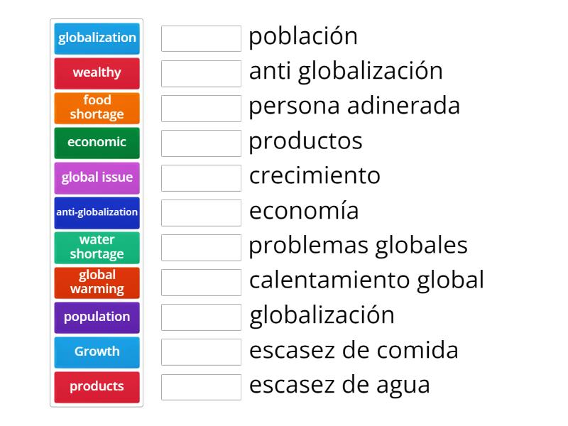
Population
Anti globatization
wealthy
products
growth
economic
Global issue
Global warming
globalization
Food shortage
Water shotage

Slide 9
Links of educational exercises on the web
https://wordwall.net/es/resource/54649784/globalization
https://wordwall.net/es/resource/54566473/unit-1-globalization-and-communication-vocabulary

Slide 10
Present perfect tense
Acciones iniciadas en el pasado y que continúan en el presente
They haven't lived here for years.
She has worked in the bank for five years.
We have had the same car for ten years.
Cuando se hace referencia a un periodo temporal inacabado
I have worked hard this week.
It has rained a lot this year.
We haven't seen her today.
Acciones reiteradas en un periodo inespecífico, entre el pasado y el presente.
They have seen that film six times
It has happened several times already.
We have eaten at that restaurant many times.

Slide 11
Present perfect tense
Acciones concluidas en un pasado muy reciente (+just)
Have you just finished working?
I have just eaten.
We have just seen her.
Has he just left?
Cuando la dimensión temporal no es relevante o conocida
Someone has eaten my soup!
Have you seen 'Gone with the Wind'?
She has studied Japanese, Russian, and English.

Slide 12

Present perfect tense
I
You He
We Have She Has
They It

Slide 13
Regular verbs Irregular verbs
Walk= caminar write = escribir
Walked pasado simple wrote =pasado simple
Walked pasado participio written = pasado participio
Have not = haven’t
Has not= hasn’t

Slide 14
Afirmativa | Negativa | Interrogativa
I have walked | have + not I haven't walked | Have I walked?
You have written | You haven't walked. | Where Have you gone?
He, she, it has walked | has+not He, she, it hasn't walked | Has he, she, it walked?
We have walked | We haven't walked | Have we walked?
You have walked | You haven't walked | Have you walked?
They have walked | They haven't walked | Have they walked?

Slide 15
Link of educational didactic exercise
https://wordwall.net/es-ar/community/present-perfect echo

Slide 16
EXERCISES
1. Completa con have / has
She _has___ finished her homework.
They _have_____ visited that place.
I _have_____ seen that movie.
He _has_____ eaten sushi.
We _have_____ studied English.

Slide 17
EXERCISES
Completa con el participio correcto
(verbos entre paréntesis)
I have _eaten_____ (eat) pizza.
She has _gone_____ (go) to the park.
They have _played_____ (play) soccer.
He has _written_____ (write) a letter.
We have _seen_____ (see) that film.

Slide 18
EXERCISES
Escribe oraciones en Present Perfect
(Ejemplo: I / eat pizza → I have eaten pizza)
She / visit London → _she has visited London______
They / finish the test → _They have finished the test_____
He / read that book → __He has read that book________
We / watch that movie → __We have watched that movie_____
I / do my homework → __I have done my homework______

Slide 19
EXERCISES
Negative sentences
(Cambia a negativo)
I have eaten sushi. → __________________
She has finished her work. → __________________
They have played soccer. → __________________

Slide 20
EXERCISES
Questions
(Forma preguntas)
1.- You / ever / travel abroad?
👉 __________________
2.- She / finish / her homework?
👉 __________________
3.- They / see / that movie?
👉 __________________

Slide 21
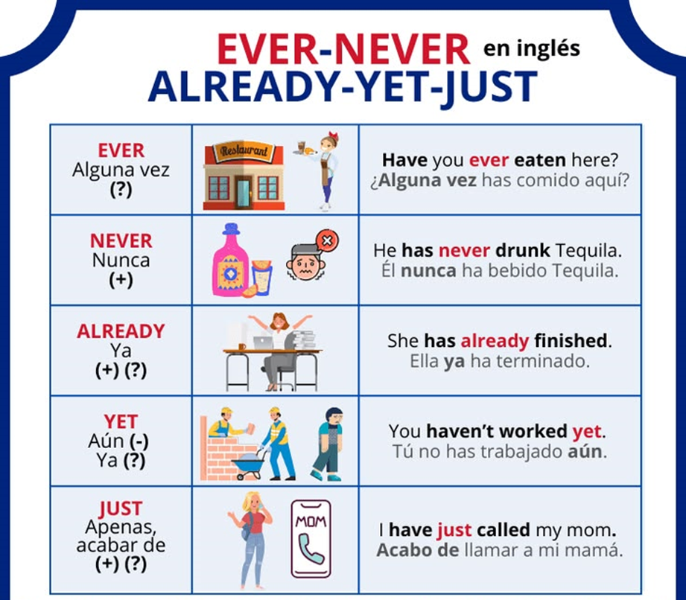

Slide 22
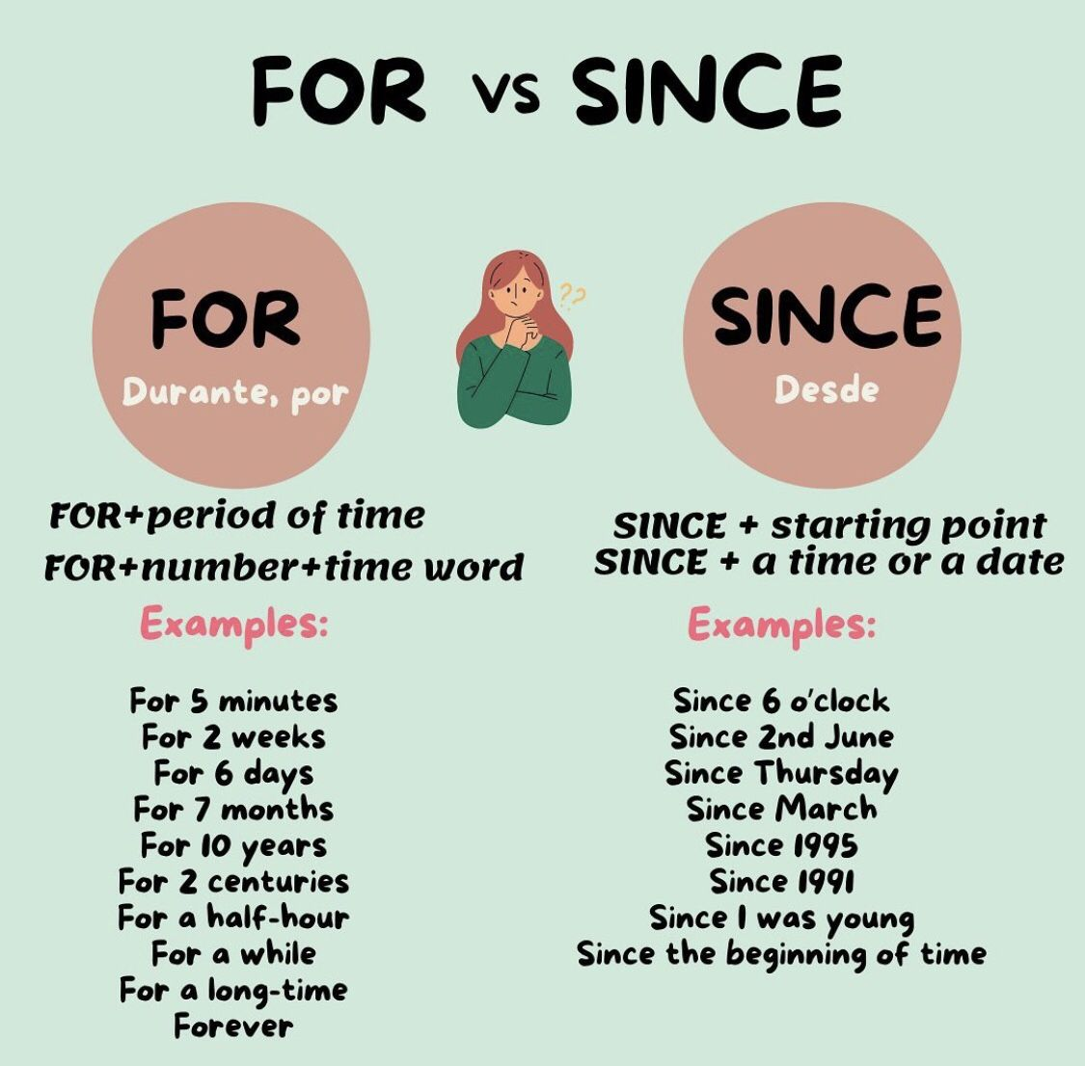

Slide 23
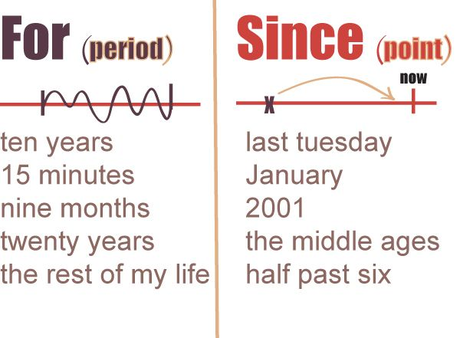

Slide 24

Link interactivo
https://www.youtube.com/watch?v=cd1-B87SgdA echo

Slide 25

EXERCISE
Completa con FOR o SINCE
I have lived here __for____ 5 years.
She has studied English __since____ 2020.
They have known each other _for_____ a long time.
He has worked here _since_____ January.
We have been friends _since_____ childhood.
I have studied English _for_____ 3 years.
She has lived in Chile _since_____ 2015.
They have played soccer _for_____ two hours.
He has had this phone __since____ last year.
We have been here _since_____ Monday.

Slide 26



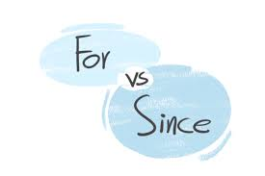
EXERCISE
. Corrige las oraciones, ojo puede que esté correcta
I have lived here since for 10 years.
👉 __________________
She has studied English since 2018.
👉 __________________
They have known each other since for a long time.
👉 __________________
He has worked here for two years.
👉 __________________
We have been friends for since 2010.
👉 __________________
I have had this phone since for three months.
👉 __________________
She has lived in Chile since 2015.
👉 __________________
They have played soccer since for two hours.
👉 __________________

Slide 27
Links interactivos
Never / ever:
https://www.youtube.com/watch?v=3i3cN4kXB0Q
Just / already / yet
https://www.youtube.com/watch?v=Kd5L9M6OfYQ
Never / ever / just / already / yet
https://www.aprenderinglesrapidoyfacil.com/2014/06/30/ejercicios-ever-never-already-yet-y-just-en-ingles-exercises/

Slide 28
Video PRESENT PERFECT TENSE https://www.youtube.com/watch?v=gu_GI_RO5B0
CONVERSATION 1:
¿Cuantas veces hay p.p. tense? R: 7 veces
¿Qué expresiones de tiempo de P.P Tense hay? R:For / ever
CONVERSATION 2:
¿Cuantas veces hay p.p. tense? R: 2
¿Qué expresiones de tiempo de P.P Tense hay? R: just / for
CONVERSATION 3:
¿Cuantas veces hay p.p. tense? R: 3
¿Qué expresiones de tiempo de P.P Tense hay? R: Ever / never

Slide 29
EXERCISE
Escriben oraciones sobre acciones reales o imaginarias que hayan realizado. Las escriben en el chat y los compañeros deciden si son verdaderas o falsas. Por ejemplo:
I have fallen asleep during my own presentation
My dog has stolen my homework
I have forgotten my phone in the fridge.
I have worn different shoes in each foot
Una vez que tenga la votación de los compañeros, el estudiante debe decir si era verdadera o falsa

