Slide 1
“HOW DO YOU FEEL?
UNIT 1

Slide 2
Objetivo
Los estudiantes serán capaces de:
Expresar emociones
Hablar de enfermedades simples
Preguntar y responder cómo se sienten

Slide 3

Vocabulary (Feelings & Illnesses)
Feelings (emociones):
happy 😊 → feliz
sad 😢 → triste
tired 😴 → cansado/a
scared 😨 → asustado/a
angry 😠 → enojado/a
Illnesses (enfermedades):
headache → dolor de cabeza
stomachache → dolor de estómago
cold → resfriado
fever → fiebre
cough → tos
Broken arm → brazo roto
Runny nose nariz húmeda
Sore thoat → dolor de garganta
Toothache → dolor de dientes
Cut → corte

Slide 4
ADVICE
Get some rest! = ¡Descansa!
I hope you get better soon! = ¡Espero te mejores!

Slide 5
ESTRUCTURA
How do you feel?
I feel happy he/she feels happy
I feel bad he/she feels bad
I am happy he/she is happy
I am bad he/she is bad
What’s the matter? (¿qué pasa? / ¿cuál es el problema?)
I have a cold he/she has a coll
I have a headache he/she has a headache

Slide 6
Link del video
https://www.youtube.com/watch?v=5xZYFPJ0fps
(para abrir, seleccionar el link, apretar el botón derecho del mouse y luego elegir “abrir hipervínculo”)

Slide 7
READ THE TEXT AND ANSWER THE QUESTIONS
Questions
How does Tom feel?
He feels sick
What does he have?
He has a headache and a cough
Is he at school?
No. He is at home
Who helps him?
His mom
Tom is at home today. He feels sick.
He has a headache and a cough.
He is tired and sad.
His mom gives him medicine and he rests.

Slide 8
Choose the correct answer
1“I have a stomachache” means:
a) Tengo dolor de cabeza
b) Tengo dolor de estómago
c) Tengo fiebre
2“She has a cold” means:
a) Ella está feliz
b) Ella tiene resfriado
c) Ella tiene dolor
3“I feel sick” means:
a) Me siento enfermo
b) Me siento feliz
c) Me siento fuerte
4“He has a fever” means:
a) Él tiene tos
b) Él tiene fiebre
c) Él tiene sueño

Slide 9
Choose the correct answer
5“I have a cough” means:
a) Tengo tos
b) Tengo frío
c) Tengo hambre
6“She feels tired” means:
Ella está enojada
b) Ella está cansada
c) Ella está asustada
7“He feels sad” means:
Él está feliz
b) Él está triste
c) Él está enfermo
8“I feel happy” means:
Estoy enfermo
b) Estoy feliz
c) Estoy cansado

Slide 10
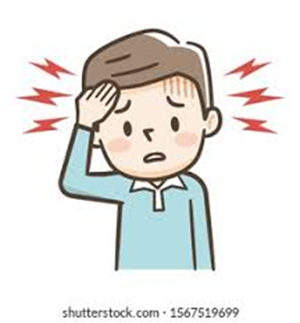
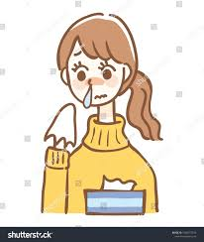
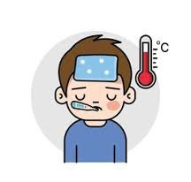
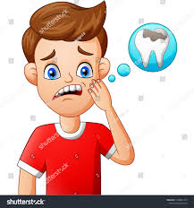
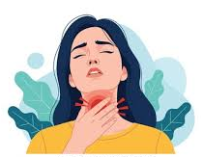
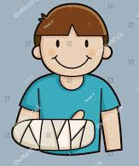
Look at the picture and complete the sentence:
I have a _headache________
She has a ___runny nose___________
He has a _fever_________
He has a __toothache_____________
She has a _sore throat_______
He has a broken arm__________
What’s the matter?

Slide 11
Ejercise:
Make sentences with feelings and illness
Ex: I feel bad, because I have a cold
I feel bad, because I have a cut
I feel tired, because I have a headche
I feel bad, because I have a cough

Slide 12
Reading Activity
Text: “A Sick Day”
Lucy is a student. Today she is not at school because she feels sick.
In the morning, she wakes up and feels very tired.
She also has a headache and a fever.
Her mom checks her temperature and gives her some medicine.
Lucy stays in bed and drinks tea. She watches TV and rests all day.
In the afternoon, she feels a little better, but she still has a cough.
Her mom tells her to sleep early so she can feel better tomorrow.

Slide 13

MULTIPLE CHOICE
1Why is Lucy not at school?
Because she is happy
b) Because she feels sick
c) Because she is playing
2What does Lucy have in the morning?
A cold and hunger
b) A headache and a fever
c) A cough and happiness
3What does her mom give her?
Food
b) Medicine
c) Toys
4What does Lucy do during the day?
She goes to school
b) She plays outside
c) She rests and watches TV
5How does Lucy feel in the afternoon?
Worse
b) The same
c) A little better

Slide 14
Write true or false
. True or False
Lucy goes to school. _F__
Because Lucy is sick
She feels tired. _T__
She has a fever. _T__
She plays with friends. _F__
Because Lucy rests and watches TV
She watches TV. _T__

Slide 15
Answer the questions
Short Answers
How does Lucy feel in the morning?
She feels very tired
What does her mom do?
Her mom checks her temperature and gives her some medicine
What does Lucy drink?
She drinks tea
Does she feel better later?
yes

Slide 16
Should= debería (consejo)
Afirmativo
Sujeto + should + verbo + complemento
I should go to bed = yo debería acostarme
Negativo
Sujeto + should + not (shouldn’t) + verbo + complemento
She should not (shouldn’t) go out = ella no debería salir
Interrogativo
Should + sujeto + verbo + complemento?
Should it play with the food? = ¿debería jugar con la comida? (animal)
Should she take some medicine? = ¿debería ella tomar medicina?

Slide 17
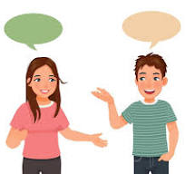
Text.
Tom: Hi, Sally! What’s wrong?
Sally: Hi, Tom. I feel sick.
Tom: What’s the matter?
Sally: I have a headache and an earache.
Tom: Oh! You should take some medicine.
Sally: Yes, but I also have a stomachache.
Tom: That’s too bad! I think you should go to the doctor
Vocabulary:
Earache: dolor de oído

Slide 18
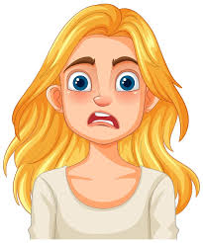
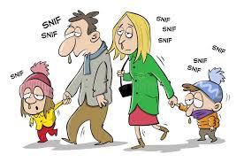
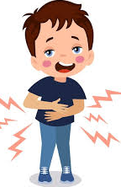
My sick family
Laura: Hi, Maria! How are you today?
Maria: Hi Laura. I am very worried.
Laura: Oh no! What’s wrong?
Maria: My family is sick.
Laura: Really? Tell me.
Maria: My husband has a cold and a cough. He is very tired.
Laura: That’s not good. And your children?
Maria: My first son Marcos, has a fever and a headache.
Laura: Oh no!
Maria: My second son Luis, has a stomachache. He doesn’t want to eat.
Laura: Poor boy. And your third child?
Maria: My daughter Candy, has a toothache. Her tooth hurts a lot.
Laura: That sounds terrible. You have many problems!
Maria: Yes, I am very stressed and tired.
Laura: I hope your family feel better soon.
María: I hope so too!
Vocabulary
Toothache=dolor de muela (diente)
Son= hijo
Daughter = hija
Worried=preocupado(a)

Slide 19
Exercise: create advices according to the Maria’s family
Ej: Maria should take care of her family
Maria shouldn’t go out whitout seeing her family
1.- her husband should rest
her husband shouldn’t go out at night whitout a coat
2.- Marcos should drink water
Marcos shouldn’t take a shower
3.- Luis should eat fruit and vegatables
Luis shouldn’t eat sweet and chocolate
4.- Candy should go to the dentist
Candy shouldn’t eat sweet and chocolate

Slide 20
Questions
Answer the questions
How does Maria feel?
👉 _Maria feels worried_________________________
What does her husband have?
👉 _her husband has a cold and a cough____________
What does her daughter have?
👉 _Candy has a toothache________________________

Slide 21
Advices
Brush your teeth = cepillate los dientes
Eat fruit and vegetables = come fruta y verdura
Drink water = toma agua
Go out at night without a coat =Sale de noche desabrigado
Take a shower = toma una ducha
Eat healthy food = come comida sana
wash your hands = lavate las manos
Go to the dentist = anda al dentista
Take care of your family = cuida a tu familia
Rest = descansa
Eat sweet or chocolate= comer dulce o chocolate

Slide 22
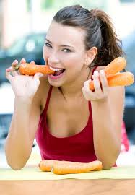
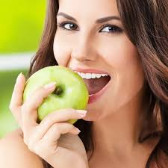
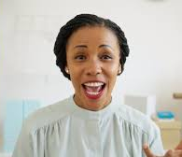
POEM
Can you see my teeth?
I use them to chew.
I chew things like carrots
so my teeth stay like new.
Can you see my teeth?
I use them to bite.
I bite things like apples
so my teeth will stay white.
Can you see my teeth?
I use them to speak.
Luego de leer la poesía varias veces, hacen un afiche en el que escribirán tres o cuatro recomendaciones para cuidar los dientes.

Slide 23
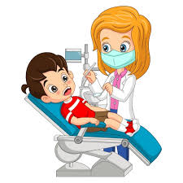
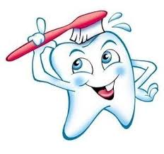
How to care of my teeth
Afirmative
You should brush your teeth after every meal
you should wash your hand
you should eat vegetables
You shold go to the dentist
Negative
You shouldn’t eat Candy
you shouldn't go to bed without washing your teeth
you shouldn't eat too much sweets
Questions for the dentist
Should I eat fruit and vegetables?
Should I brush my teeth every night?
Should I eat sweet every day?

Slide 24
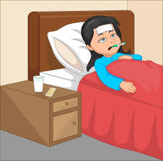
Sally’s e-mail
Hi Jane:
I can´t go to school this week. I don’t feel well. I’m in bed with
a terrible cold. I have a headache and an earache. The doctor says I should drink a lot of water and rest and I shouldn’t watch TV. I can’t talk because I have a sore throat too.
See you next week.
Love,
Sally
Sally is in bed. She has a _cold_____.
Sally has a _headache_________, a __earache_______ and a sore throat.
Sally should __drink water and rest________________
She shouldn’t __watch TV_________

Slide 25
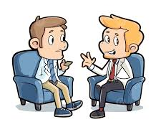
Dialogue about illnesses and advices
Peter: Hi, Tom! How are you?
Bob: Hi, Peter! I don’t feel well.
Peter: What’s the matter?
Bob: I have a stomachache.
Peter: Oh! That’s too bad. You should rest.
Bob: Yes, the doctor says I shouldn’t eat sweets or chocolates. He says I should drink water and stay in bed.
Peter: I hope you get better.
Bob: Thank you, Bye
Peter: Bye

Slide 26
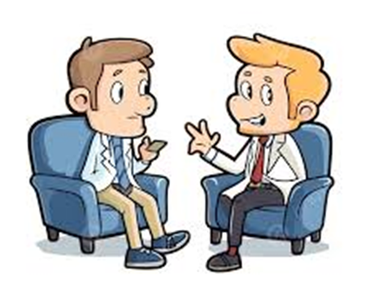
Complete the Sentences
Bob doesn’t feel _well_____.
Bob has a __stomachache.
The doctor says Bob should drink _water____.
Bob should stay in _bed_____.
Peter hopes Bob gets _better__.

Slide 27
Choose the Correct Answer
Bob has a:
a) headache
b) stomachache
c) cold
Bob should:
a) run outside
b) take a rest
c) eat candy
Bob shouldn’t eat:
a) fruit
b) vegetables
c) sweets and chocolates

Slide 28
Vocabulary Match
Stomachache _c__
Rest __d___
Better __a___
Doctor __b___
a) Healthy again
b) A person who helps sick people
c) Pain in the stomach
d) Relax and sleep
Actions/verbs
Drink _d____
Eat _e____
Stay __a___
Rest _c____
Hope _____
a) To remain in one place
b) To want something good
c) To sleep or relax
d) To take liquid
e) To have food
Feelings / Conditions
Sick _b____
Well __c___
Bad _e____
Tired _d____
Happy __a___
a) Full of energy and joy
b) Not healthy
c) Good condition
d) Needing sleep or rest
e) Not good

Slide 29
Link interactivo “should / shouldn’t”
https://wordwall.net/es/resource/7139279/should-shouldnt

