Slide 1
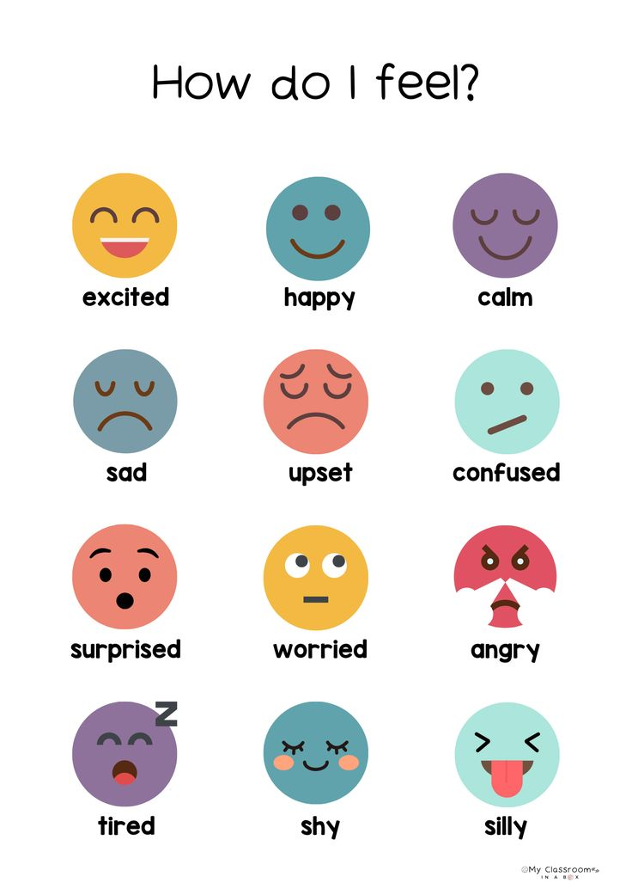

Slide 2
FEELINGS AND OPINIONS

Slide 3
Vocabulary – Match the feeling
1. Match the emotion with the correct definition.
Happy
Angry
Excited
Bored
Nervous
Proud
Sad
Surprised
Sorprendido(a)
Feliz
Triste
Enojado(a)
Orgulloso(a)
Emocionado(a)
Nervioso(a)
Aburrido(a)

Slide 4
Vocabulary – Match the feeling
1. Match the emotion with the correct definition.
Happy
Angry
Excited
Bored
Nervous
Proud
Sad
Surprised
Positive
Happy
Excited
Proud
surprise
Negative
angry
Bored
Nervous
sad

Slide 5
2. Complete the sentences
Use the correct feeling word.
happy – nervous – bored – excited – angry – proud
I feel __happy________ when I get good grades.
She is ___nervous_______ because she has a big test today.
They are _excited_________ to go on vacation.
He feels __bored________ when he watches the same movie again.
My mother is _angry_________ because the room is messy.
We feel _proud_________ when our team wins a game.

Slide 6
3. Expressing opinions: Complete the sentences with your own opinion.
I think soccer is __________________.
In my opinion, school is __________________.
I believe homework is __________________.
I think English is __________________.
In my opinion, weekends are __________________.

Slide 7
💡 Expresiones útiles para enseñar:
Feelings
I feel happy. / I am happy / she feels / he feels / he is happy /she is happy
I feel nervous. / I am nervous / she is nervous / they are nervous
I feel excited.
Opinions
I think…
In my opinion…
I believe…

Slide 8

To be verb
I am
You
We are
They
He
She is
it

Slide 9
4. Writing – Short answer
Answer using feelings and opinions.
How do you feel when you have a difficult test?
I feel … because
What do you think about sports at school?
I think sports are good because
How do you feel when you spend time with friends?
I feel excited, because
What do you think about learning English?
I think English is very important for our life

Slide 10
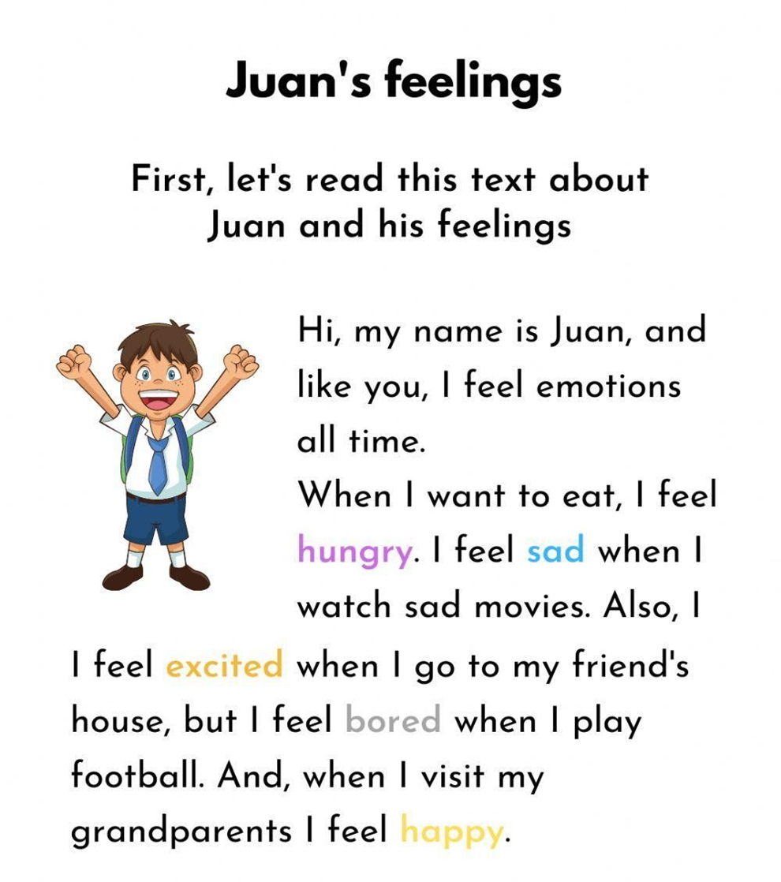
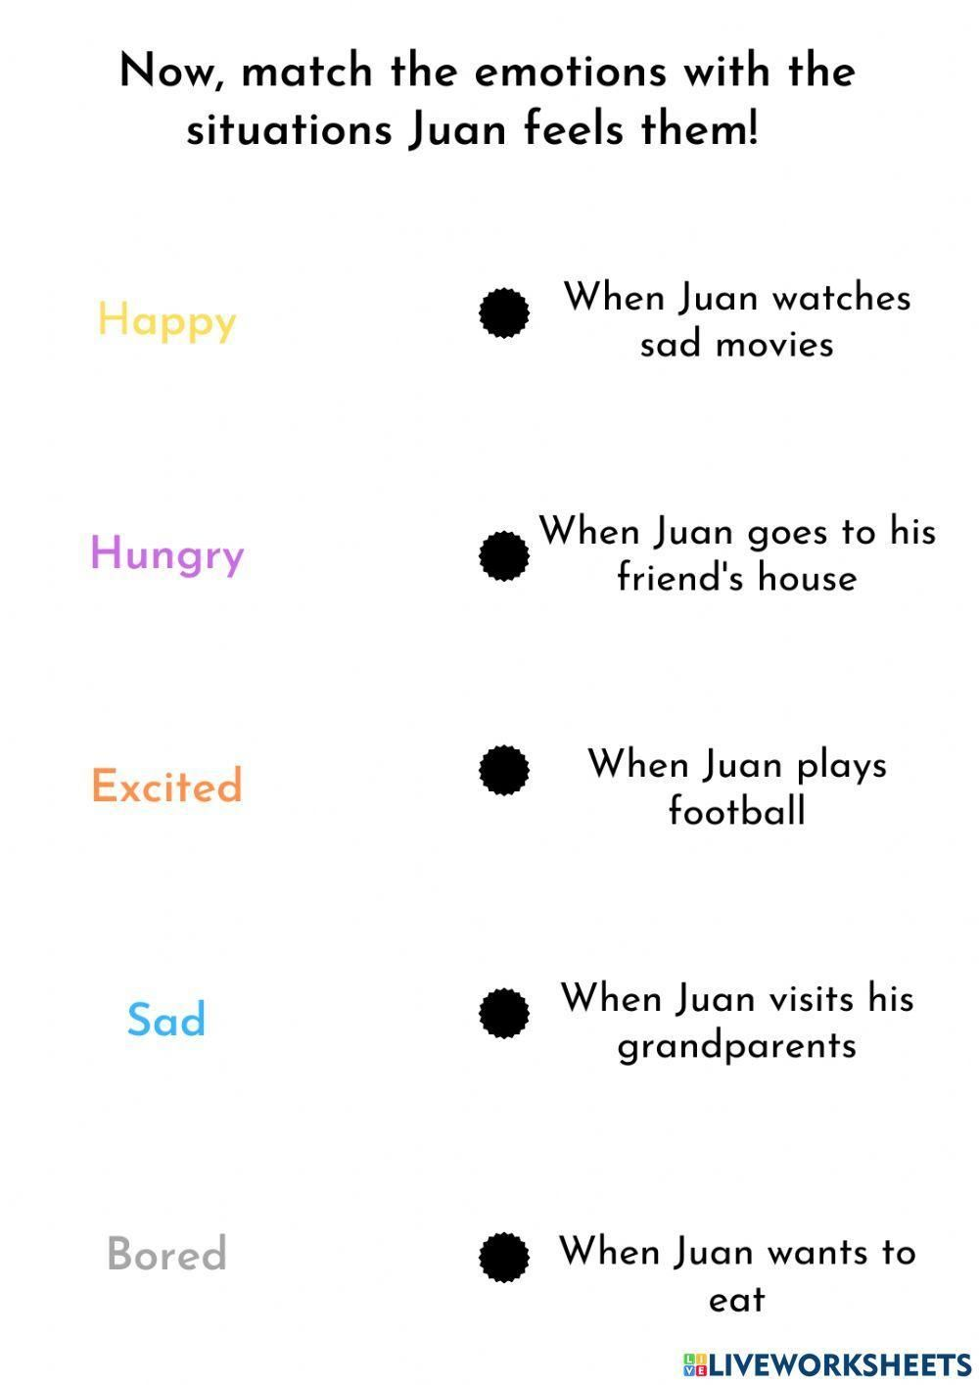

Slide 11
Now answer the questions about Juan
Why does Juan feel emotions all the time?
Because Juan is human and all humans feel emotions
Does Juan feel emotions all the time? (Yes/No)
yes
Can you remember a time when you felt like Juan? What emotion did you feel?
I remember yesterday I felt hungry when I saw the food that my mom was cooking
Why do you think Juan feels excited when he goes to his friend’s house?
Because he wanna play
he wants to play
I think because is very excited
Which of Juan’s feelings do you feel the most often?
Hungry
Calm
Happy

Slide 12
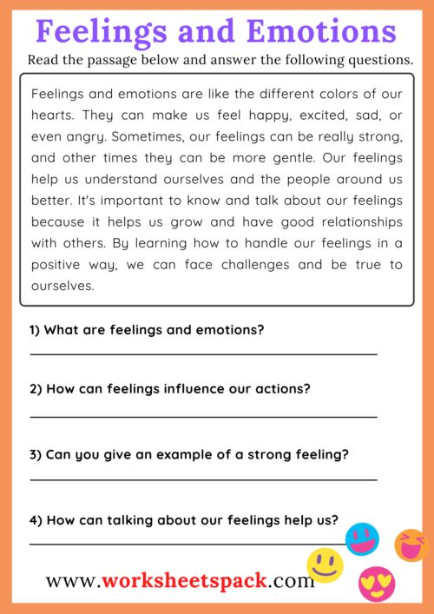
Vocabulary
Strong: fuerte
Gentle: suave, amable, dulce
Grow: crecer
Relationships: relaciones
Handle: manejar

Slide 13
Conectores de orden
Los conectores de orden "first", "second", "next" y "finally" se utilizan para describir el orden en el cual suceden dos o más acciones.

Slide 14
First, second, next, finally
Finalmente Next
Segundo Finally
Primero First
Siguiente Second

Slide 15
Ejemplo: ¿Cómo hacer una tortilla?
"First, I take out the eggs. Second, I heat the butter in a pan. Next, I add the eggs. Finally, I eat the omelette with toast."
(Primero, saco los huevos. Segundo, pongo mantequilla en el sartén. Siguiente, agrego los huevos. Finalmente, como los huevos con tostadas.)

Slide 16
EXERCISES
Write the correct connector in the line.
_First_____ I wake up at 7 am in the morning. _Second__ I take a shower and get dressed. _Next__________ I have breakfast with my family. _Finally____ I go to school.

Slide 17
EXERCISES
Now, write your own journal:
First I study, second I go for a park, and finally I rest.
First I wake up at 5:50 am in the mornig, second i take a shower and get dressed, next i have breakfast, finally i go to classes
First I wake up at 9:00 second .- i brush my teeth next I eat a peace of my pizza finally.- start my class on line

Slide 18
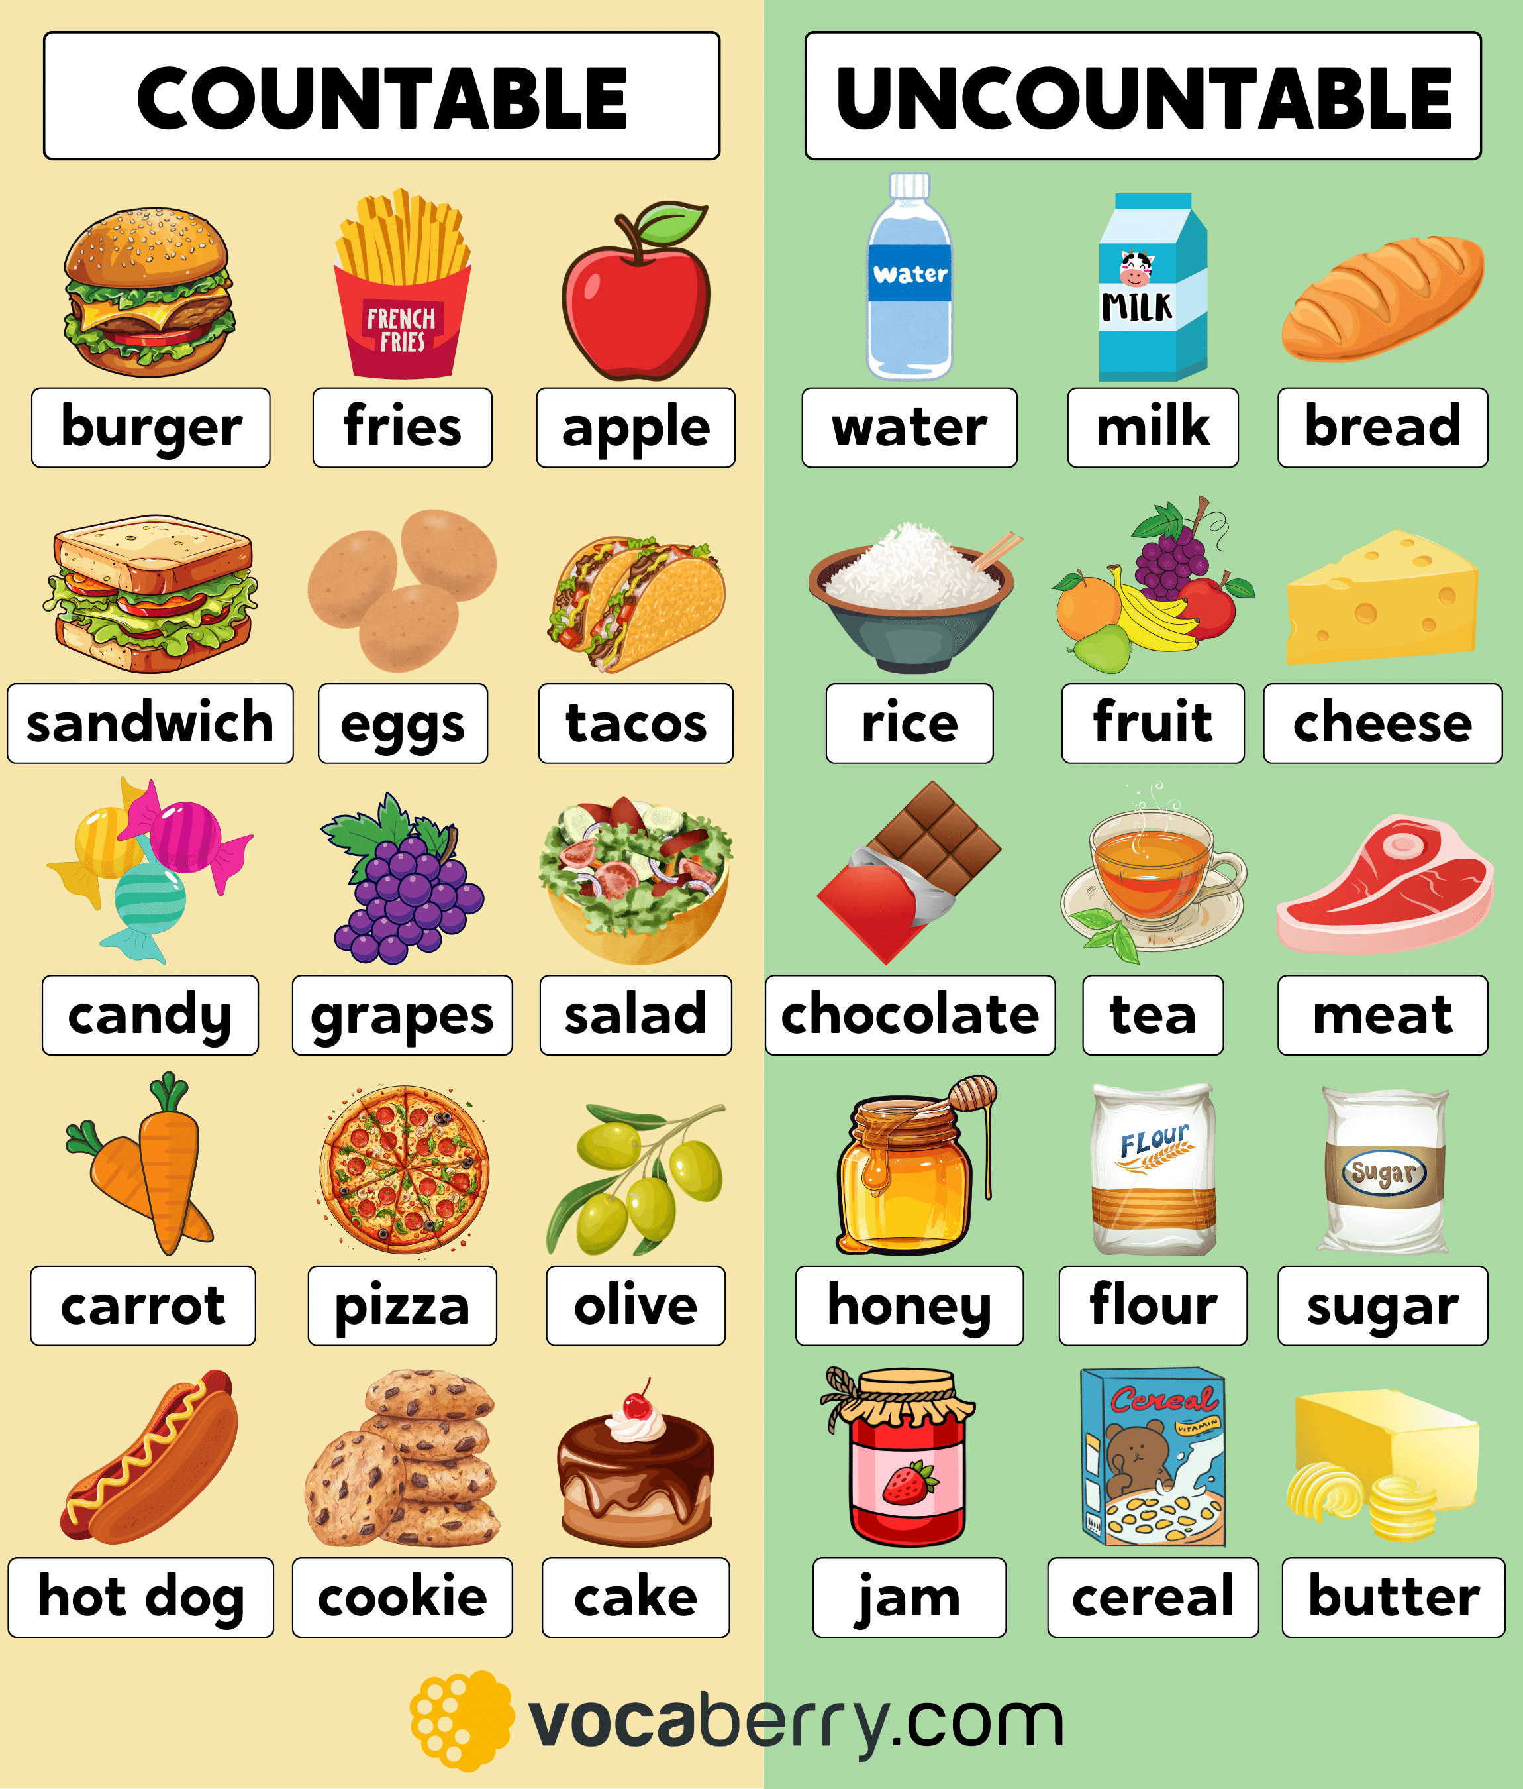

Slide 19
Links juegos educativos y didácticos
Juego de sustantivos contables e incontables
https://wordwall.net/es/resource/89585194/english/countable-or-uncountable-food echo
Juego de cuantificadores en inglés
https://es.educaplay.com/editor-de-recursos/28522871/
https://wordwall.net/es-us/community/countable-uncountable

Slide 20
¿Qué son los cuantificadores?
Los quantifiers en inglés se usan para hablar de cantidades no específicas, como "mucho", "poco", "algunos". Además, existen cuantificadores que se pueden usar solo con palabras contables, como apple (manzana) y otros que solo se pueden usar con palabras incontables como flour (harina).

Slide 21
¿Cómo se usan?
Sustantivos Contables (Countable Nouns): Cosas que se pueden contar (ej. books). Se usan con cuantificadores como Many (muchos), Few/A few (pocos). Some (algunos) a lot of (mucho) any (algo de /ninguno)
Sustantivos Incontables (Uncountable Nouns): Cosas que no se pueden contar individualmente, como líquidos, ideas o masas (ej. water). Se usan con Much (mucho), Little/A Little of (poco). Some (algunos) a lot of (mucho) any (algo de / ninguno)
Ambos: Some (algo de/algunos), Any (algo de/ninguno), A lot of (mucho) se aplican a ambos para indicar cantidades indefinidas

Slide 22
¿Cuándo se debe usar “many”?
👉 Significa: muchos / muchas
👉 Se usa con cosas contables
Se ocupa para afirmación (se usa poco), interrogación, negación
Ejemplos:
many apples → muchas manzanas
many students → muchos estudiantes

Slide 23
¿Cuándo se debe usar “much”?
👉 Significa: mucho / mucha
👉 Se usa con cosas incontables
Se ocupa en afirmación (muy ocasional) , negación e interrogación
Ejemplos:
much water → mucha agua
much money → mucho dinero

Slide 24
¿Cuándo se debe usar “some”?
👉 Significa: algunos / algo de
👉 Se usa en oraciones afirmativas y en preguntas cuando es “ofrecimiento” o “petición”
👉 Se usa con cosas contables e incontables
Ejemplos:
some apples → algunas manzanas ex. Today I ate some apples
some milk → algo de leche ex. My son drank some milk yesterday

Slide 25
¿Cuándo se debe usar “any”?
👉 Significa: alguno / nada
👉 Se usa en: oraciones interrogativas y negativas
👉 Se usa en cosas contables e incontables
Ejemplos:
Do you have any apples? → ¿Tienes algunas manzanas?
I don’t have any money → No tengo dinero

Slide 26
¿Cuándo se debe usar “a few”?
✅ 4. A FEW
👉 Significa: unos pocos (algunas (os))
👉 Se usa con contables
Ejemplos:
a few of friends → un pocos de amigos
a few of books →un pocos de libros

Slide 27
¿Cuándo se debe usar “a little”?
👉 Significa: un poco
👉 Se usa con no contables
Ejemplos:
a little of water → un poco de agua
a little of sugar → un poco de azúcar

Slide 28
¿Cuándo se debe usar “a lot of”?
👉 Significa: mucho / muchos / muchas
👉 Se usa con todo (contables e incontables)
👉 Se utiliza casi siempre en oraciones afirmativas.
Ejemplos:
a lot of apples → muchas manzanas
a lot of water → mucha agua

Slide 29
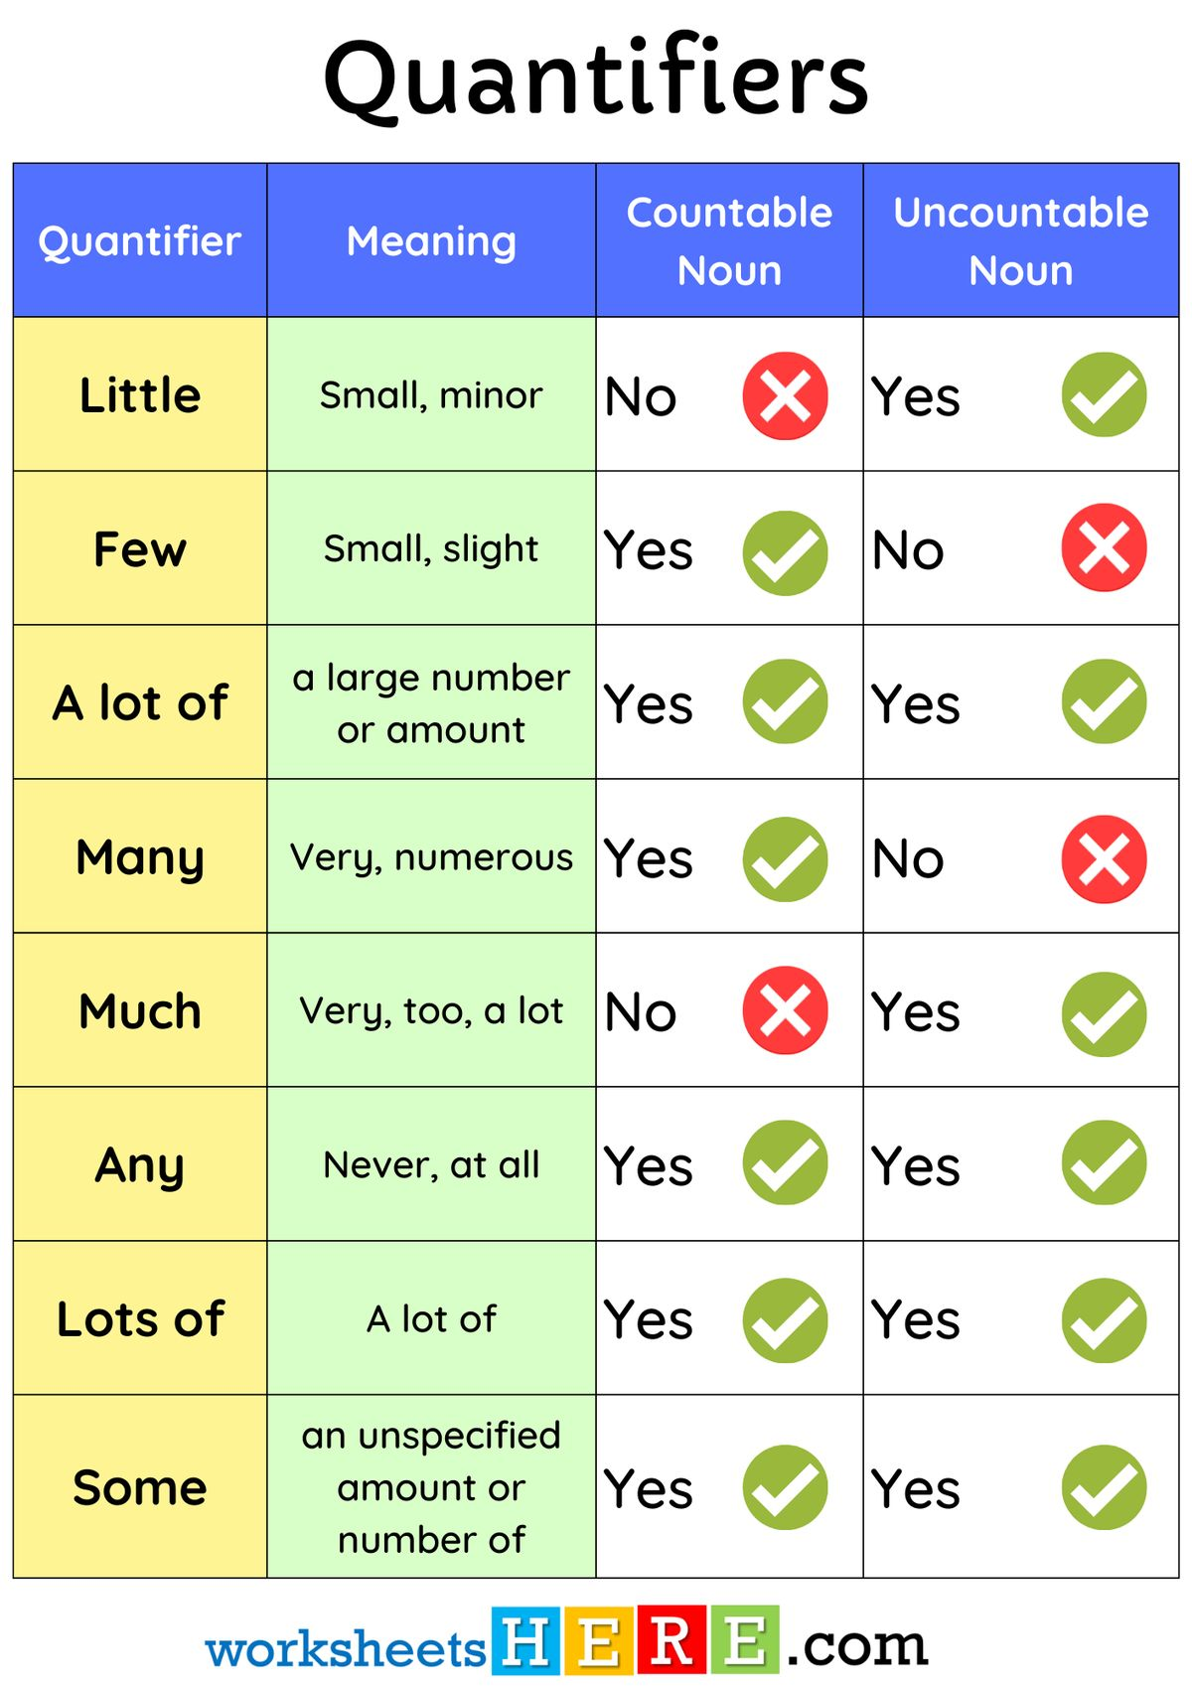

Slide 30
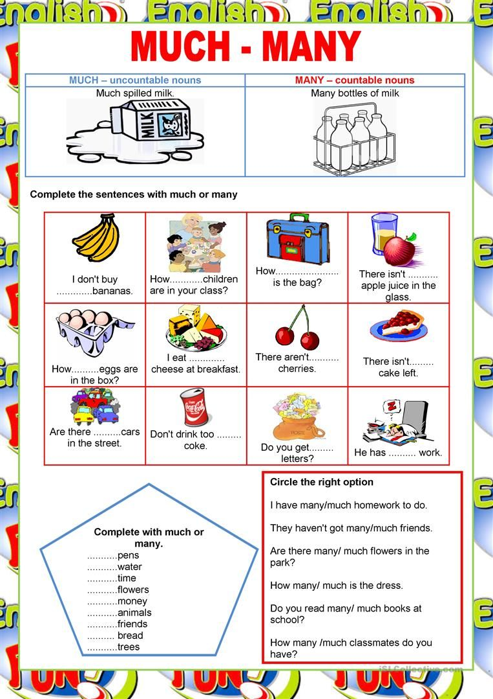


much
Many

Slide 31
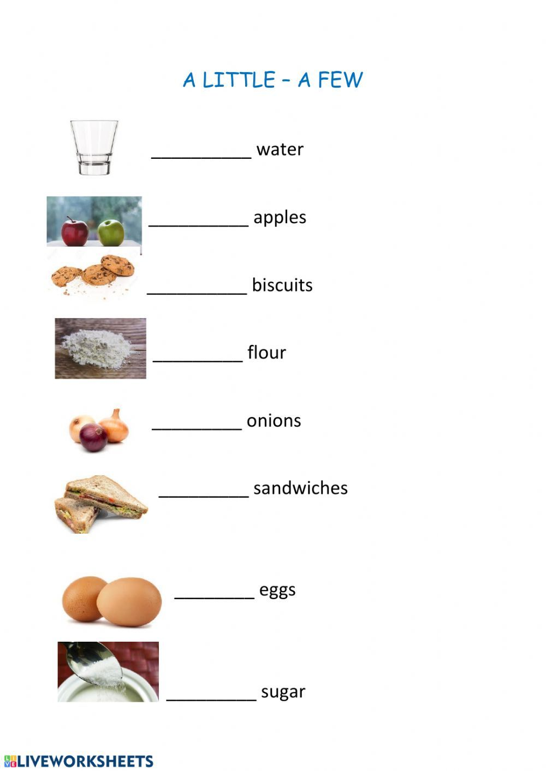


A little
A few

Slide 32
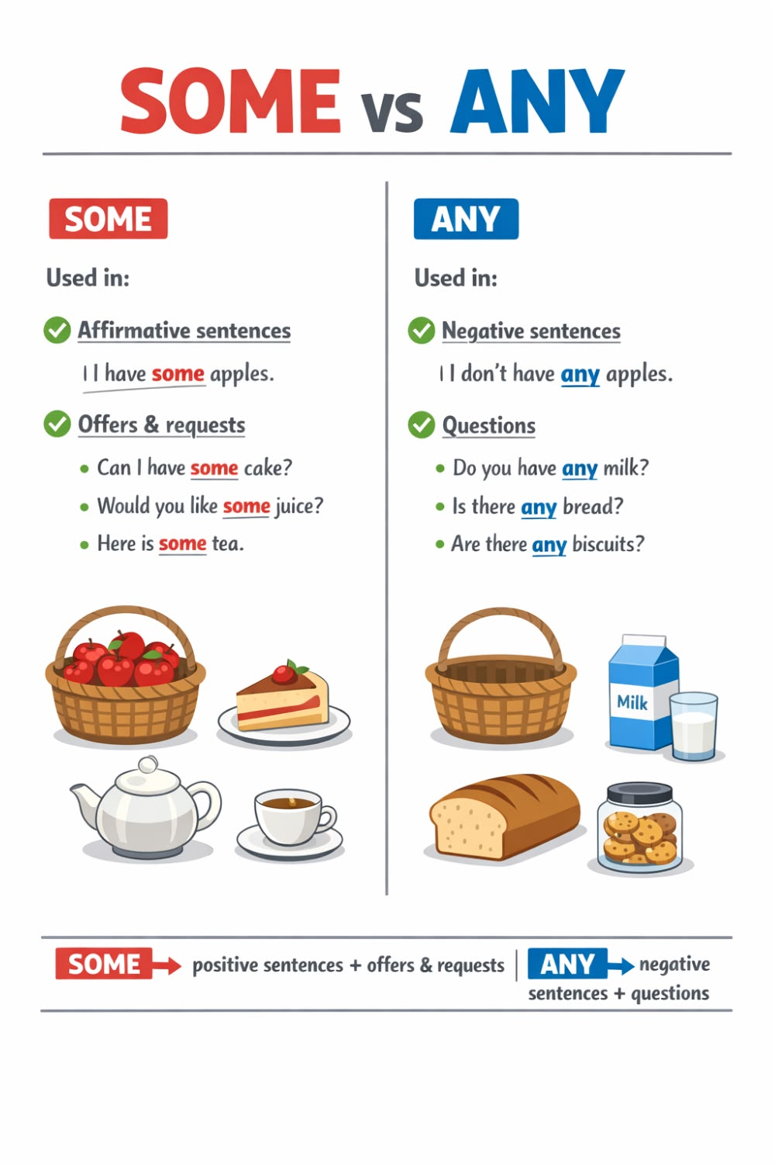

Slide 33
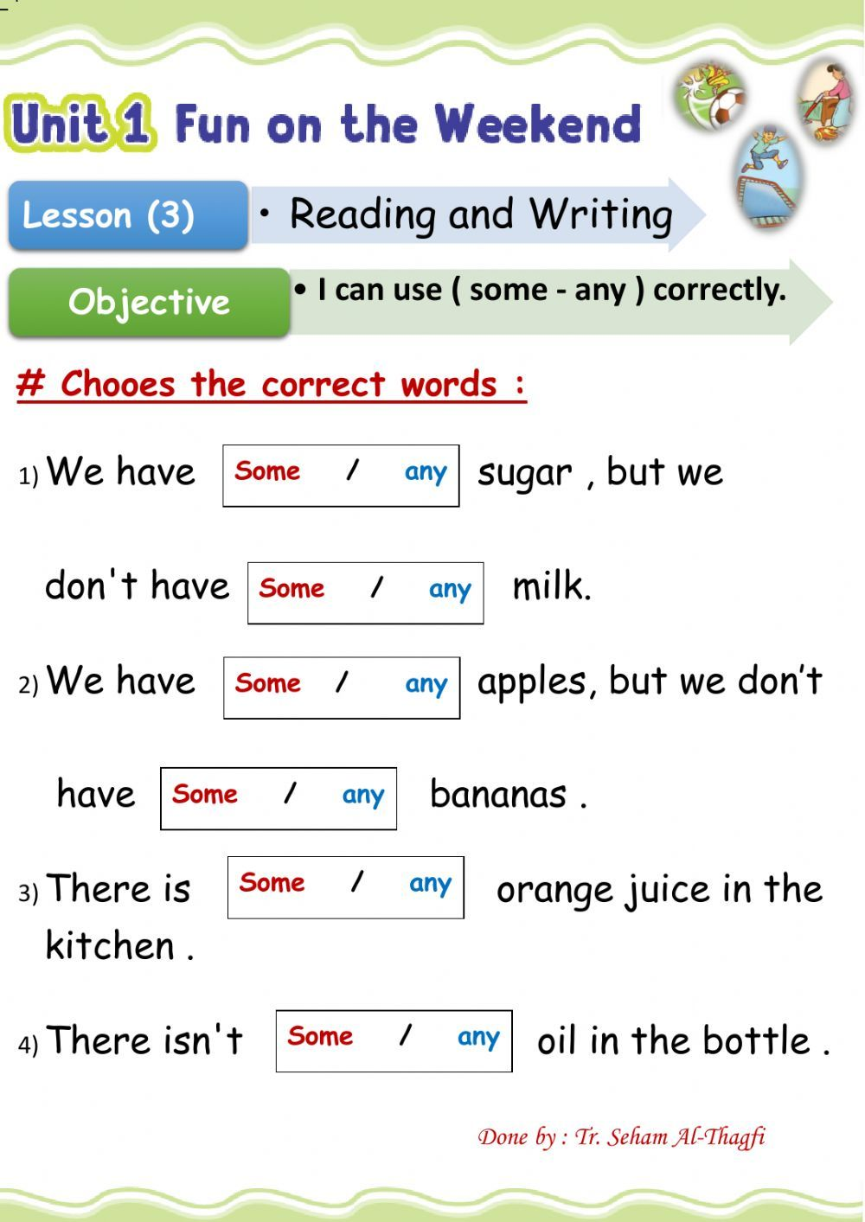


Slide 34
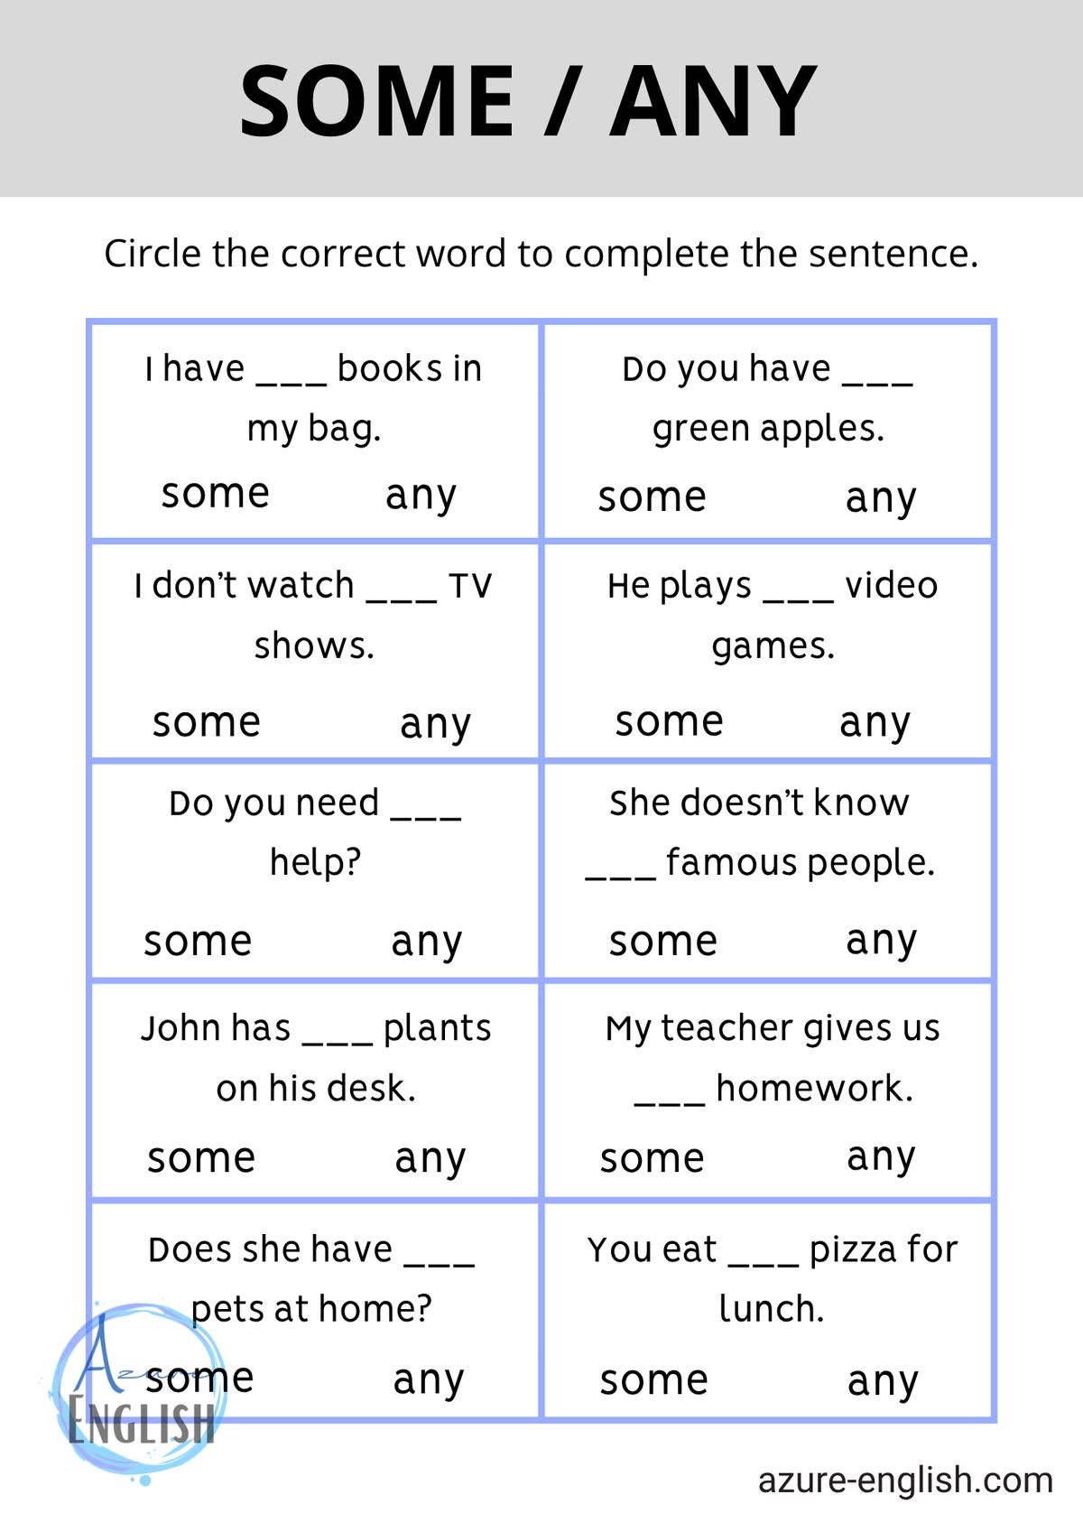

Slide 35
Explicaciones
https://www.google.com/search?q=el+many+y+el+much+se+ocupa+en+afirmacion%2C+negacion+e+interrogacion%3F&rlz=1C1AVFB_enCL895CL895&oq=el+many+y+el+much+se+ocupa+en+afirmacion%2C+negacion++e+interrogacion%3F&aqs=chrome..69i57.30002j0j15&sourceid=chrome&ie=UTF-8#fpstate=ive&vld=cid:e0da495d,vid:05fBAHsZiSg,st:0

Slide 36
Countable = many / few
Uncountable = much / little
Both = a lot of / lots of
Countables= we use “a” or “an”
A= un / una
An= un / una
Example:
A banana An orange

Slide 37
Educational links
https://www.liveworksheets.com/worksheet/en/english-second-language-esl/1267365

Slide 38
Emma’s Kitchen
Emma lives with her family. Every Saturday, they prepare lunch together. In the kitchen, there are many vegetables on the table. There are tomatoes, onions, carrots, and potatoes. There are also some apples and bananas for dessert.
Emma opens the fridge. There is a lot of milk, but there is little juice. There is some cheese, but there isn’t any butter. Her mother asks, “Do we have any rice?” Emma looks in the cupboard and says, “Yes, we have a lot of rice, but we have few eggs.”
Her brother wants to make a cake. He needs flour, sugar, and eggs. There is much sugar in the jar, but there is little flour. They need to go to the supermarket.
At the supermarket, they buy many eggs, some butter, a lot of flour, and a few oranges. Emma is happy because she loves cooking with her family.

Slide 39
True or False
Emma’s family cooks on Sunday. __F____
There are many vegetables on the table. _T_____
There is little juice in the fridge. _T_____
They have many eggs at home. __F____
Emma likes cooking. _T_____

Slide 40
Questions
What fruit is on the table?
There are apples and bananas
Is there any butter in the fridge?
No
How much sugar is in the jar?
There is much sugar in the jar
Why do they go to the supermarket?
Because, her brother wants to make a cake
What do they buy?
they buy many eggs, some butter, a lot of flour, and a few oranges.

Slide 41
Countable nouns | Uncountable nouns
apples | milk
eggs | juice
oranges | cheese
 | butter
 | rice
 | flour
 | sugar

Slide 42
Complete with the correct word(many / much some / any / little / few / a lot of)
There are _many___ vegetables.
There is _a lot of_____ milk.
There isn’t _any__ butter.
They have _a few_____ eggs.
There is _little__ flour.

