Slide 1

TECHNOLOGY AND ITS EFFECTS
UNIT 2

Slide 2

IN THIS UNIT YOU WILL:
read and listen to texts about the use of
ICT (Information and Communications
technology) and its effects.
express ideas and opinions, using words
and expressions related to technological
devices and advances.
neither/nor y either/or es fundamental para mejorar la capacidad de conectar ideas, comparar opciones y expresar negaciones de manera formal. Estos conectores se utilizan específicamente para relacionar dos personas, cosas o acciones

Slide 3

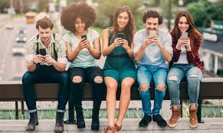
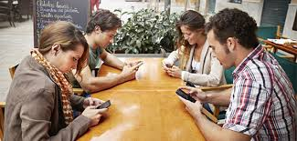
Do you think we are prisoners of technology? Why? Why not?
Yes, because people lives connected to technology
In which way is addiction to technology manifested?
People is addicted to social media, video games, gambling

Slide 4
POSIBLE ANSWERS
Yes, I think many people are prisoners of technology because they depend too much on their phones, social media, and the internet. Technology is useful, but excessive use can affect communication, sleep, and mental health. However, if people use technology responsibly and balance it with real-life activities, it can be very helpful instead of harmful.
Addiction to technology is manifested through excessive use of phones, computers, social media, or video games. People may spend too much time online, ignore their responsibilities, sleep less, and feel anxious or stressed when they cannot use technology.

Slide 5
In your opinion, which of the following statements are true? DISCUSS answers in your group.
__T__The use of the Internet and social networks can become an addiction.
__T___The Internet is taking the place of sports and games.
__F___Social networks may lead to antisocial behavior.
_T___Teens spend more time in cyberspace than in the real world.

Slide 6
ASK YOURSELF
a. Do you consider yourself an Internet addict? Why? Why not?
Jaime=yes
Axel=no
Emily=yes
Martina=no
Paz=yes
Vicente=no
b. What suggestion or advice can you offer Internet addict person?
Axel= spend less time in internet and replace it for other activities
Martina=Replace screen time with something that moves your body: dancing, walking, stretching.

Slide 7
The Effects of Technology
Technology has improved communication around the world. People have used the internet for decades, and many families have had smartphones since 2010.
However, technology also has negative effects. Some students have already become addicted to social media. Others haven’t slept well because they use their phones late at night.
Doctors have studied these problems for many years. They say teenagers should spend less time online and more time exercising.
Some people have never had problems with technology, but others have experienced stress and anxiety.

Slide 8
Multiple Choice
What is the main topic of the text?
Sports
Technology and its effects
Food habits
What problem do some students have?
They study too much
They are addicted to social media
They never use technology
What do doctors recommend?
Using phones all day
Sleeping less
Spending less time online

Slide 9
Answer the questions
How long have people used the internet?
👉 _people have used it for decades_______
Since when have many families had smartphones?
👉 _Since 2010__________________
What problems have some teenagers experienced?
👉 _addiction to social media and having trouble in sleeping__________________
Have all people had problems with technology?
👉 __not all people_________________

Slide 10
.

Slide 11
.

Slide 12
.

Slide 13
.

Slide 14
.

Slide 15
.

Slide 16
.

Slide 17
.

Slide 18
.

Slide 19
.

Slide 20
.

Slide 21
.

Slide 22
.

Slide 23
.

Slide 24
.

