Slide 1
Medios de transporte
UNIT 2

Slide 2
¿qué medios conoces?
CAR = AUTO
BUS = MICRO O BUS
TRAIN = TREN
PLANE / AIRPLANE = AVIÓN
ROLLERS= PATINES
SUBWAY= METRO
BIKE / BICYCLE = BICICLETA
SKATE = MONO PATÍN
BOAT = BOTE

Slide 3

Vocabulary
Write the correct letter:
Car → ___d___
Bus → __f____
Train → ___c___
Airplane → _b_____
Bicycle → __a____
Boat → __e____
a) bicicleta
b) avión
c) tren
d) auto
e) Bote
f) bus

Slide 4
Choose the correct answer
A _airplane__ flies in the sky.
a) car
b) airplane
c) bus
A _boat__ goes on water.
a) boat
b) train
c) bicycle
A _bicycle_____ has two wheels.
a) bus
b) bicycle
c) airplane

Slide 5

Grammar: the use of “by”
Sujeto + verbo + by + medio de transporte
go
fly
travel
Examples
I go to school by bus. 🚌 yo voy al colegio en bus
She goes to work by car. 🚗 ella va al trabajo en auto
We travel by airplane. ✈️ nosotros viajamos en avión
They go home by train. 🚆 Ellos van a casa en tren

Slide 6

BY = EN
👉 “BY significa cómo tú te transportas.”
En español:
“by bus” = “en bus
“by car” = “en auto”
IMPORTANTE
❌ NO:
by a bus
by the car
✅
SOLO:
by bus
by car
by train

Slide 7
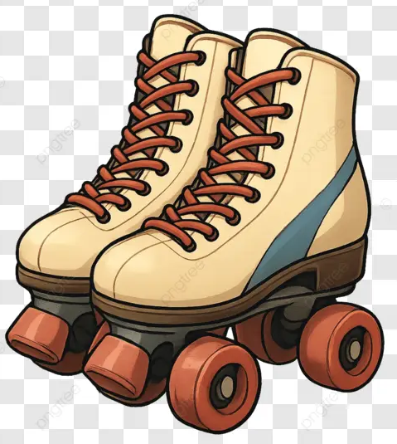
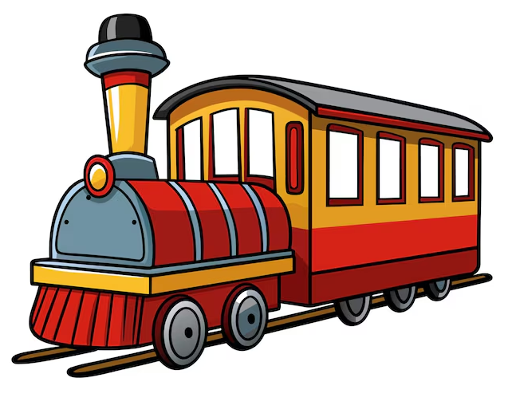



___________
_________
__________
__________
__________
____________

Slide 8
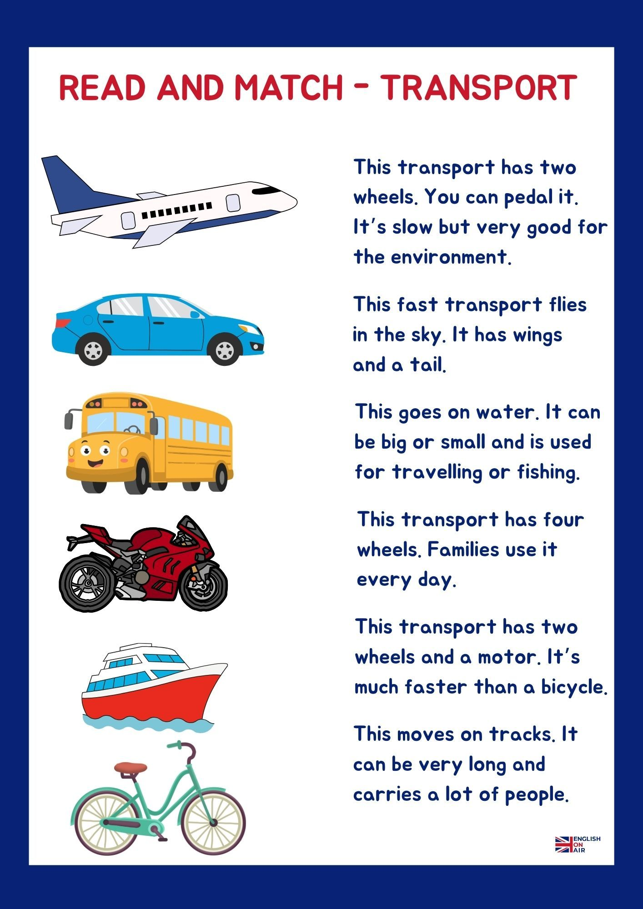

Slide 9
Complete the sentences
I go to school by __bus_____.
My father travels by _car____.
We cross the river by __boat___.
I ride my _bicycle___ in the park.
People travel long distances by _airplane_.
(Palabras: car – airplane – boat – bicycle – bus)

Slide 10
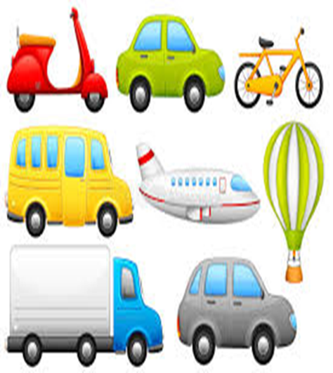
CORRECT THE MISTAKE
I go to school by a bus.
✅ _I go to school by bus_______
She travels by the car.
✅ _she travels by car______________
We go by airplane to Brazil.
✅ _we go to Brazil by airplane_______
My father goes work by car.
✅ _correct______________________
They travels by train.
✅ _They travel by train_____________

Slide 11

CORRECT THE MISTAKE
I go to school on bus.
✅ ___________________________
She travels with airplane.
✅ ___________________________
They go by the train.
✅ ___________________________
My mother goes by a car.
✅ ___________________________
We travel in airplane.
✅ ___________________________

Slide 12
Listen to your teacher and complete the sentences
My father travels to work by __________.
We go to the beach by __________.
She visits her grandmother by __________.
They travel to another country by __________.
My brother goes to the park by __________.
I go to the supermarket by _________

Slide 13
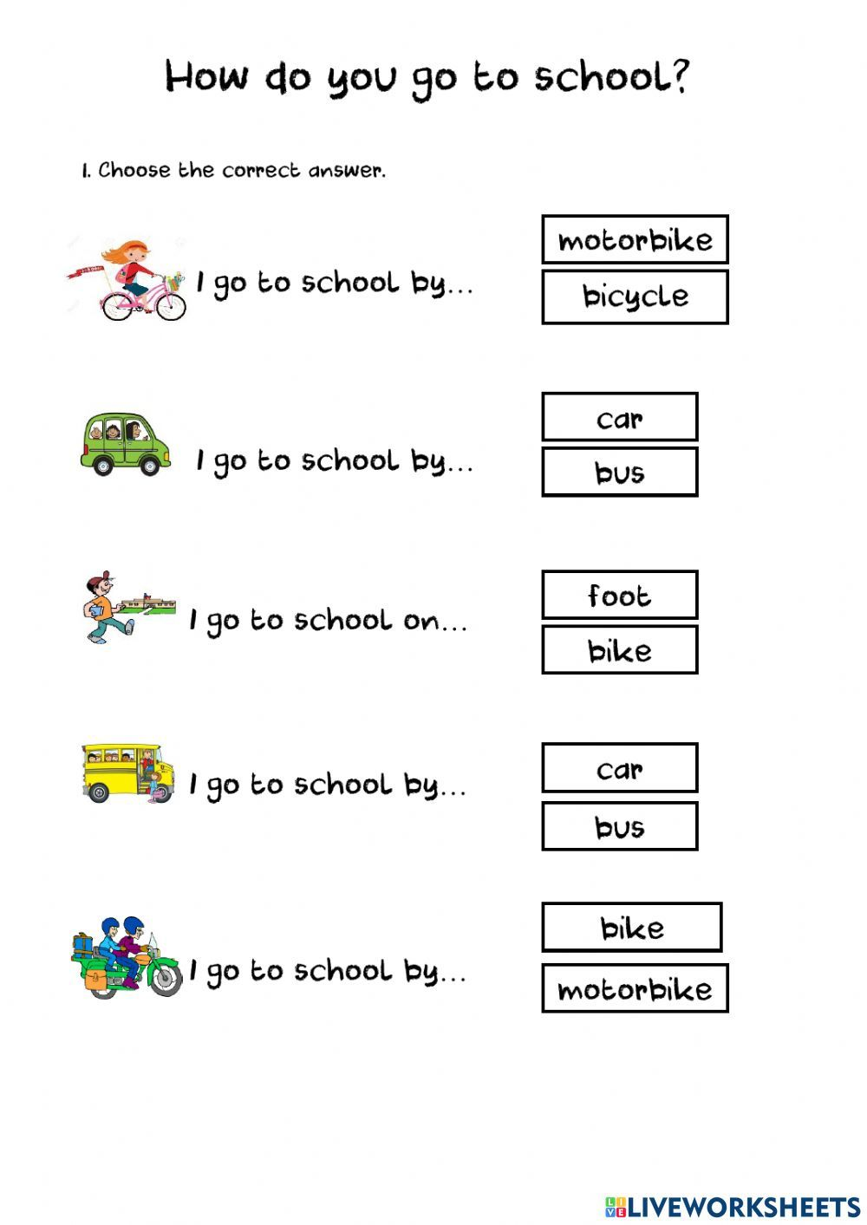


Slide 14
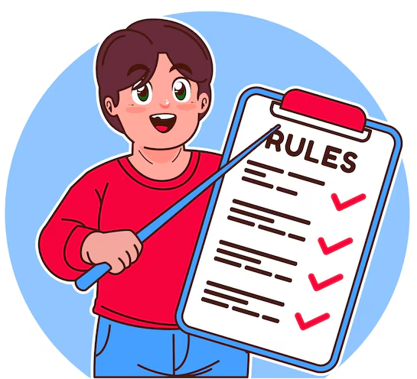
REGLAS
Verbos que suelen usar “BY”
Go: ir
Travel: viajar
arrive : llegar
Visit : visitar
Sail: navegar
etc
Verbos que usan el transporte DIRECTO
ride a bicycle
drive a car
fly an airplane

Slide 15
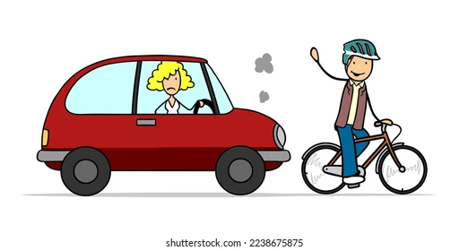
RECUERDA
✅ ride a bicycle
❌ ride by bicycle
✅ drive a car
❌ drive by car

Slide 16
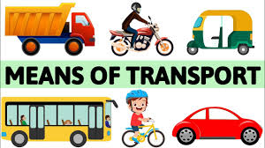




COMPLETE
I ______ to school by bus.
We ______ by airplane in summer.
She ______ a bicycle in the park.
My father ______ a car to work.
They ______ the river by boat.
sail

Slide 17
go by bus
ride a bicycle
drive a car
travel by airplane
go by train
BY + transport | Direct transport
__________ | __________
__________ | __________
__________ __________ | __________ __________

