Slide 1
HEALTHY HABITS
UNIT 2

Slide 2
Link listening: dialogue between anna and tom
https://speaktor.com/app/reader/01KRA6BV8WZB1TTWNJ1HN90B9E/

Slide 3
Anna: Hi Tom! What do you usually eat for breakfast?
Tom: Hi Anna! I usually eat cereal and drink milk. What about you?
Anna: I eat fruit and yogurt, and I drink orange juice.
Tom: That sounds healthy! Do you eat fast food?
Anna: Sometimes. I like burgers and fries, but I don’t eat them every day.
Tom: Me too. I love pizza and soda, but I know they are not very healthy.
Anna: Yes, it’s better to eat vegetables and drink water.
Tom: I agree. I also like salad and grilled chicken.
Anna: Great! Healthy food makes us strong and energetic.

Slide 4
Listen and classify
✏️ Write the foods and drinks in the correct column:
HEALTHY FOOD | UNHEALTHY FOOD | HEALTHY DRINKS | UNHEALTHY DRINKS
SALAD | BURGER | WATER | SODA
CHICKEN | PIZZA | MILK
YOGURT | FRIES | ORANGE JUICE
CEREAL
FRUIT
VEGETABLE

Slide 5
Circle the correct answer
Tom drinks:
a) soda
b) milk
Anna eats:
a) fruit and yogurt
b) fries and burgers
They think vegetables are:
a) unhealthy
b) healthy

Slide 6
QUESTIONS ABOUT YOURSELF
A: Matilda: bread /Tomas: bread and eggs / Vicho: egg
A;Benjamin: salad /Agustin: salad
A: Matilda: wáter /Benjamin: wáter / Julieta: water
A: Vicho: coffee /Benjamin : orange juice/ Tomas: nothing / Davor: gatorade/ Agustin: pineapple juice
What do you eat for breakfast?
What is your favorite healthy food?
Do you drink soda or water?
What do you usually drink at lunch?

Slide 7
What are Healthy Habits?
Healthy habits are good activities that help our body and mind stay healthy.
Examples:
eating healthy food 🍎
drinking water 💧
exercising 🏃
sleeping well 😴
brushing your teeth
Healthy habits help us:
✅ feel good
✅ have energy
✅ stay strong
✅ prevent diseases

Slide 8
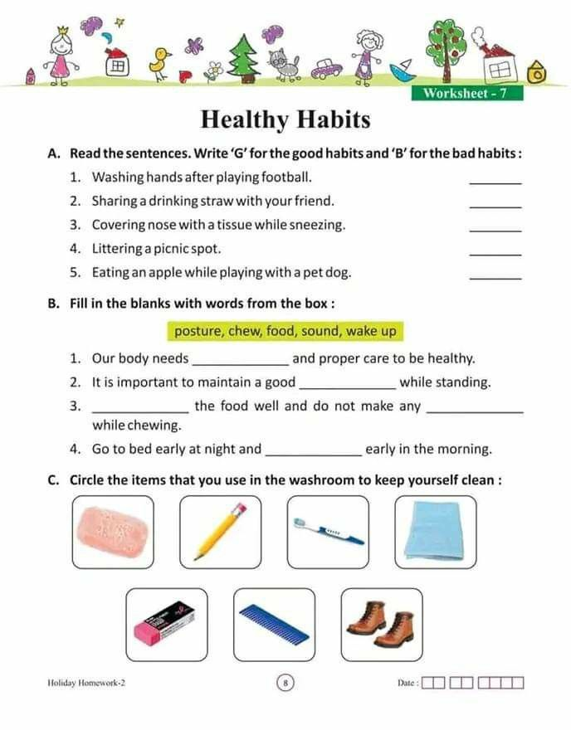






B
wake up

Slide 9
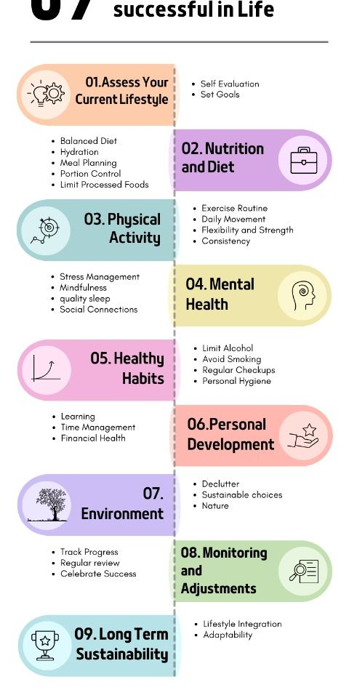

Slide 10
Examples of healthy habits:
Drink water
Eat fruit
Eat vegetables
Exercise regularly
Brush your teeth
Wash your hands
Eat healthy food
Walk
Ride a bike
Play sports
Drink milk
Take a shower
Stretch your body
Drink natural juice
Practice yoga
Run in the park
Limit screen time
Read books
Relax and rest
Keep your room clean
Visit the doctor
Protect your skin from the sun

Slide 11
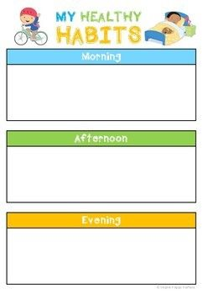
I wake up early and drink water
I have lunch healthy and then I relax for a moment
I go the gym and then I drink water

Slide 12
QUESTIONS ABOUT YOURSELF
What healthy habits do you have?
__Tomas: I drink water____
Do you drink enough water?
_Matilda: I drink a lot of water_
How many hours do you sleep?
_6, 7, 8______________
Do you exercise?
_Julieta : yes______________
What healthy food do you eat?
__Benjamin: salad____________

Slide 13
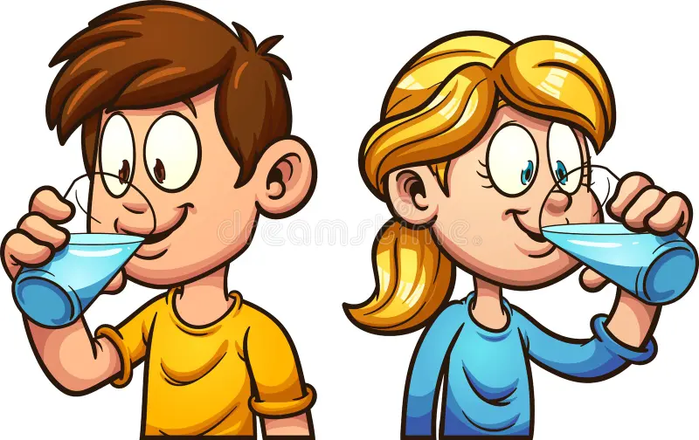
TEACHER SAYS ACTIVITies and you have to write “healthy or unhealthy”…
healthy
unhealthy
healthy
healthy
unhealthy
healthy
unhealthy
healthy

Slide 14
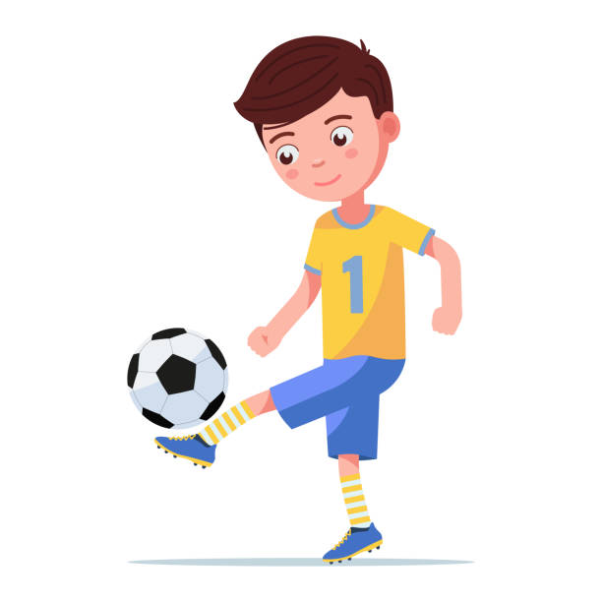
If you have mistakes, correct your answer:
My brother plays soccer on weekends __healthy____
They fall asleep very late _unhealthy______
I don’t drink soda _healthy_______
Sarah doesn’t eat breakfast __unhealthy_______
She eats vegetables for lunch _healthy________
Cindy and Rick never exercise _unhealthy________
He doesn’t eat many candies __healthy_______

Slide 15

If you have mistakes, correct your answer:
Tom doesn´t go to the gym __unhealthy_______
We spend many hours on the phone __unhealthy_______
Jhon sleeps 8 hours every night __healthy_________
She doesn’t wash her teeth everyday __unhealthy_______
He doesn´t drink too much coffee _healthy________

Slide 16
Negar: S + don’t/ doesn’t + verb + c
Don’t I, you, we, they
Doesn’t He, she, it
I don’t drink soda / Cindy doesn’t exercise
Afirmación: S + verb(s, es) + c
He, she, it verbo (s, es)
We spend many hours on the pone / She eats vegetables for lunch
Interrogativa Do/ does + S + verb + c ?
Do I, you, we, they
Does he, she, it
Do you eat fruit? / Does she sleep 8 hours?

Slide 17
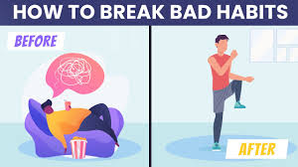
Change the sentences to healthy habits:
She doesn’t sleep enough hours.
___She sleeps 8 hours__________________
They watch TV all day.
__they don’t watch TV all day_____________
3. We don’t eat healthy food.
________________________________
4. I eat hamburgers every day.
_______________________________
5. He doesn’t brush his teeth every day.
______________________________________

Slide 18

Change the sentences to healthy habits:
We eat too much pizza.
_________________________________
He never drinks water.
_________________________________
She skips breakfast.
__________________________________
They play video games all night.
___________________________________

Slide 19
SHOULD and MUST
SHOULD
👉 Se usa para:
dar consejos
recomendaciones
sugerencias
📌 Meaning:
should = deberías
Examples:
You should drink water.
We should eat vegetables.
MUST
👉 Se usa para:
obligaciones
reglas
cosas muy importantes
📌 Meaning:
must = debes / tienes que
Examples:
You must do your homework.
Students must wear uniforms.

Slide 20
EASY RULES
SHOULD: DEBERÍA | MUST: DEBES
advice | obligation
recommendation | rule
optional | necessary

Slide 24
o
o

Slide 25
Objetivo 1
Objetivo 2
Objetivo 3

Slide 26


