Slide 1
Medios de transporte
UNIT 2

Slide 2
¿qué medios conoces?
CAR = AUTO
BUS = MICRO O BUS
TRAIN = TREN
PLANE / AIRPLANE = AVIÓN
ROLLERS= PATINES
SUBWAY= METRO
BIKE / BICYCLE = BICICLETA
SKATE = MONO PATÍN
BOAT = BOTE

Slide 3

Grammar: the use of “by”
Sujeto + verbo + by + medio de transporte
go
sail
travel
Examples
I go to school by bus. 🚌 yo voy al colegio en bus
She goes to work by car. 🚗 ella va al trabajo en auto
We travel by airplane. ✈️ nosotros viajamos en avión
They go home by train. 🚆 Ellos van a casa en tren

Slide 4

BY = EN
👉 “BY significa cómo tú te transportas.”
En español:
“by bus” = “en bus
“by car” = “en auto”
IMPORTANTE
❌ NO:
by a bus
by the car
✅
SOLO:
by bus
by car
by train

Slide 5
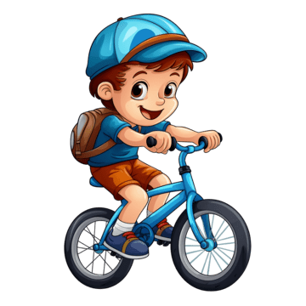
Vocabulary
Write the correct letter:
Car → ___d___
Bus → __f____
Train → ___c___
Airplane → _b_____
Bicycle → __a____
Boat → __e____
a) bicicleta
b) avión
c) tren
d) auto
e) Bote
f) bus

Slide 6
Choose the correct answer
A _airplane__ flies in the sky.
a) car
b) airplane
c) bus
A _boat__ goes on water.
a) boat
b) train
c) bicycle
A _bicycle_____ has two wheels.
a) bus
b) bicycle
c) airplane

Slide 7

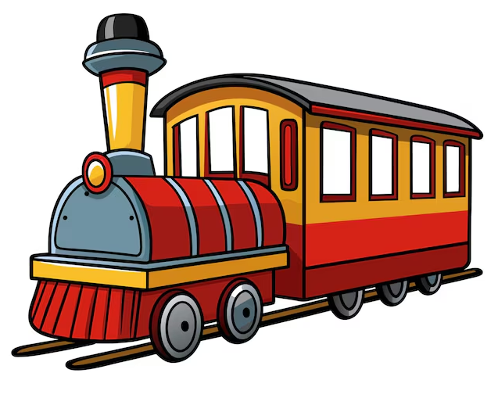



_BICYCLE___
_AIRPLANE________
_SUBWAY__
_ROLLER_____
_TRAIN_____
__SKATE_______

Slide 8
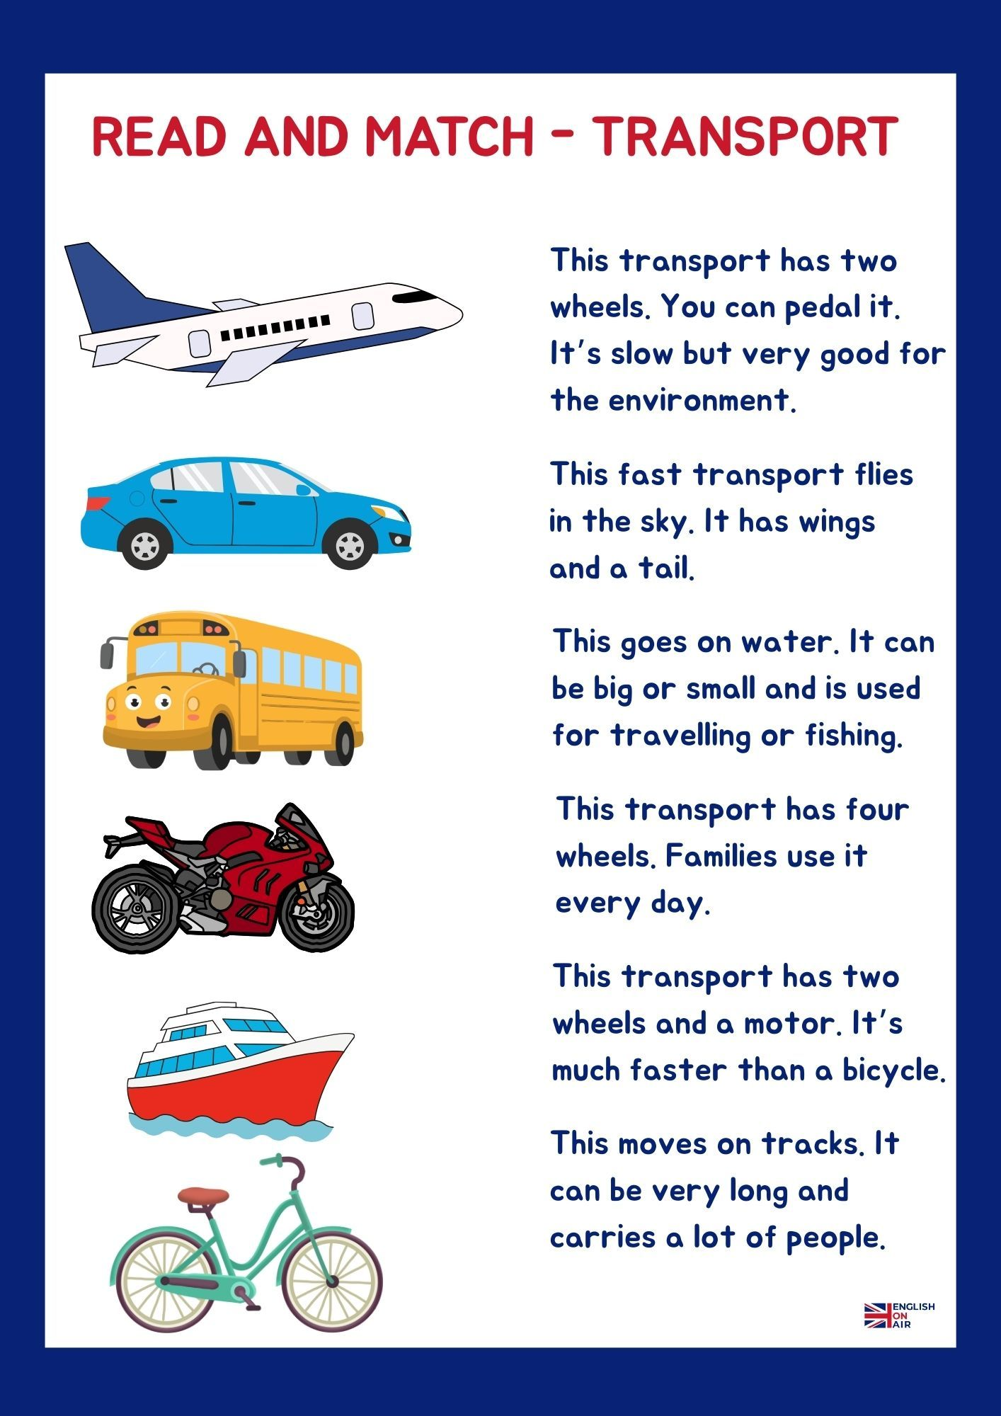

Slide 9
Listen to your teacher and complete the sentences
My father travels to work by _car_______.
We go to the beach by _bus_________.
She visits her grandmother by _train_____.
They travel to another country by _airplane__.
My brother goes to the park by _bike_____.
I go to the supermarket by _car______

Slide 10
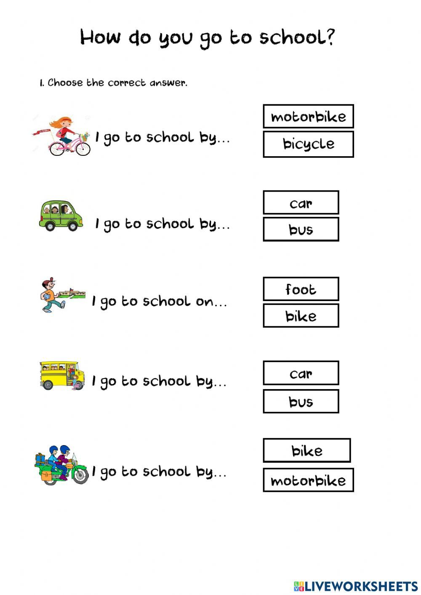

Ir a pie o transportarse a pie, no ocupo el “by”.
Ocupo “on foot” =a pie
Example:
I go to school on foot = yo voy al colegio a pie
I walk to school
I go to school on foot

Slide 11
Complete the sentences
I go to school by __bus_____.
My father travels by _car____.
We cross the river by __boat___.
I ride my _bicycle___ in the park.
People travel long distances by _airplane_.
(Palabras: car – airplane – boat – bicycle – bus)

Slide 12
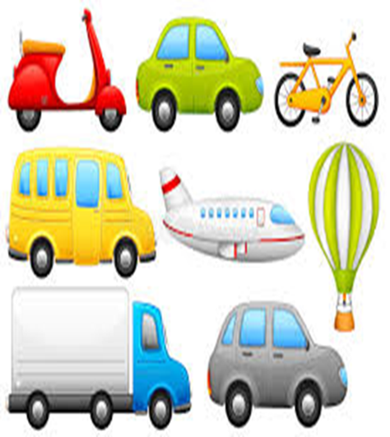
CORRECT THE MISTAKE
I go to school by a bus.
✅ _I go to school by bus_______
She travels by the car.
✅ _she travels by car______________
We go by airplane to Brazil.
✅ _we go to Brazil by airplane_______
My father goes to work by car.
✅ _correct______________________
They travels by train.
✅ _They travel by train_____________

Slide 13

CORRECT THE MISTAKE
I go to school on bus.
✅ _I go to_school by bus________
She travels with airplane.
✅ _She travels by airplane_______
They go by the train.
✅ _They go by train_____________
My mother goes by a car.
✅ _My mother goes by car._______
We travel in airplane.
✅ _we travel by airplane_________

Slide 14



Challenge Exercise (Ejercicio de desafío)
Find ALL the mistakes: (4)
My sister go to school by a bus and my parents travels by the car.
_____________________________________________

Slide 15
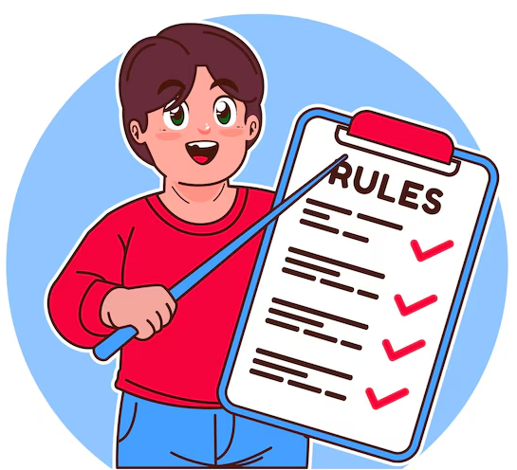
REGLAS
Verbos que suelen usar “BY” (4)
Go: ir
Travel: viajar
arrive : llegar
Visit : visitar
etc
Verbos que usan el transporte DIRECTO (4)
ride a bicycle
drive a car
fly an airplane
Sail a boat

Slide 16
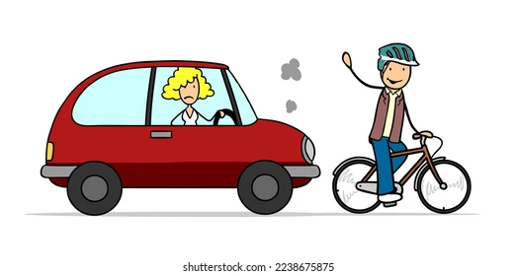
RECUERDA
✅ ride a bicycle
❌ ride by bicycle
✅ drive a car
❌ drive by car

Slide 17
Reglas de oro del uso de “BY”
Se usa para señalar el medio de transporte que utilizamos “en” y se usa en los verbos: go, travel, arrive, visit
Ejemplo : she travels by plane / they go to the cinema by car
No usa artículos (the, a, an)
Ejemplo : she travels by the plane
Algunos verbos NO usan “by” (ride, drive, fly and sail)
Ejemplo: I ride my bike
I drive my car
I sail a boat

Slide 18
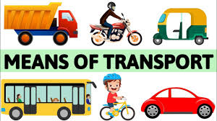




COMPLETE
I ______ to school by bus.
We ______ by airplane in summer.
She ______ a bicycle in the park.
My father ______ a car to work.
They ______ the river by boat.
sail

Slide 19
go by bus
ride a bicycle
drive a car
travel by airplane
go by train
BY + transport | Direct transport
__________ | __________
__________ | __________
__________ __________ | __________ __________

Slide 20
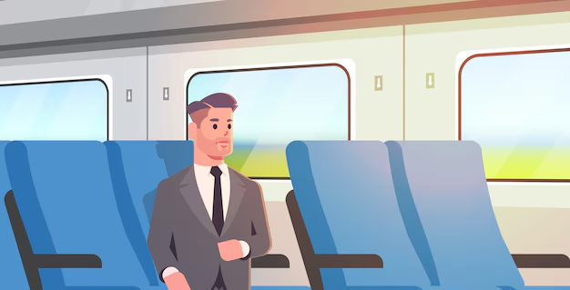
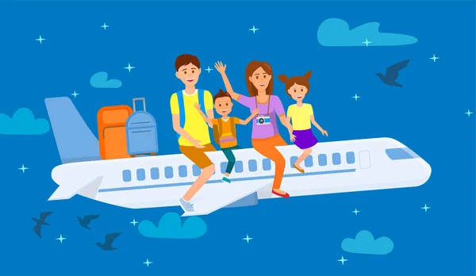
Read the text
My Family and Transportation
Hello! My name is Ben. I go to school by bus every day. My mother goes to work by car because her office is far away. My father travels by train to the city.
On weekends, my family likes to travel by boat to a small island. My sister rides her bicycle in the park, and I go by subway with my friends to the shopping mall.
In summer, we travel by plane to visit my grandparents. I love airplanes because they are fast and exciting!
VOCABULARY
Far away : lejós
Small island : isla pequeña
Fast and exciting: rápido y emocionante

Slide 21

Answer the questions:
How does Ben go to school?
👉 ___________________________
How does his mother go to work?
👉 ___________________________
How does his father travel to the city?
👉 ___________________________
What transport does the family use on weekends?
👉 ___________________________
How does Ben travel in summer?
👉 ___________________________

Slide 22
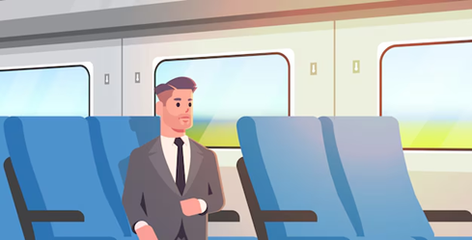
Complete
bus – plane – train – boat – subway
Ben goes to school by __________.
His father travels by __________.
The family travels by __________ on weekends.
Ben goes to the mall by __________.
In summer, they travel by __________.

Slide 23
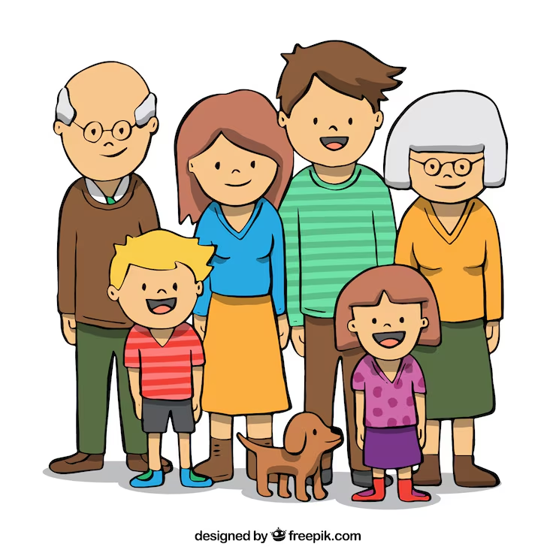
Write 3 sentences about your family.
My mother goes to work by __________.
My father travels by __________.
I go to the park by __________.
( I go downtown by)

