Slide 1
Means of transport
UNIT 2

Slide 2
¿qué medios conoces?
CAR = AUTO
BUS = MICRO O BUS
TRAIN = TREN
PLANE / AIRPLANE = AVIÓN
ROLLERS= PATINES
SUBWAY= METRO
BIKE / BICYCLE = BICICLETA
SKATE = MONO PATÍN
BOAT = BOTE

Slide 3

Grammar: the use of “by”
Sujeto + verbo + by + medio de transporte
go
sail
travel
Examples
I go to school by bus. 🚌 yo voy al colegio en bus
She goes to work by car. 🚗 ella va al trabajo en auto
We travel by airplane. ✈️ nosotros viajamos en avión
They go home by train. 🚆 Ellos van a casa en tren

Slide 4

BY = EN
👉 “BY significa cómo tú te transportas.”
En español:
“by bus” = “en bus
“by car” = “en auto”
IMPORTANTE
❌ NO:
by a bus
by the car
✅
SOLO:
by bus
by car
by train

Slide 5

Vocabulary
Write the correct letter:
Car → ___d___
Bus → __f____
Train → ___c___
Airplane → _b_____
Bicycle → __a____
Boat → __e____
a) bicicleta
b) avión
c) tren
d) auto
e) Bote
f) bus

Slide 6
Choose the correct answer
A _airplane__ flies in the sky.
a) car
b) airplane
c) bus
A _boat__ goes on water.
a) boat
b) train
c) bicycle
A _bicycle_____ has two wheels.
a) bus
b) bicycle
c) airplane

Slide 7





_BICYCLE___
_AIRPLANE________
_SUBWAY__
_ROLLER_____
_TRAIN_____
__SKATE_______

Slide 8
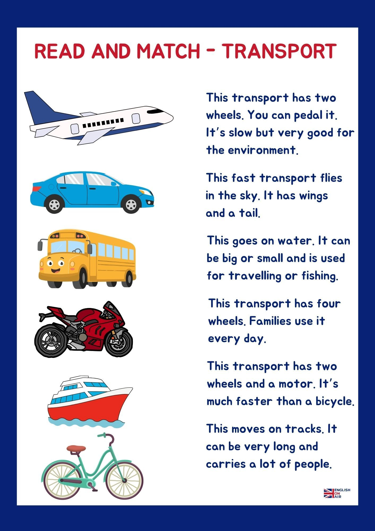

Slide 9
Listen to your teacher and complete the sentences
My father travels to work by _car_______.
We go to the beach by _bus_________.
She visits her grandmother by _train_____.
They travel to another country by _airplane__.
My brother goes to the park by _bike_____.
I go to the supermarket by _car______

Slide 10
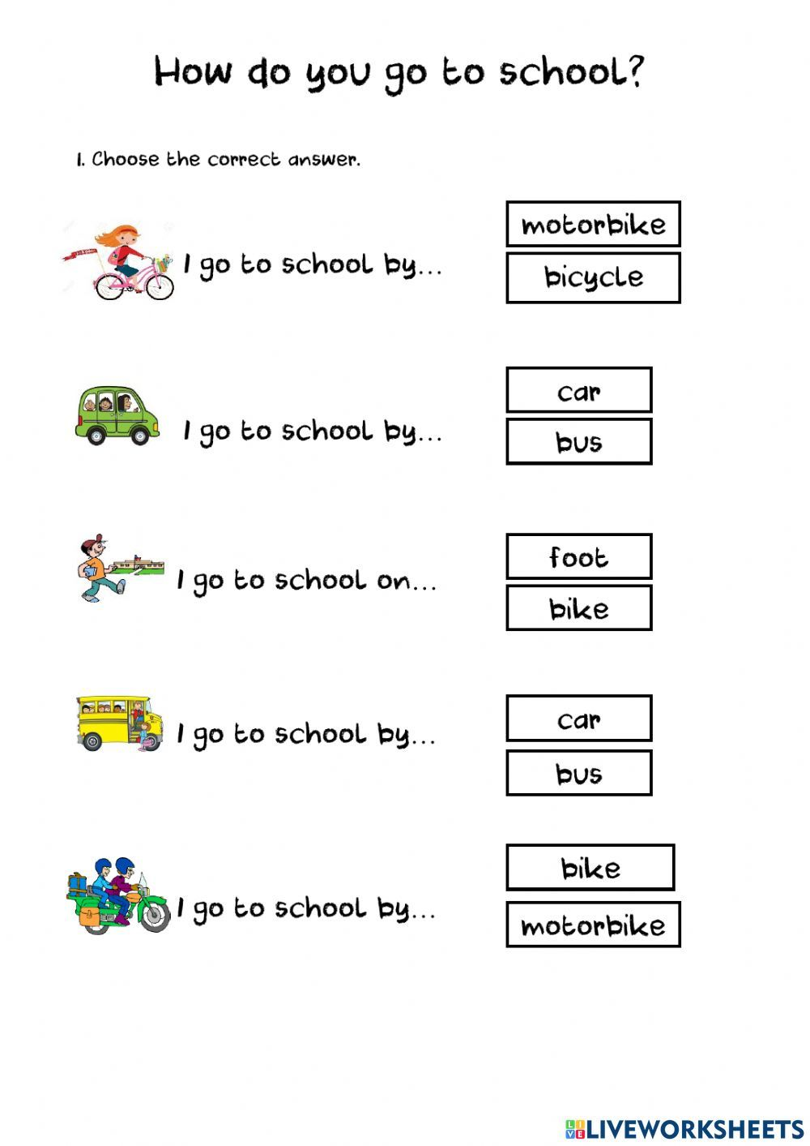

Ir a pie o transportarse a pie, no ocupo el “by”.
Ocupo “on foot” =a pie
Example:
I go to school on foot = yo voy al colegio a pie
I walk to school
I go to school on foot

Slide 11
Complete the sentences
I go to school by __bus_____.
My father travels by _car____.
We cross the river by __boat___.
I ride my _bicycle___ in the park.
People travel long distances by _airplane_.
(Palabras: car – airplane – boat – bicycle – bus)

Slide 12
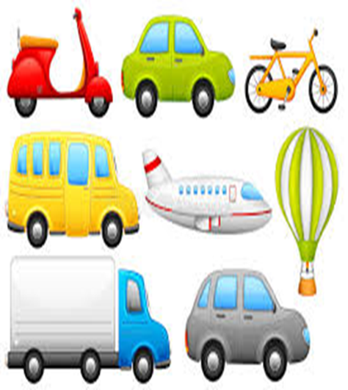
CORRECT THE MISTAKE
I go to school by a bus.
✅ _I go to school by bus_______
She travels by the car.
✅ _she travels by car______________
We go by airplane to Brazil.
✅ _we go to Brazil by airplane_______
My father goes to work by car.
✅ _correct______________________
They travels by train.
✅ _They travel by train_____________

Slide 13

CORRECT THE MISTAKE
I go to school on bus.
✅ _I go to_school by bus________
She travels with airplane.
✅ _She travels by airplane_______
They go by the train.
✅ _They go by train_____________
My mother goes by a car.
✅ _My mother goes by car._______
We travel in airplane.
✅ _we travel by airplane_________

Slide 14


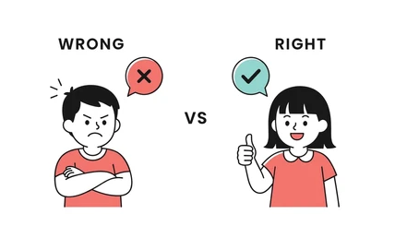
Challenge Exercise (Ejercicio de desafío)
Find ALL the mistakes: (4)
My sister go to school by a bus and my parents travels by the car.
My sister goes to school by bus and my parents travel by car_____
He, she, it = verb (s/es)

Slide 15
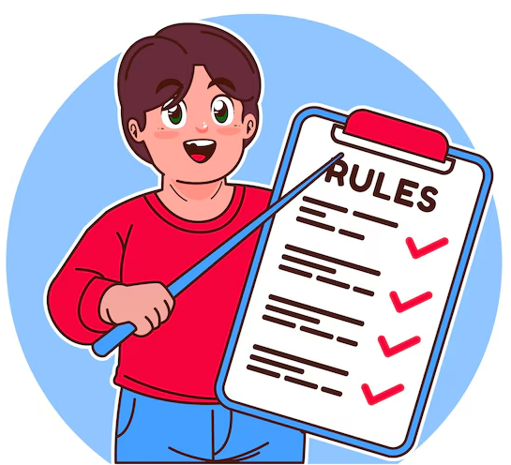
REGLAS
Verbos que suelen usar “BY” (4)
Go: ir
Travel: viajar
arrive : llegar
Visit : visitar
etc
Verbos que usan el transporte DIRECTO (4)
ride a bicycle
drive a car
fly an airplane
Sail a boat

Slide 16
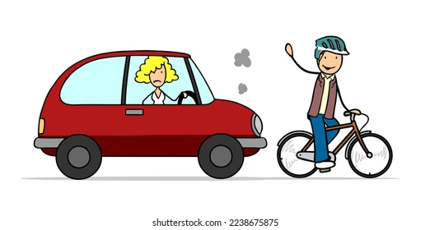
RECUERDA
✅ ride a bicycle
❌ ride by bicycle
✅ drive a car
❌ drive by car

Slide 17
Reglas de oro del uso de “BY”
Se usa para señalar el medio de transporte que utilizamos “en” y se usa en los verbos: go, travel, arrive, visit
Ejemplo : she travels by plane / they go to the cinema by car
No usa artículos (the, a, an)
Ejemplo : she travels by the plane
Algunos verbos NO usan “by” (ride, drive, fly and sail)
Ejemplo: I ride my bike or I ride a horse
I drive my car
I sail a boat

Slide 18
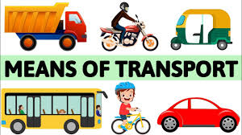




COMPLETE
I ______ to school by bus.
We ______ by airplane in summer.
She ______ a bicycle in the park.
My father ______ a car to work.
They ______ the river by boat.
sail
He, she, it = verb (s/es)

Slide 19
go by bus
ride a bicycle
drive a car
travel by airplane
go by train
BY + transport | Direct transport (sin by)
_go by bus_ | _ride a bicycle
_travel by airplane | _drive a car__
_go by train_____ __________ | __________ __________

Slide 20
CORRECCT OR INCORRECT???
She travel by plane. She travels by plane
I go by a bus. I go By bus
She sails by a boat she sails a boat
They arrive by the train. They arrive by train
We go by boat. correct
My father travels by a car. My father travels by car
I ride by bicycle I ride my / a bicycle
We fly by plane. We fly a plane

Slide 21
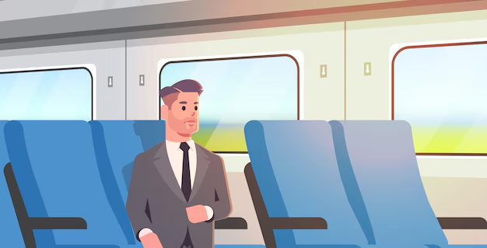
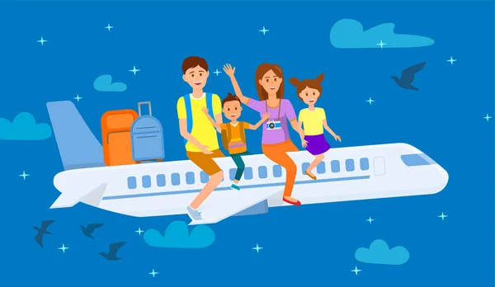
Read the text
My Family and Transportation
Hello! My name is Ben. I go to school by bus every day. My mother goes to work by car because her office is far away. My father travels by train to the city.
On weekends, my family likes to travel by boat to a small island. My sister rides her bicycle in the park, and I go by subway with my friends to the shopping mall.
In summer, we travel by plane to visit my grandparents. I love airplanes because they are fast and exciting!
VOCABULARY
Far away : lejós
Small island : isla pequeña
Fast and exciting: rápido y emocionante

Slide 22

Answer the questions:
How does Ben go to school?
👉 __he goes by bus_______________
How does his mother go to work?
👉 _she goes by car________________
How does his father travel to the city?
👉 _he travels by train_______________
What transport does the family use on weekends?
👉 _a boat________________________
How does Ben travel in summer?
👉 __he travels by plane_____________

Slide 23
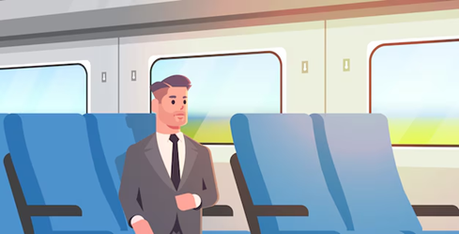
Complete
bus – plane – train – boat – subway
Ben goes to school by _bus_________.
His father travels by _train_________.
The family travels by _boat_________ on weekends.
Ben goes to the mall by _subway_________.
In summer, they travel by _plane_________.

Slide 24
VERDADERO O FALSO
Ben goes to school by train. _F___ by bus
His mother goes to work by car. _v_____
The family travels by boat on weekends. _v_____
Ben rides a bicycle to the shopping mall. _F_____ by subway
Ben loves airplanes. _v_____

Slide 25
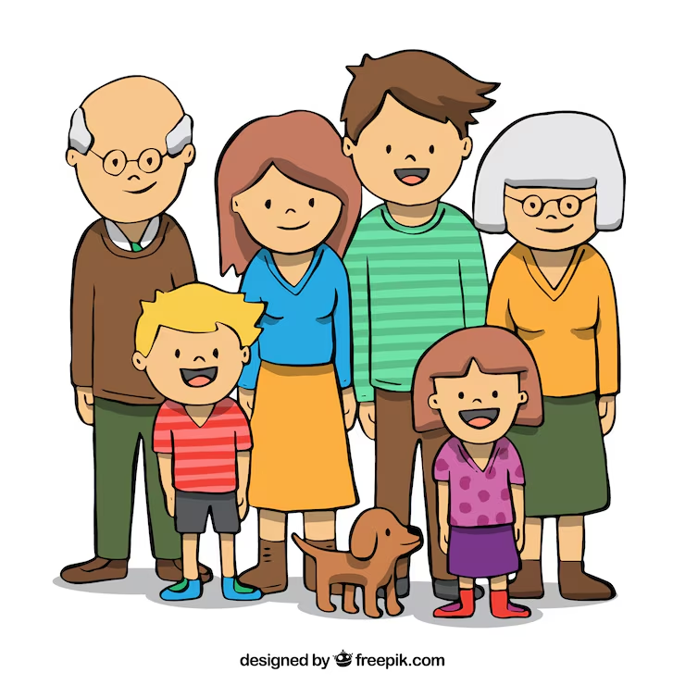
Write 3 sentences about your family.
My mother goes to work by __car________.
My father travels by __car________.
I go to the park by __scooter________.
( I go downtown by)
I go to the park on foot
(a pie = on foot
Sin by)

Slide 26
Liks
juegos
https://www.youtube.com/watch?v=3BXEEjE991U
https://www.youtube.com/watch?v=xSQfAwvR3KE
https://www.youtube.com/watch?v=pAXSWhzb9kI
Canción .
https://www.youtube.com/watch?v=5-DeiXPJ3H8&list=RD5-DeiXPJ3H8&start_radio=1

