Slide 1
HEAL
THY HABITS
UNIT 2

Slide 2
Link listening: dialogue between anna and tom
https://speaktor.com/app/reader/01KRA6BV8WZB1TTWNJ1HN90B9E/

Slide 3
Anna: Hi Tom! What do you usually eat for breakfast?
Tom: Hi Anna! I usually eat cereal and drink milk. What about you?
Anna: I eat fruit and yogurt, and I drink orange juice.
Tom: That sounds healthy! Do you eat fast food?
Anna: Sometimes. I like burgers and fries, but I don’t eat them every day.
Tom: Me too. I love pizza and soda, but I know they are not very healthy.
Anna: Yes, it’s better to eat vegetables and drink water.
Tom: I agree. I also like salad and grilled chicken.
Anna: Great! Healthy food makes us strong and energetic.

Slide 4
Listen and classify
✏️ Write the foods and drinks in the correct column:
HEALTHY FOOD | UNHEALTHY FOOD | HEALTHY DRINKS | UNHEALTHY DRINKS
SALAD | BURGER | WATER | SODA
CHICKEN | PIZZA | MILK
YOGURT | FRIES | ORANGE JUICE
CEREAL
FRUIT
VEGETABLE

Slide 5
Circle the correct answer
Tom drinks:
a) soda
b) milk
Anna eats:
a) fruit and yogurt
b) fries and burgers
They think vegetables are:
a) unhealthy
b) healthy

Slide 6
QUESTIONS ABOUT YOURSELF
A: Matilda: bread /Tomas: bread and eggs / Vicho: egg
A;Benjamin: salad /Agustin: salad
A: Matilda: wáter /Benjamin: wáter / Julieta: water
A: Vicho: coffee /Benjamin : orange juice/ Tomas: nothing / Davor: gatorade/ Agustin: pineapple juice
What do you eat for breakfast?
What is your favorite healthy food?
Do you drink soda or water?
What do you usually drink at lunch?

Slide 7
What are Healthy Habits?
Healthy habits are good activities that help our body and mind stay healthy.
Examples:
eating healthy food 🍎
drinking water 💧
exercising 🏃
sleeping well 😴
brushing your teeth
Healthy habits help us:
✅ feel good
✅ have energy
✅ stay strong
✅ prevent diseases

Slide 8
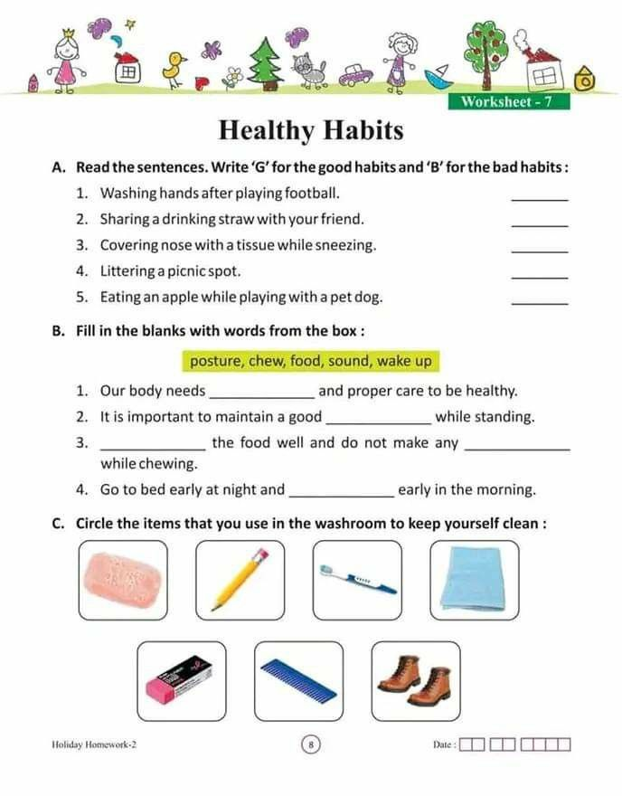






B
wake up

Slide 9
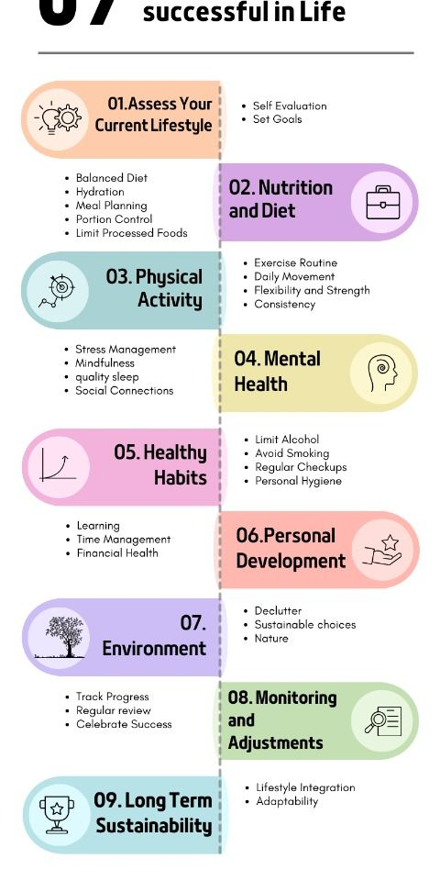

Slide 10
Examples of healthy habits:
Drink water
Eat fruit
Eat vegetables
Exercise regularly
Brush your teeth
Wash your hands
Eat healthy food
Walk
Ride a bike
Play sports
Drink milk
Take a shower
Stretch your body
Drink natural juice
Practice yoga
Run in the park
Limit screen time
Read books
Relax and rest
Keep your room clean
Visit the doctor
Protect your skin from the sun

Slide 11
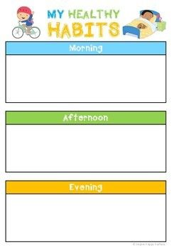
I wake up early and drink water
I have lunch healthy and then I relax for a moment
I go the gym and then I drink water

Slide 12
QUESTIONS ABOUT YOURSELF
What healthy habits do you have?
__Tomas: I drink water____
Do you drink enough water?
_Matilda: I drink a lot of water_
How many hours do you sleep?
_6, 7, 8______________
Do you exercise?
_Julieta : yes______________
What healthy food do you eat?
__Benjamin: salad____________

Slide 13
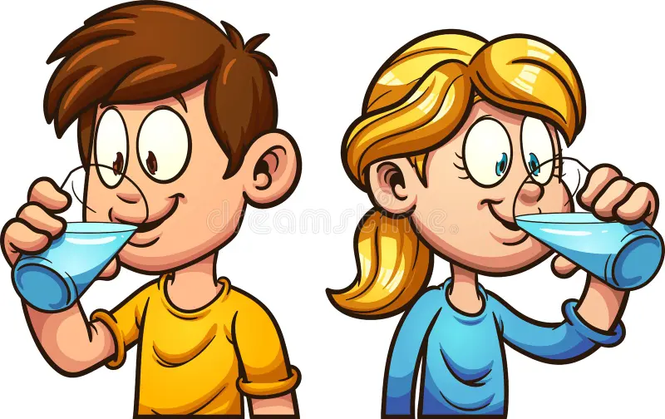
TEACHER SAYS ACTIVITies and you have to write “healthy or unhealthy”…
healthy
unhealthy
healthy
healthy
unhealthy
healthy
unhealthy
healthy

Slide 14
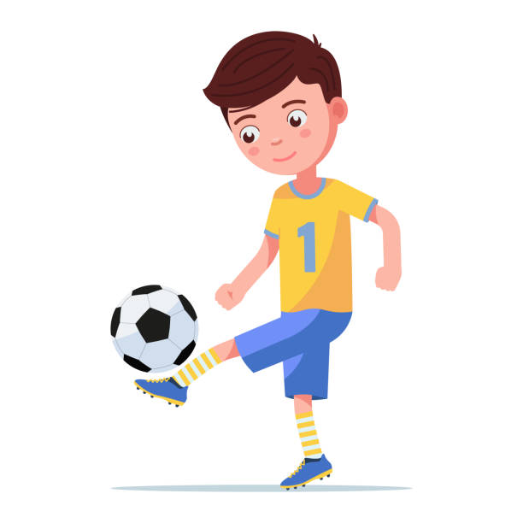
If you have mistakes, correct your answer:
My brother plays soccer on weekends __healthy____
They fall asleep very late _unhealthy______
I don’t drink soda _healthy_______
Sarah doesn’t eat breakfast __unhealthy_______
She eats vegetables for lunch _healthy________
Cindy and Rick never exercise _unhealthy________
He doesn’t eat many candies __healthy_______

Slide 15

If you have mistakes, correct your answer:
Tom doesn´t go to the gym __unhealthy_______
We spend many hours on the phone __unhealthy_______
Jhon sleeps 8 hours every night __healthy_________
She doesn’t wash her teeth everyday __unhealthy_______
He doesn´t drink too much coffee _healthy________

Slide 16
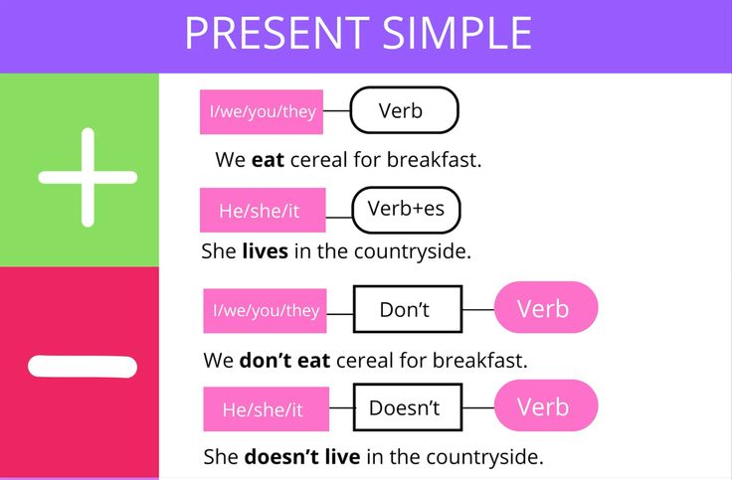
, S

Slide 17
afirmativa y negativa
AFIRMATIVA
S (I, you, we, they) + V + C Ej: You eat salad
S (he, she, it) + V (s/es) + C Ej: She eats salad
Ej: She goes to school
NEGATIVA
S (I, you, we, they) DON’T + V + C Ej: You don’t eat salad
S (he, she, it) DOESN’T + V + C Ej: She doesn’t eat salad

Slide 18

SIMPLE PRESENT
En este tiempo se ocupan los auxiliares DO y Does
Preguntas
y
Does He=él Negación (+ not)
she=ella
it=esto(a)
(cosa o animal)
I = yo
You= tú
We=nosotros(as)
They=ellos (as)

Slide 19
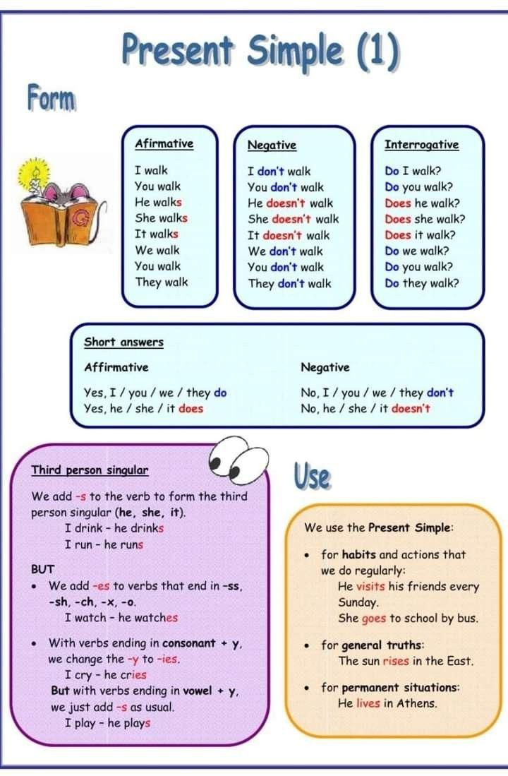


Slide 20
      FORMA AFIRMATIVA
      ¿Se le pone S/ES al verbo?
      She _si______
      We _no_______
      I __no______
      He _si______
      You _no______
      They _no_______
      It _si_______
    FORMA NEGATIVA
    ¿Se niega con don’t o doesn’t?
      She __doesn´t_____
      We _don´t_______
      I __don’t______
      He _doesn´t______
      You _don´t______
      They _don´t_______
      It _doesn´t_______

Slide 21
      FORMA AFIRMATIVA
      ¿Se le pone S/ES al verbo?
      Sandra and me__no_____
      Frank _si_______
      My dog and my cat__no____
      He and she __no_____
      Peter and Sussy _no______
      Sussy __si______
      the table__si______
    FORMA NEGATIVA
    ¿Se niega con don’t o doesn’t?
      My cat _doesn´t______
      John__doesn´t______
      I _don´t_______
      He and they __don’t_____
      Tinna _doen’t______
      Sonia and Mike __don’t____
      Your dogs _don´t_______

Slide 22
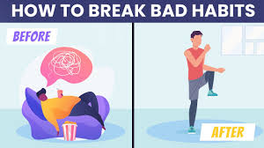
Change the sentences to healthy habits:
She doesn’t sleep enough hours.
___She sleeps enough hours_______________
They watch TV all day.
___They don´t watch TV all day____________
3. We don’t eat healthy food.
____We eat healthy food____________________
4. I eat hamburgers every day.
___I don’t eat hamburgers every day________
5. He doesn’t brush his teeth every day.
___He brushes his teeth every day__________

Slide 23

Change the sentences to healthy habits:
We eat too much pizza.
____We don’t eat too much pizza________
He never drinks water. Never =nunca
___He _drinks water__________________
She skips breakfast.
___She doesn´t skip breakfast__________
They play video games all night.
___They don’t play video games all night___

Slide 24
Create sentences with she, they, you healthy or unheathy

Slide 25
SHOULD and MUST
SHOULD
👉 Se usa para:
dar consejos
recomendaciones
sugerencias
📌 Meaning:
should = deberías
Examples:
You should drink water.
We should eat vegetables.
MUST
👉 Se usa para:
obligaciones
reglas
cosas muy importantes
📌 Meaning:
must = debes / tienes que
Examples:
You must do your homework.
Students must wear uniforms.

Slide 26
EASY RULES
SHOULD: DEBERÍA | MUST: DEBES
advice | obligation
recommendation | rule
optional | necessary

Slide 30
o
o

Slide 31
Objetivo 1
Objetivo 2
Objetivo 3

Slide 32


