Slide 1
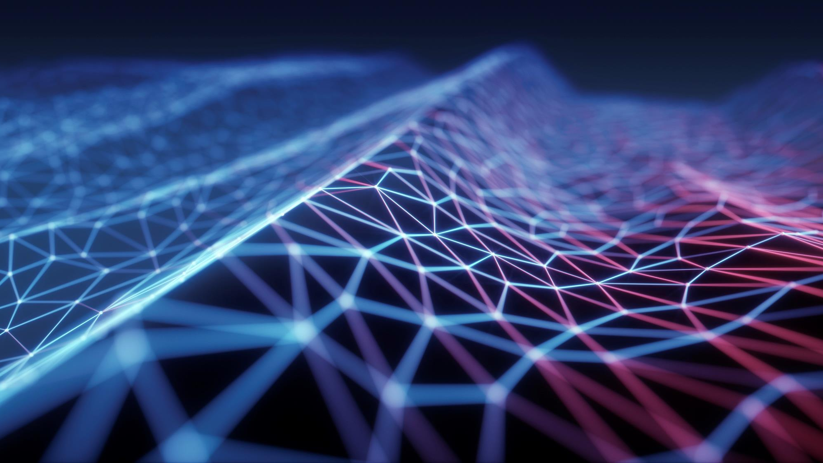
TECHNOLOGY AND ITS EFFECTS
UNIT 2

Slide 2

IN THIS UNIT YOU WILL:
read and listen to texts about the use of
ICT (Information and Communications
technology) and its effects.
express ideas and opinions, using words
and expressions related to technological
devices and advances.
neither/nor y either/or es fundamental para mejorar la capacidad de conectar ideas, comparar opciones y expresar negaciones de manera formal. Estos conectores se utilizan específicamente para relacionar dos personas, cosas o acciones

Slide 3

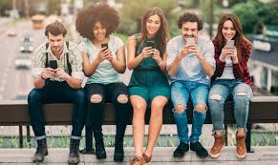
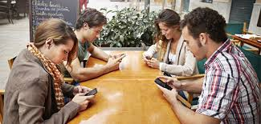
Do you think we are prisoners of technology? Why? Why not?
Yes, because people lives connected to technology
In which way is addiction to technology manifested?
People is addicted to social media, video games, gambling

Slide 4
POSIBLE ANSWERS
Yes, I think many people are prisoners of technology because they depend too much on their phones, social media, and the internet. Technology is useful, but excessive use can affect communication, sleep, and mental health. However, if people use technology responsibly and balance it with real-life activities, it can be very helpful instead of harmful.
Addiction to technology is manifested through excessive use of phones, computers, social media, or video games. People may spend too much time online, ignore their responsibilities, sleep less, and feel anxious or stressed when they cannot use technology.

Slide 5
In your opinion, which of the following statements are true? DISCUSS answers in your group.
__T__The use of the Internet and social networks can become an addiction.
__T___The Internet is taking the place of sports and games.
__F___Social networks may lead to antisocial behavior.
_T___Teens spend more time in cyberspace than in the real world.

Slide 6
ASK YOURSELF
a. Do you consider yourself an Internet addict? Why? Why not?
Jaime=yes
Axel=no
Emily=yes
Martina=no
Paz=yes
Vicente=no
b. What suggestion or advice can you offer Internet addict person?
Axel= spend less time in internet and replace it for other activities
Martina=Replace screen time with something that moves your body: dancing, walking, stretching.

Slide 7
The Effects of Technology
Technology has improved communication around the world. People have used the internet for decades, and many families have had smartphones since 2010.
However, technology also has negative effects. Some students have already become addicted to social media. Others haven’t slept well because they use their phones late at night.
Doctors have studied these problems for many years. They say teenagers should spend less time online and more time exercising.
Some people have never had problems with technology, but others have experienced stress and anxiety.

Slide 8
Multiple Choice
What is the main topic of the text?
Sports
Technology and its effects
Food habits
What problem do some students have?
They study too much
They are addicted to social media
They never use technology
What do doctors recommend?
Using phones all day
Sleeping less
Spending less time online

Slide 9
Answer the questions
How long have people used the internet?
👉 _people have used it for decades_______
Since when have many families had smartphones?
👉 _Since 2010__________________
What problems have some teenagers experienced?
👉 _addiction to social media and having trouble in sleeping__________________
Have all people had problems with technology?
👉 __not all people_________________

Slide 10
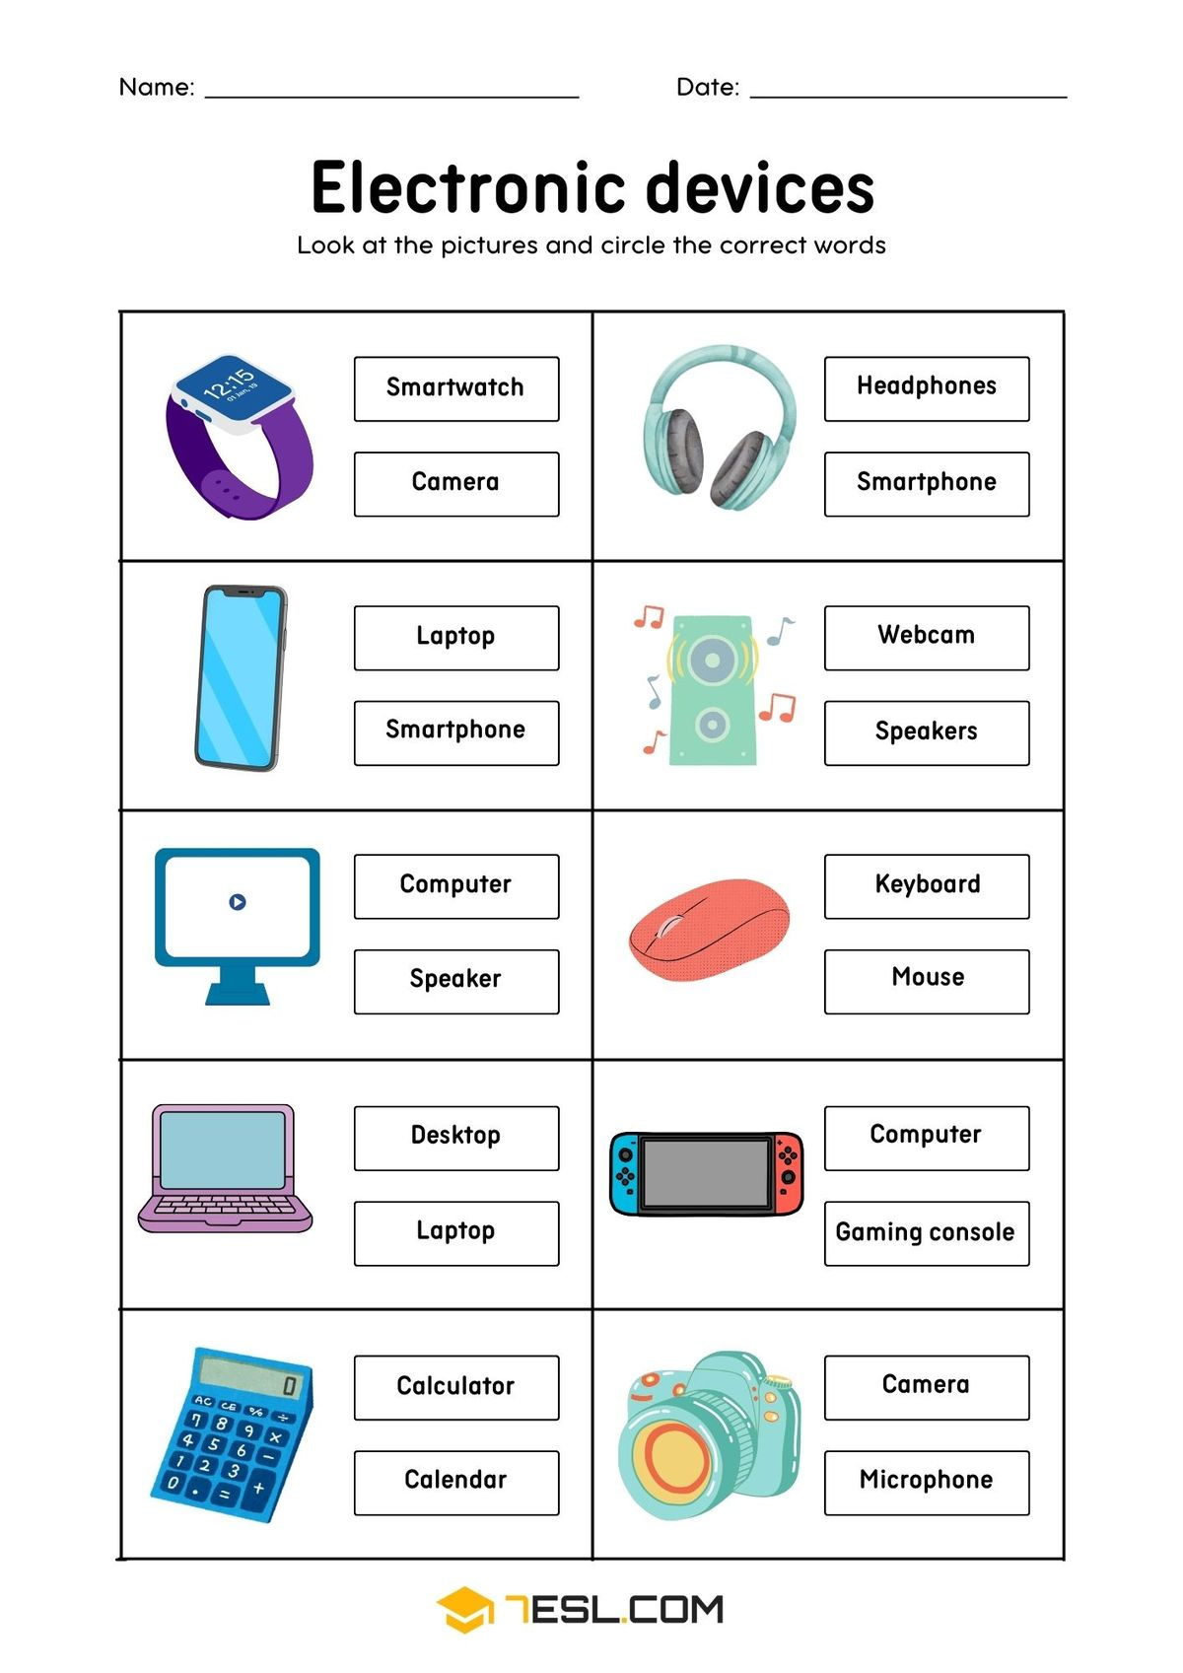

.

Slide 11
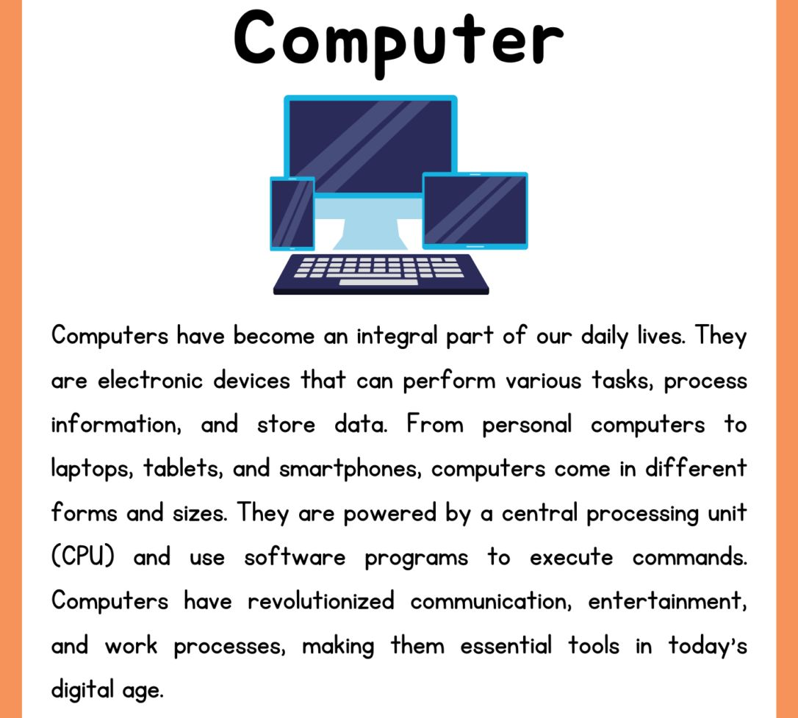
.

Slide 12
Multiple Choice
What is the main topic of the text?
Sports
Computers and their importance
Television programs
What can computers do?
Cook food
Process information and store data
Build houses
What powers a computer?
Internet connection
Battery only
CPU (Central Processing Unit)
Which devices are mentioned in the text?
Tablets and smartphones
Refrigerators and microwaves
Cameras and printers
Why are computers important today?
Because they are expensive
Because they revolutionized communication, entertainment, and work
Because they are small.

Slide 13
Vocabulary in Context: write the correct letter
1. Store _b_____ | a. Programs used by computers
2. Software__a____ | b. Keep information
3. Device_c_____ | c. Machine or electronic object
4. Process__d____ | d. Organize or handle information

Slide 14
PERSONAL QUESTIONS
Do you use computers every day? Why?
👉 __Martina: No, I only use it for my classes_________
What are the advantages of computers?
👉 __Axel: I can connect with others and take my classes___
Can computers have negative effects? Explain.
👉 __Facundo: yes, because they can be addicted, they can affect your sleep__

Slide 15
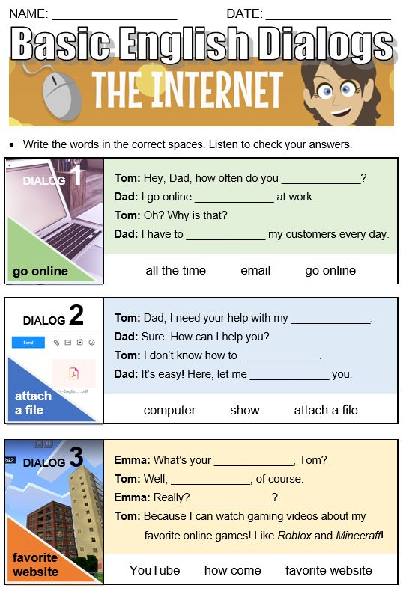
Go online
All time
email
computer
Attach a file
show
Favorite website
YouTube
How come

Slide 16
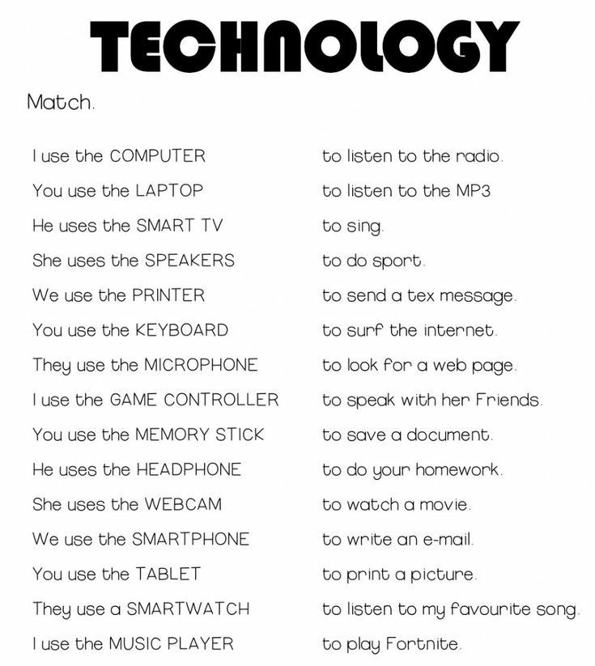
.

Slide 17
smartphone – laptop – webcam – speakers – memory stick – keyboard – Smart TV – printer
I use the __memory stick_______ to save important files.
She uses the __smart TV_________ to watch Netflix.
They use the __keyboard______ to type documents quickly.
We use the __laptop____________ to communicate in online classes.
He uses the __speakers________ to listen to loud music.
My father uses the ___webcam_______ to work from home.
I use the ___printer_________ to print my homework.
Teenagers use the _smartphone___ to send messages and use social media.

Slide 18
Use “to” + verb
Rewrite the Sentences
TO=PARA
Example:👉 I use my smartphone. I send text messages.
✅ I use my smartphone to send text messages.
She uses her laptop. She studies online. _She uses her laptop to study online
They use the speakers. They listen to music. _They use the speakers to listen to music
We use the webcam. We talk to our friends. We use the webcam to talk to our friends
He uses the keyboard. He writes emails. He uses the keyboard to write emails
I use the Smart TV. I watch movies. I use the smart TV to watch movies

Slide 19
Correct the Errors
She uses the printer to surf the internet. ❌
👉_She uses the printer to print documents_
They use the speakers to print documents. ❌
👉 __they use the speakers to listen to music___
I use the memory stick to watch movies. ❌
👉 _I use the memory stick to transfer photos_____
He uses the webcam to listen to music. ❌
👉 _He uses the webcam to make video calls____
We use the smartphone to print pictures. ❌
👉 _ We use the smartphone to take pictures____

Slide 20
Create two sentences about your uses with a device using “to”
I use my cell phone to talk by whatssapp
I use my headphones to listen to music
I use my computer to go to virtual classes
I use my guitar to play a song
I use my cell phone to watch videos on tik tok
I use my console to play with my friend
I use the phone to call my friends
I use the TV to watch movies
I use my tablet to take my notes//I use my smartwatch to exercise
I use my camera to take photos

Slide 21
MULTIPLE CHOICE
Which device is best for online classes?
Printer
Webcam
Speakers
Which device is used to save files?
Memory stick
Microphone
Smartwatch

Slide 22
MULTIPLE CHOICE
. Which device is mainly used to type?
Keyboard
Speaker
Headphones
Which device is commonly used to watch movies?
Smart TV
Printer
Memory stick

Slide 23
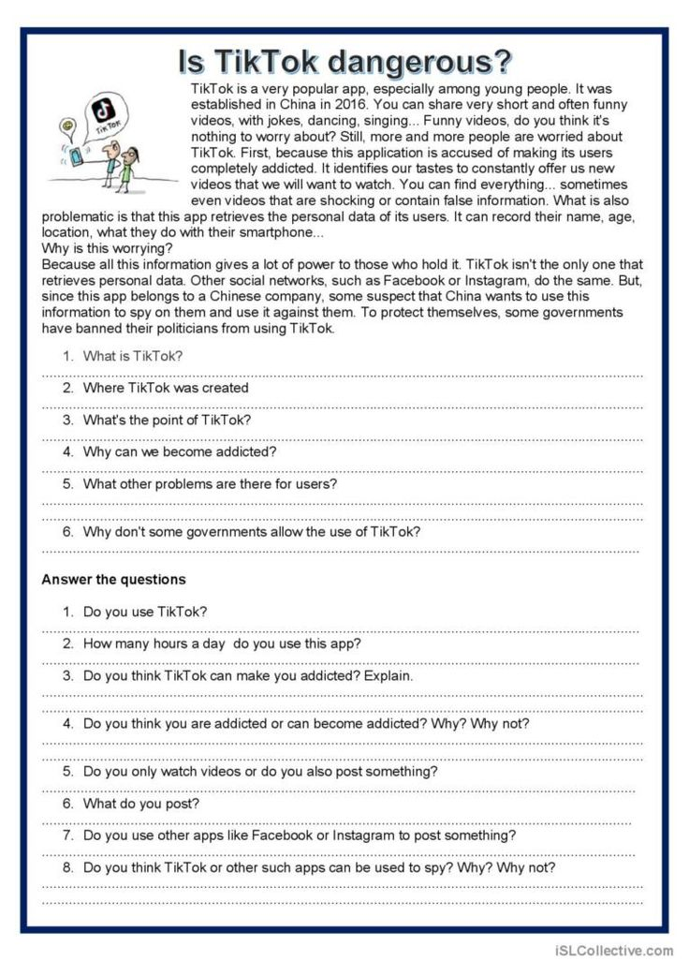
.

Slide 24
ANSWER THIS QUESTIONS IN YOUR NOTEBOOK
What is Tik Tok?
It’s a short video plataform
Where Tik Tok was created?
In China by a chinese Company in 2016
What’s the point of Tik Tok?
The point of tiktok is watching fun short videos on the app
Why can we become addicted?
Because the algorhythm identifies our tastes to constantly offer us new videos that we will want to watch. /The app identifies our tastes and constantly recommends new videos that the system knows we'll want to watch. This creates a cycle where the user becomes "completely addicted" to TikTok
What other problems are there for users?
other problems for users are that this app retrieves personal data of their users. Such as their name, age, location and what they do with their smartphone
.

Slide 25
ANSWER THIS QUESTIONS IN YOUR NOTEBOOK
How many hours a day do you use this app?
Do you think Tik Tok can make you addicted? Explain
No. I don't think tiktok can make me addicted, as I'm not very interested in the app
Do you only watch videos or do you also post sometihing?
I only watch videos, because when an app becomes super popular, it can also be super dangerous for making posts / i only watch videos i've never posted anything
What do you post?
animations make them by myself
Do you think Tik Tok or Facebook or Instagram can be used to spy? Why? Why not?
Yes, I think that facebook, instagram, and especially tiktok can be used to spy on people. They gather so much information from their users that you could do a whole map of how their lives are, which is specially helpful from spiying.
What do you think about the Tik Tok user?
I think they should stop using TikTok for 3 hours a day if they use it for 6 hours and do something productive like cleaning.
.

Slide 26
https://wordwall.net/es/resource/7472933/redes-sociales-e-internet https://wordwall.net/es/resource/6711778/redes-sociales

Slide 27
EITHER OR / NEITHER NO
EXPRESSION
EITHER OR
NEITHER NOR
MEANING IN SPANISH
O…O (cualquiera de los dos)
NI…NI (ni uno, ni lo otro)

Slide 28
EITHER OR / NEITHER NO
Easy Rule
Either...Or = one option or the other
EX: Either a laptop or a tablet. (o laptop o tablet)
Neither...Nor = not this and not that
EX: Neither Facebook nor Instagram. (ni facebook ni Instagram)

Slide 29
EITHER...OR
We use either...or cuando elegimos entre dos posibididades
.Structure
Either + option 1 + or + option 2 [o esto(a) o esto(a)]
Examples:
✅ You can use either a smartphone or a computer to access the internet.
✅ Students can either send an email or a text message.
✅ We can either use Zoom or Google Meet for online classes.

Slide 30
NEITHER...NOR
. We use neither...nor Cuando ambas opciones son negativas
Structure
Neither + option 1 + nor + option 2 [ni opción 1 ni opción 2]
Examples:
✅ I like neither coffee nor tea.
✅ Neither Tom nor Sarah is at school today.
✅ She speaks neither English nor French.

