Slide 1
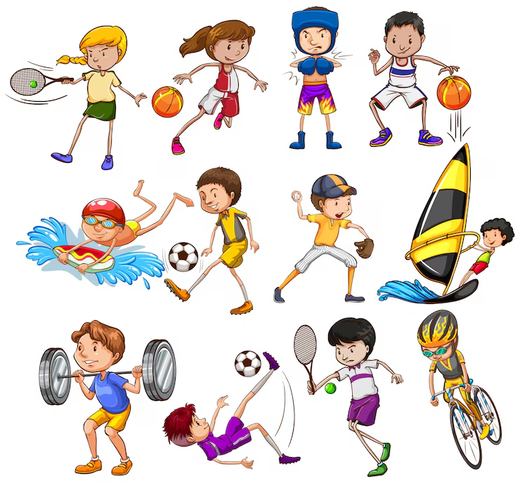

Slide 2
WHAT SPORT DO YOU LIKE?
UNIT 3

Slide 3
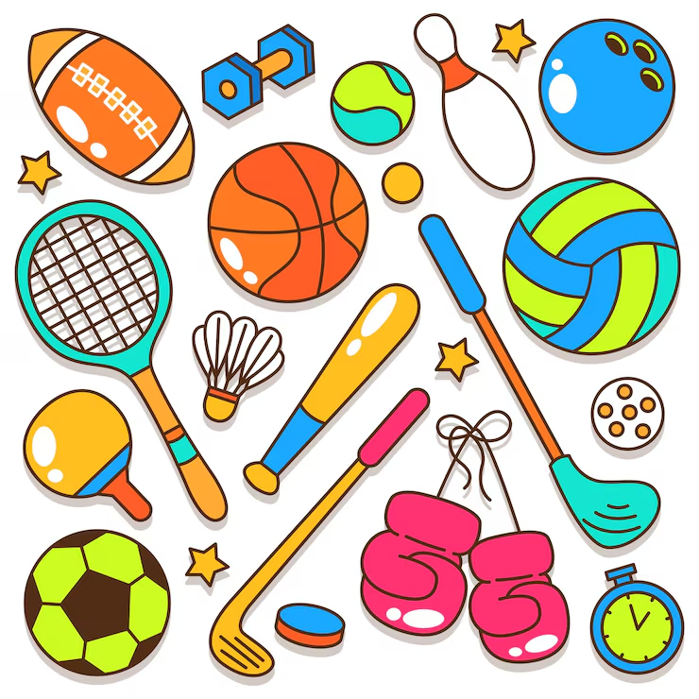
OBJETIVOS
Deportes: Football (soccer), basketball, tennis, swimming, running, volleyball, cycling.
Verbos de acción: Play, do, go, like, dislike.
Estructuras gramaticales:
  Preguntas: What sport do you like?
  ¿Qué deporte te gusta?
  Respuestas: I like... / I don't like...
  Me gusta… / No me gusta

Slide 4
VOCABULARY
Football/soccer: fútbol
Basketball: baloncesto
Tennis: tenis
Swimming: natación
Running: salir a correr
Volleyball: voleybol
Cycling: ciclismo
Play: jugar
Do: hacer
Go: ir
Like: gustar
Dislike: disgutar = don’t like

Slide 5
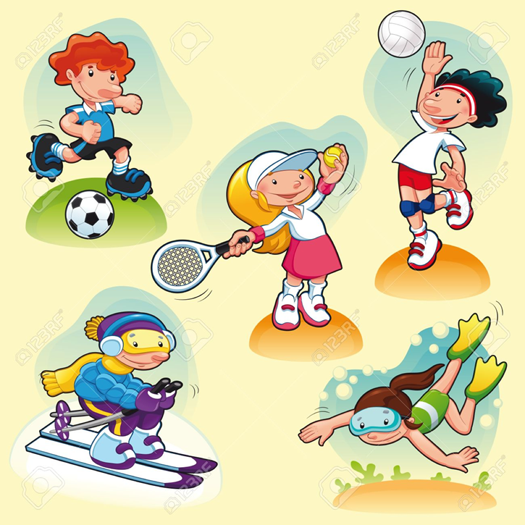
I like… / I don’t like
I _like___ football. (👍)
I _don’t like__ tennis. (👎)
I _like_ swimming. (👍)
I __don’t like_ basketball. (👎)
I _like___ running. (👍)

Slide 6

Put in order the sentences
1. like / I / volleyball / .
__I like volleyball__________________
2. cycling / don't / I / like / .
_I don’t like cycling__________________
3. like / tennis / I / don't / .
__I don’t like tennis__________________
4. swimming / like / I / .
__I like swimming _____________________

Slide 7
Chosse the correct answer
VOCABULARY
RACKET: RAQUETA
SWIMMING POOL: PISCINA
KICK: PATEAR
You play this sport with a racket.
a) football
b) tennis
c) Swimming
2. You need a bicycle.
a) cycling
b) basketball
c) Volleyball
3. You play this sport in a swimming pool.
a) baseball
b) swimming
c) Football
You usually kick the ball.
a) football
b) tennis
c) volleyball

Slide 8
Create sentences with sports
ALUMNO 1
ALUMNO 2
ALUMNA 3

Slide 9
Create sentences with sports
ALUMNO 4
ALUMNO 5
ALUMNA 6

Slide 10
Speaking
What's your favorite sport?
👉 My favorite sport is __________.
Do you play soccer?
👉 Yes, I do. / No, I don't.
Can you swim?
👉 Yes, I can. / No, I can't.
How often do you play sports?
👉 I play sports every _________

