Slide 1
ACTION VERBS
UNIT 2

Slide 2
LINK CANCIÓN DE SALUDO
https://www.google.com/search?q=canciones+inglesas+para+ni%C3%B1os+saludos+en+ingl%C3%A9s+letra&rlz=1C1AVFB_enCL895CL895&oq=canciones+inglesas+para+ni%C3%B1o&aqs=chrome.0.0i512j69i57j0i512j0i22i30l7.11958j0j15&sourceid=chrome&ie=UTF-8#fpstate=ive&vld=cid:f00acd33,vid:gghDRJVxFxU,st:0

Slide 3
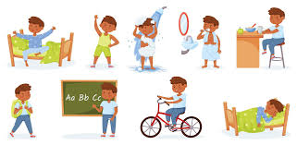
EVERYDAY = TODOS LOS DÍAS

Slide 4
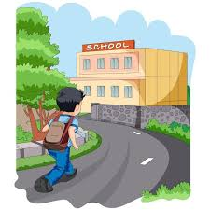
I GO TO SCHOOL = YO VOY AL COLEGIO

Slide 5
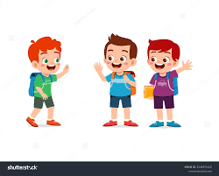
I MEET MY FRIENDS = YO ME ENCUENTRO CON MIS AMIGOS

Slide 6
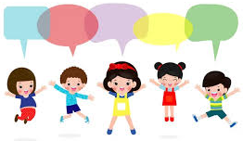
WE ALL SAY…=TODOS NOSOTROS DECIMOS…

Slide 7
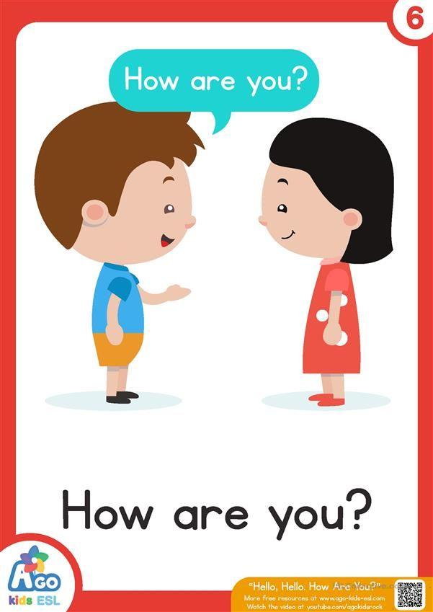

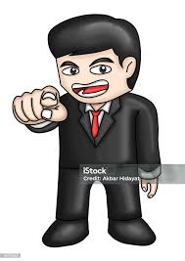
HOW ARE YOU? = ¿CÓMO ESTÁS TÚ?
I’M GOOD, I’M GREAT =
ESTOY BIEN, ESTOY GENIAL
HOW ABOUT YOU? = ¿Y TÚ?

Slide 8
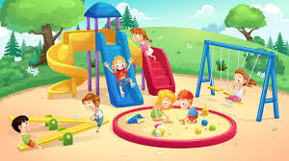
I GO AND PLAY = YO VOY Y JUEGO

Slide 9
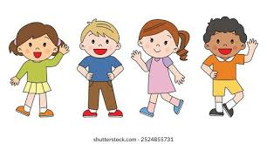
WHAT’S YOUR NAME? = ¿CUÁL ES TU NOMBRE?
NICE TO MEET YOU = GUSTO EN CONOCERTE
DO YOU WANT TO PLAY? = ¿QUIERES JUGAR?

Slide 10
LINK CANCIÓN
https://www.youtube.com/watch?v=9T6EFEpP9mc&list=RD8_Fr6EwRJsw&index=2
Cuento:
https://www.youtube.com/watch?v=8irSFvoyLHQ&list=PLN8DQHdZDXwbd4DXeOgiwHC2wP3mzXKs0
(en curso)

Slide 11
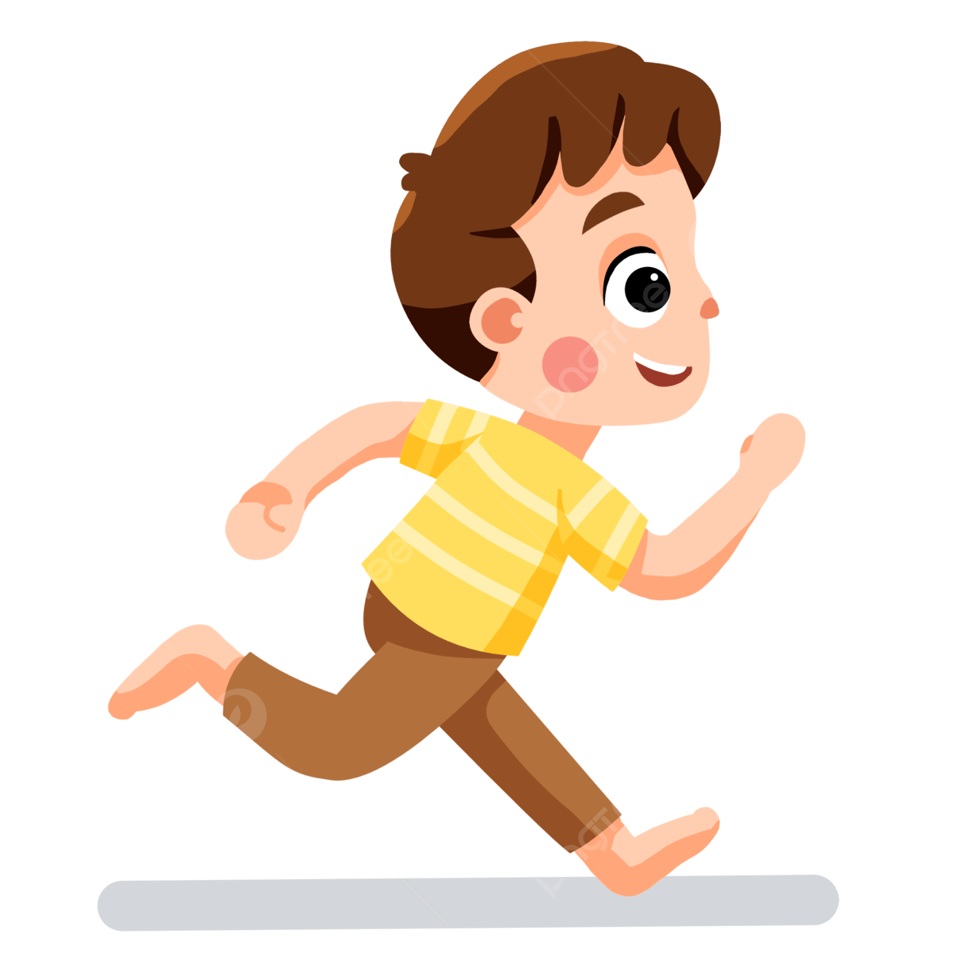
Run

Slide 12

Sleep

Slide 13
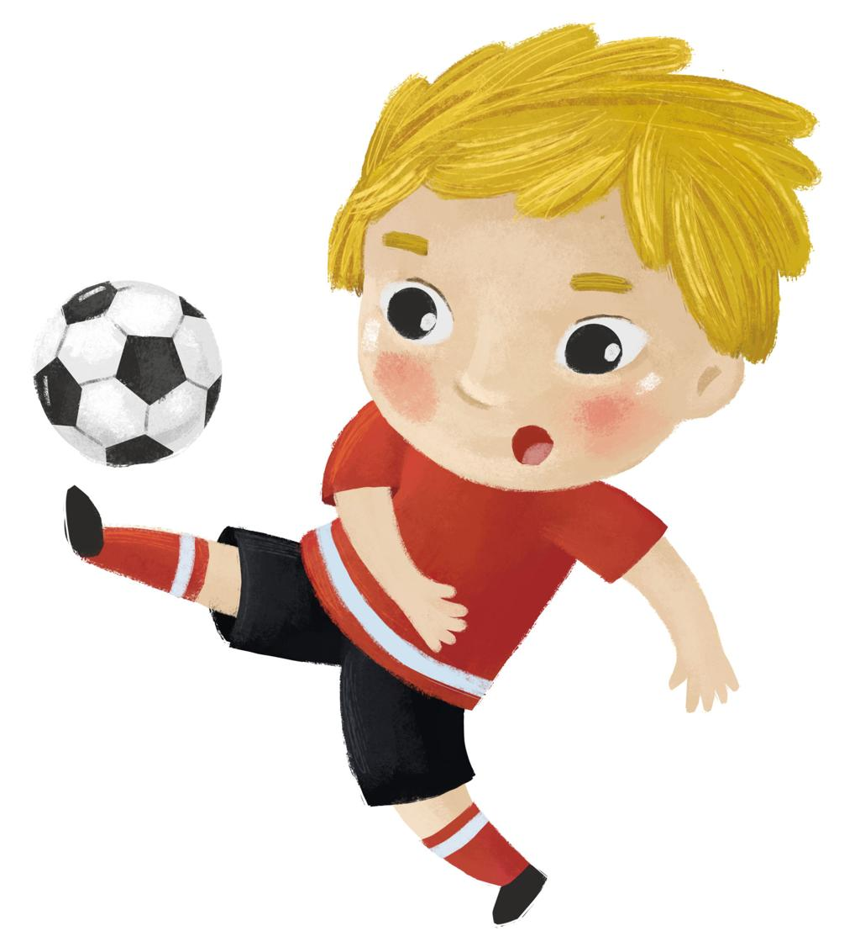
Kick

Slide 14
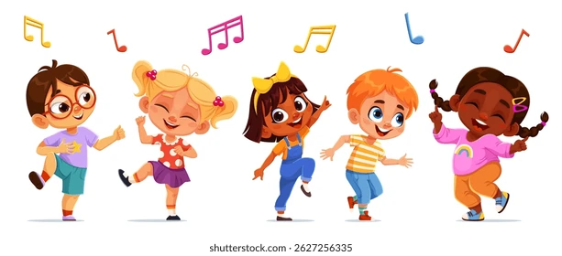
Dance

Slide 15
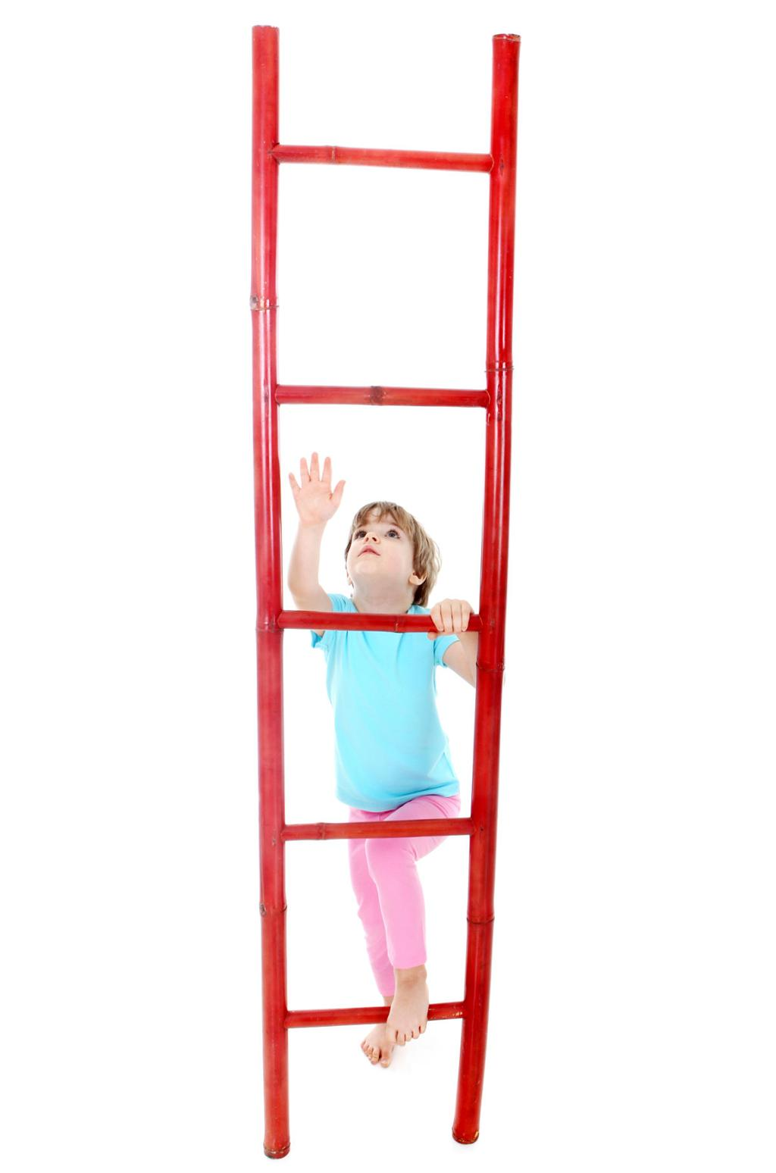
Climb

Slide 16
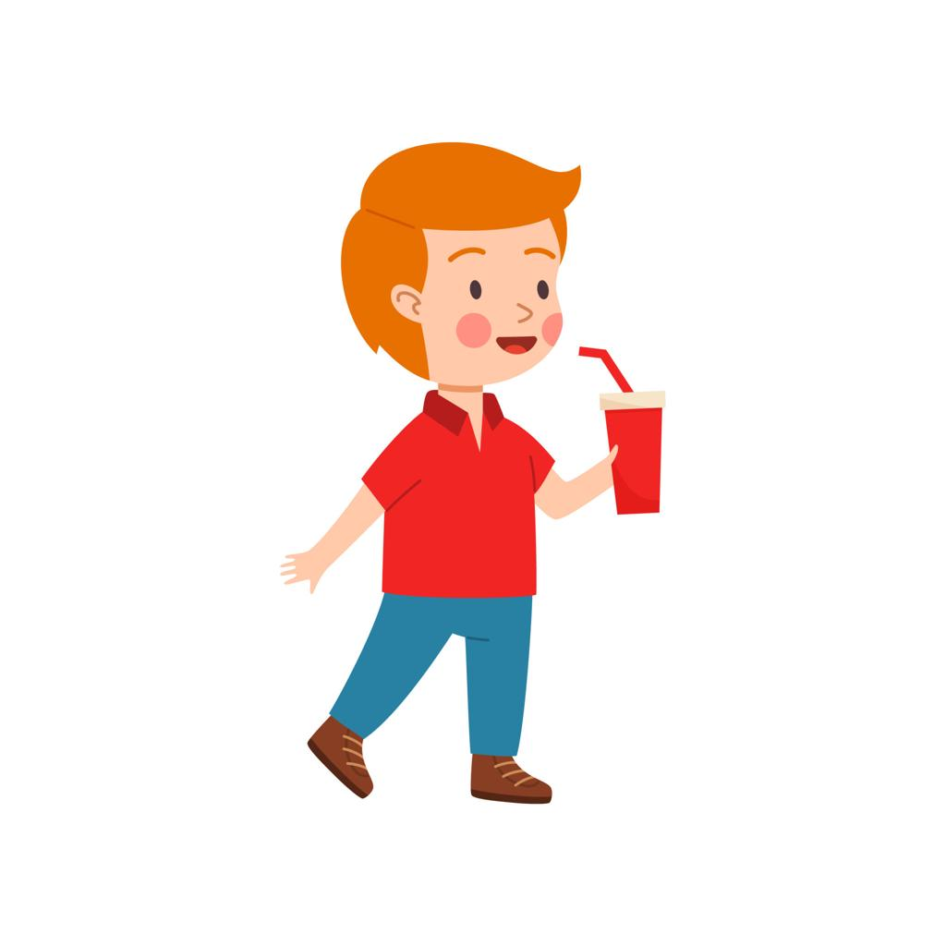
Drink

Slide 17
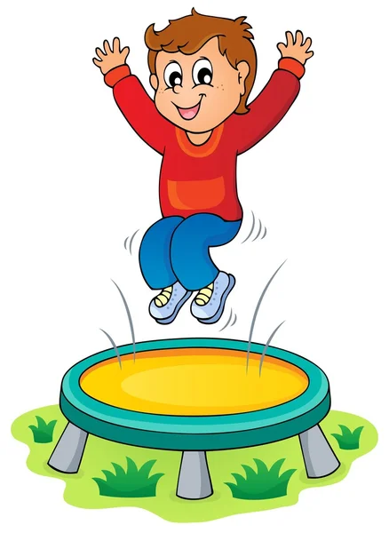
Jump

Slide 18
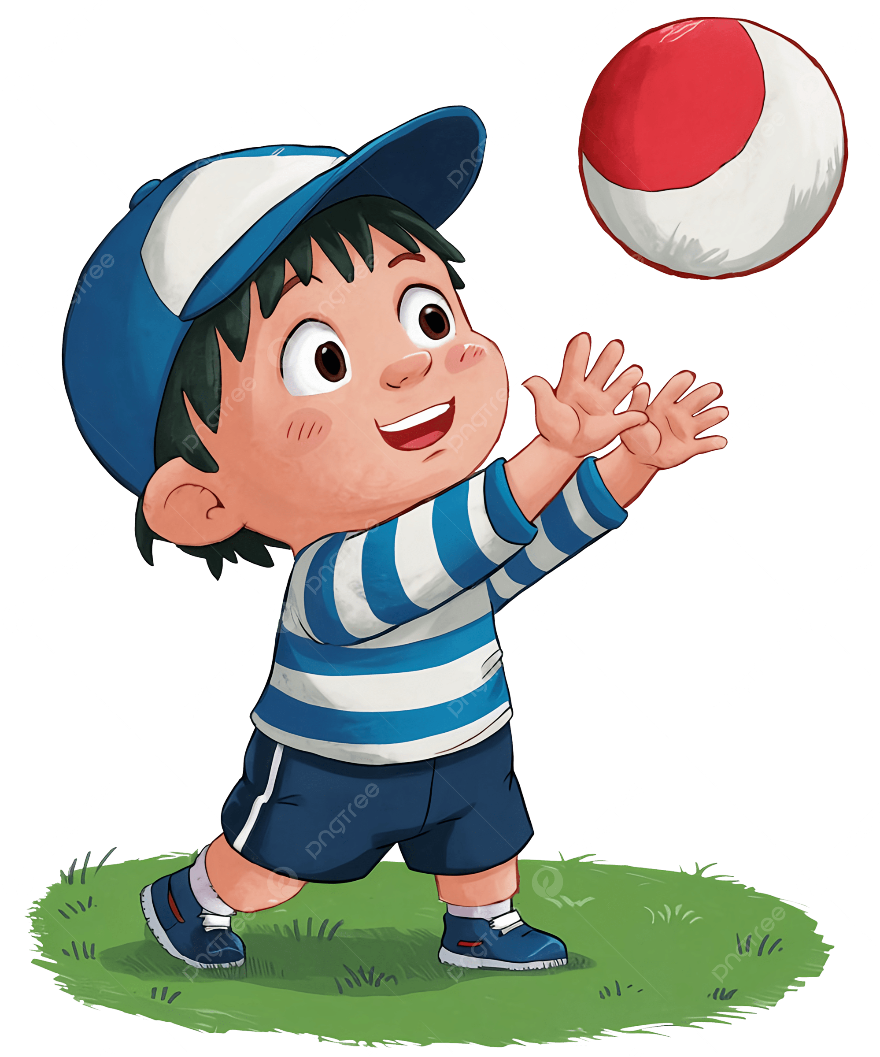
Catch

Slide 19
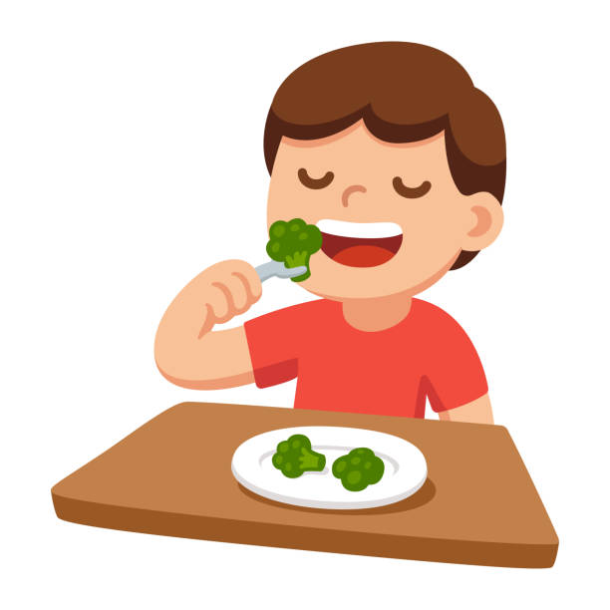
Eat

Slide 20


READ

Slide 21
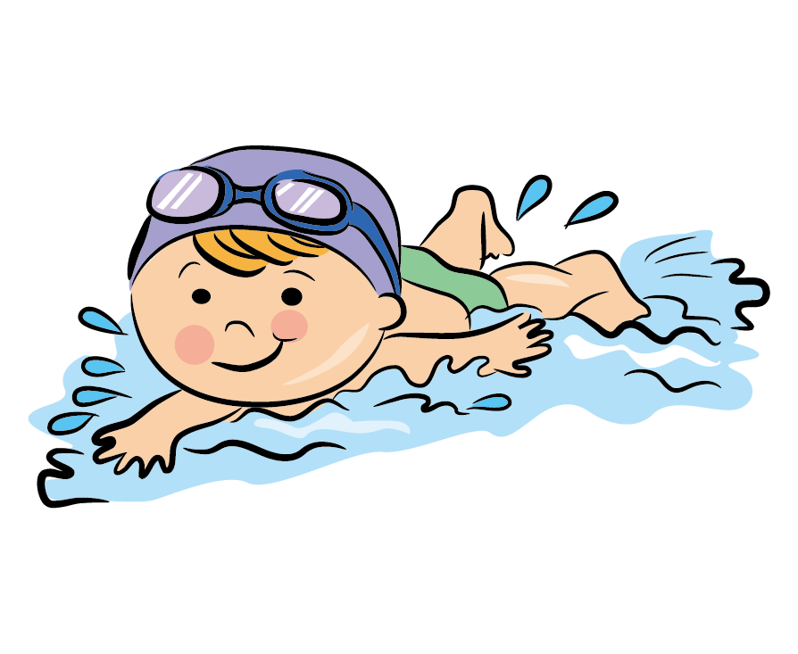
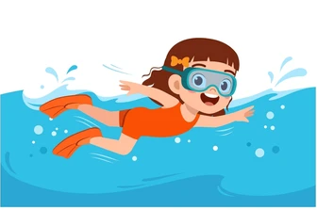
SWIM

Slide 22
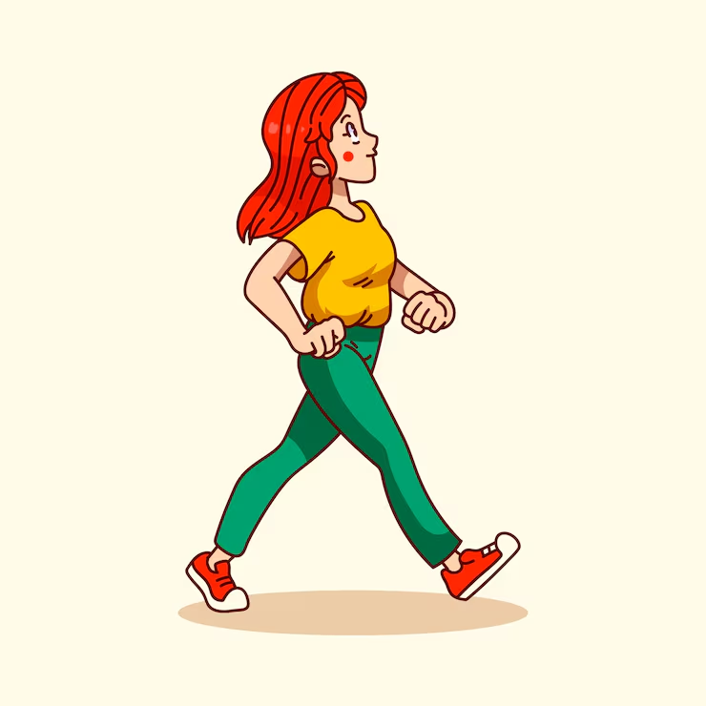
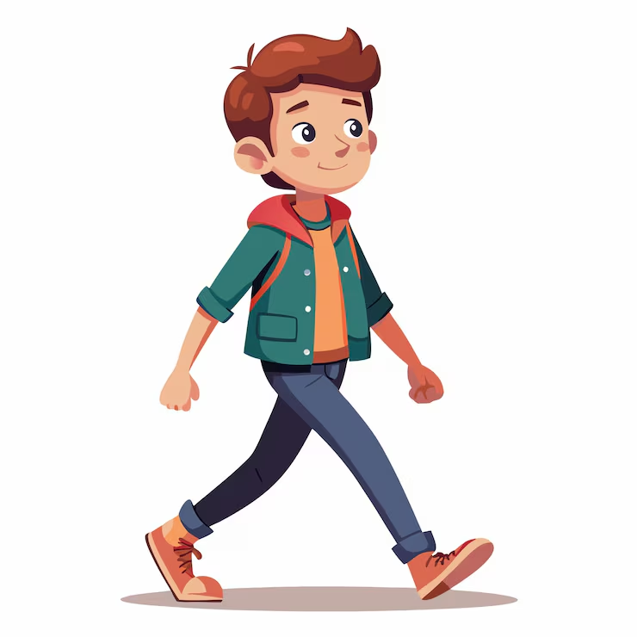
WALK

Slide 23
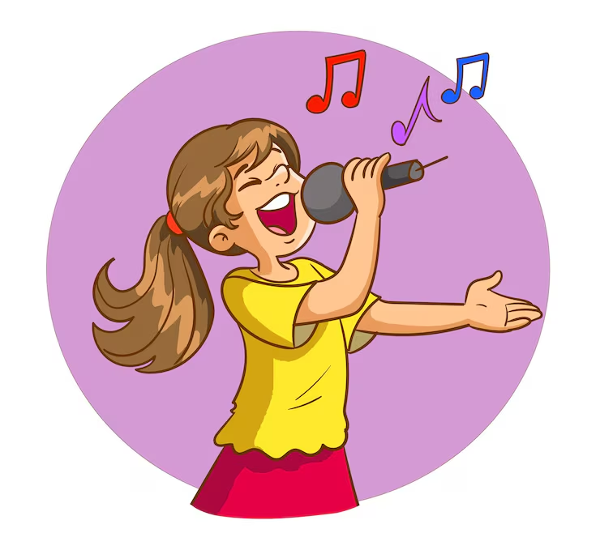
SING

Slide 24

FLY

Slide 25
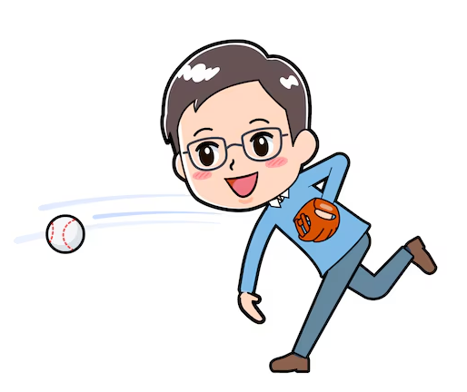
THROW

Slide 26
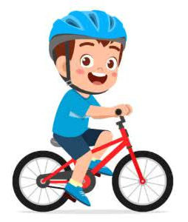
RIDE A BIKE

Slide 27
*CHOOSE TRUE OR FALSE*
1. Fish can dance.
True / False
2. Birds can read.
True / False
3. Sandra can eat pizza.
True / False
4. Monkeys can climb.
True / False
5. Airplanes can fly.
True/ False
6. Tomas can drink water.
True / False
7. Dogs can ride a bike
True / False

Slide 28



My favorite actions: Miss Mari
I can _swim___________________________.
My favorite action is __eat________________.
I can't __sing_________________________.

Slide 29
My favorite actions: Samanta
I can __sing__________________________.
My favorite action is __swim________________.
I can't _fly__________________________.

Slide 30
My favorite actions: Noah
I can _jump___________________________.
My favorite action is _sing________________.
I can't __fly_________________________.

Slide 31
My favorite actions: Matheo
I can ___swim_________________________.
My favorite action is ___climb_______________.
I can't __fly_________________________.

Slide 32
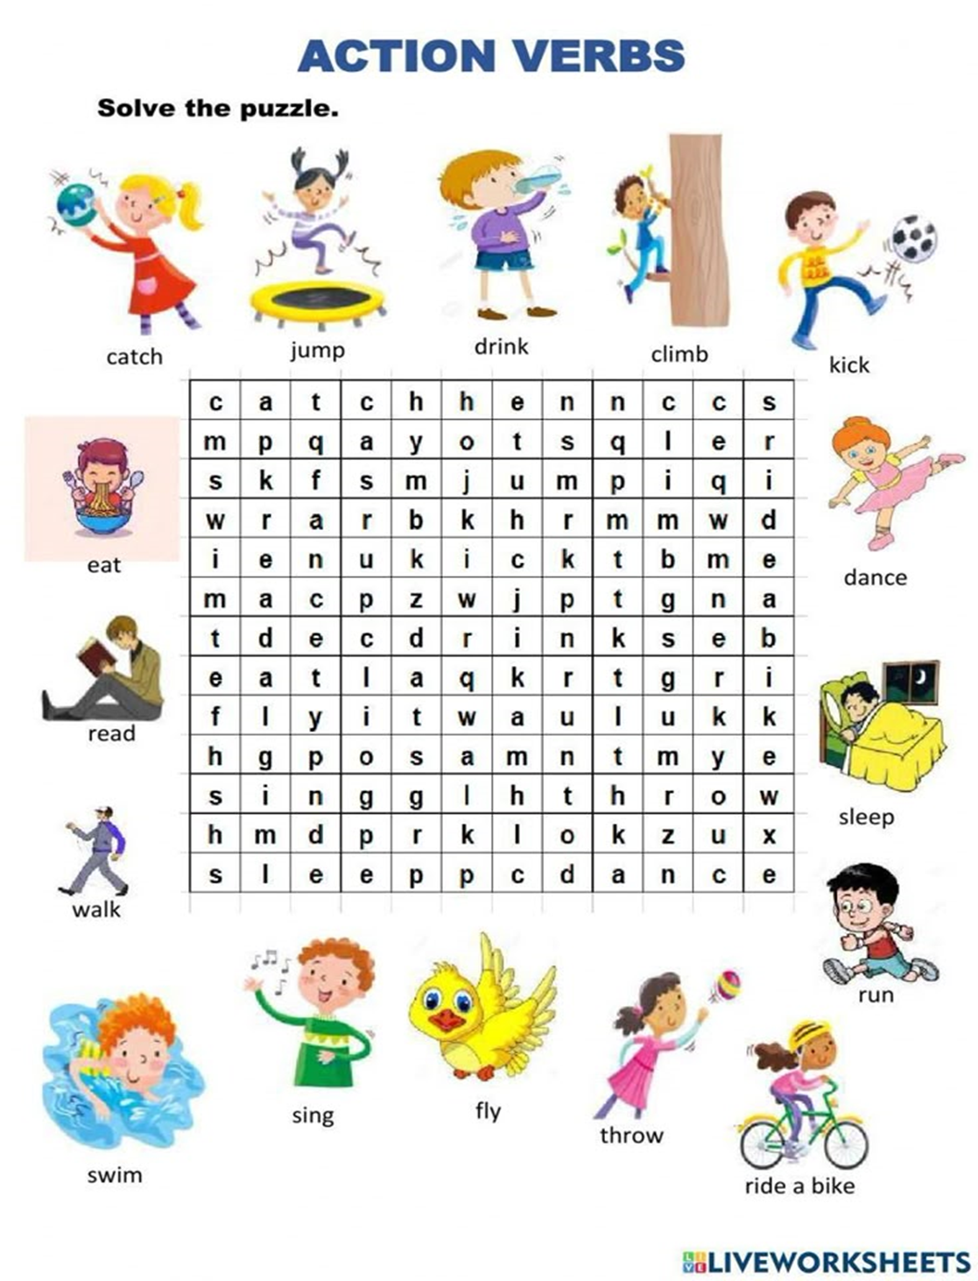


Slide 33
Escribe el verbo correcto (sing, fly o throw) en cada espacio en blanco.
Birds can __fly__________ in the sky.
I can ___sing_______ a beautiful song.
The boy can___throw____ the ball
Vocabulary
Birds= aves, pájaros
Sky= cielo
Beautiful Song= hermosa canción
Ball= pelota

Slide 34
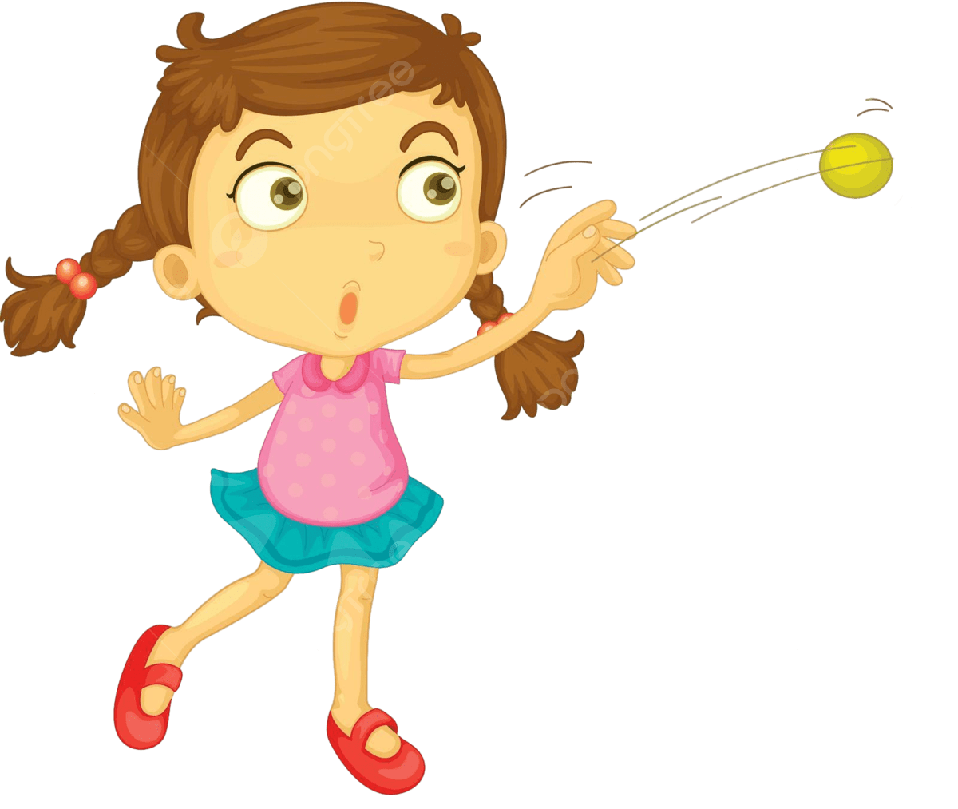
Escribe V o F
A fish can fly. | ___F_______
A superhero can throw a car. | __V________
A dog can sing like a pop star. | __F_____

Slide 35
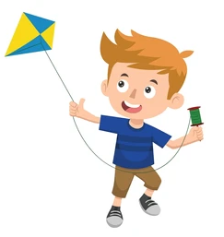
Esta es la historia de Tom, complétala con las palabras celestes:
VOCABULARY
KITE = VOLANTÍN
LIKE = GUSTAR
sing – fly – throw
Tom has a kite.
The kite can __fly________.
Tom likes music.
He can _sing_________.
Then he plays with a ball.
He can _throw____ the ball.

Slide 36
Complete with the correct verb
Word Bank: read – walk – swim
I _read_____ a book.
Fish can _swim_.
I _walk__ to school.
Dolphins can _swim__.
She _reads__ a story.
VOCABULARY
FISH = PEZ
DOLPHINS = DELFINES
SHE = ELLA

Slide 37
Unscramble the words
DAER → _READ____
KLAW → _WALK_____
MSWI → _SWIM_____

Slide 38
True or False
Fish can read. ___F_______
I can read a book. _T_________
Birds can swim. __F________
Penguins can swim. _T_________
DEVOLVERNOS A LA HOJA DE VERBOS A ENCERRAR LOS QUE HEMOS VISTO
VOCABULARY
BIRDS= PÁJAROS
PENGUINS = PINGÜINOS

Slide 39
Complete with can / can’t
I _can__ run fast. 🏃 yo puedo correr rápido
I _can’t__ sleep in class. 😴 yo no puedo dormir en clases
I _can___ dance very well. 💃yo puedo bailar muy bien
Babies _can’t_ dance. Los bebes no pueden bailar
I _can_ run in the park. Yo puedo correr en el parque

Slide 40



MEMORY GAME

Slide 41

HE CAN KICK VERDADERO

Slide 42

HE CAN´T DRINK FALSO

Slide 43
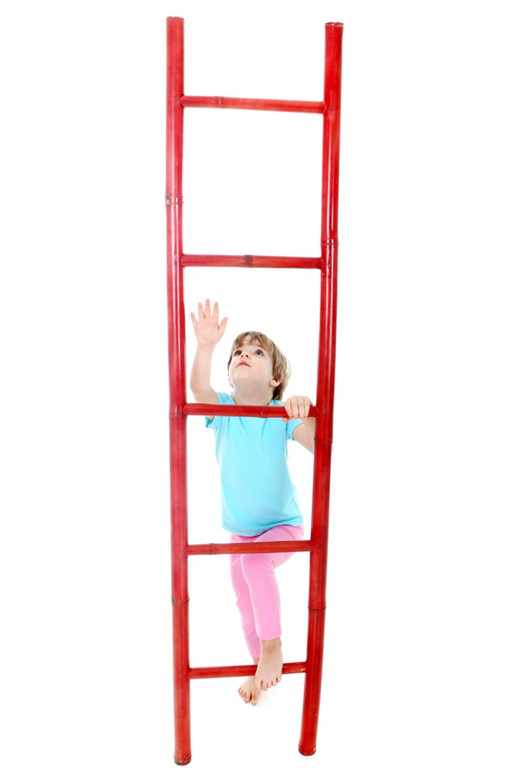
HE CAN’T CLIMB FALSO

Slide 44
Write the correct letter
Kick → _b____
Climb → __c___
Drink → __a___
a) tomar
b) patear
c) escalar

Slide 45
Complete
I can _kick_ the ball.
(kick / drink)
I can _drink__ water.
(climb / drink)
I can _climb_ a tree.
(kick / climb)

Slide 46
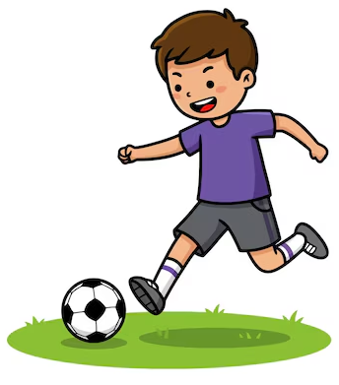
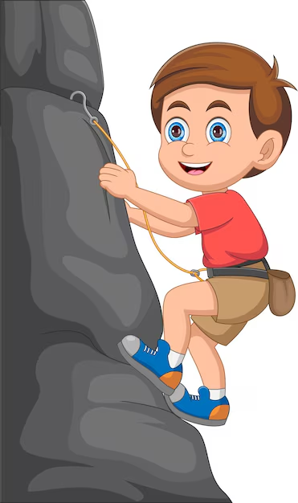
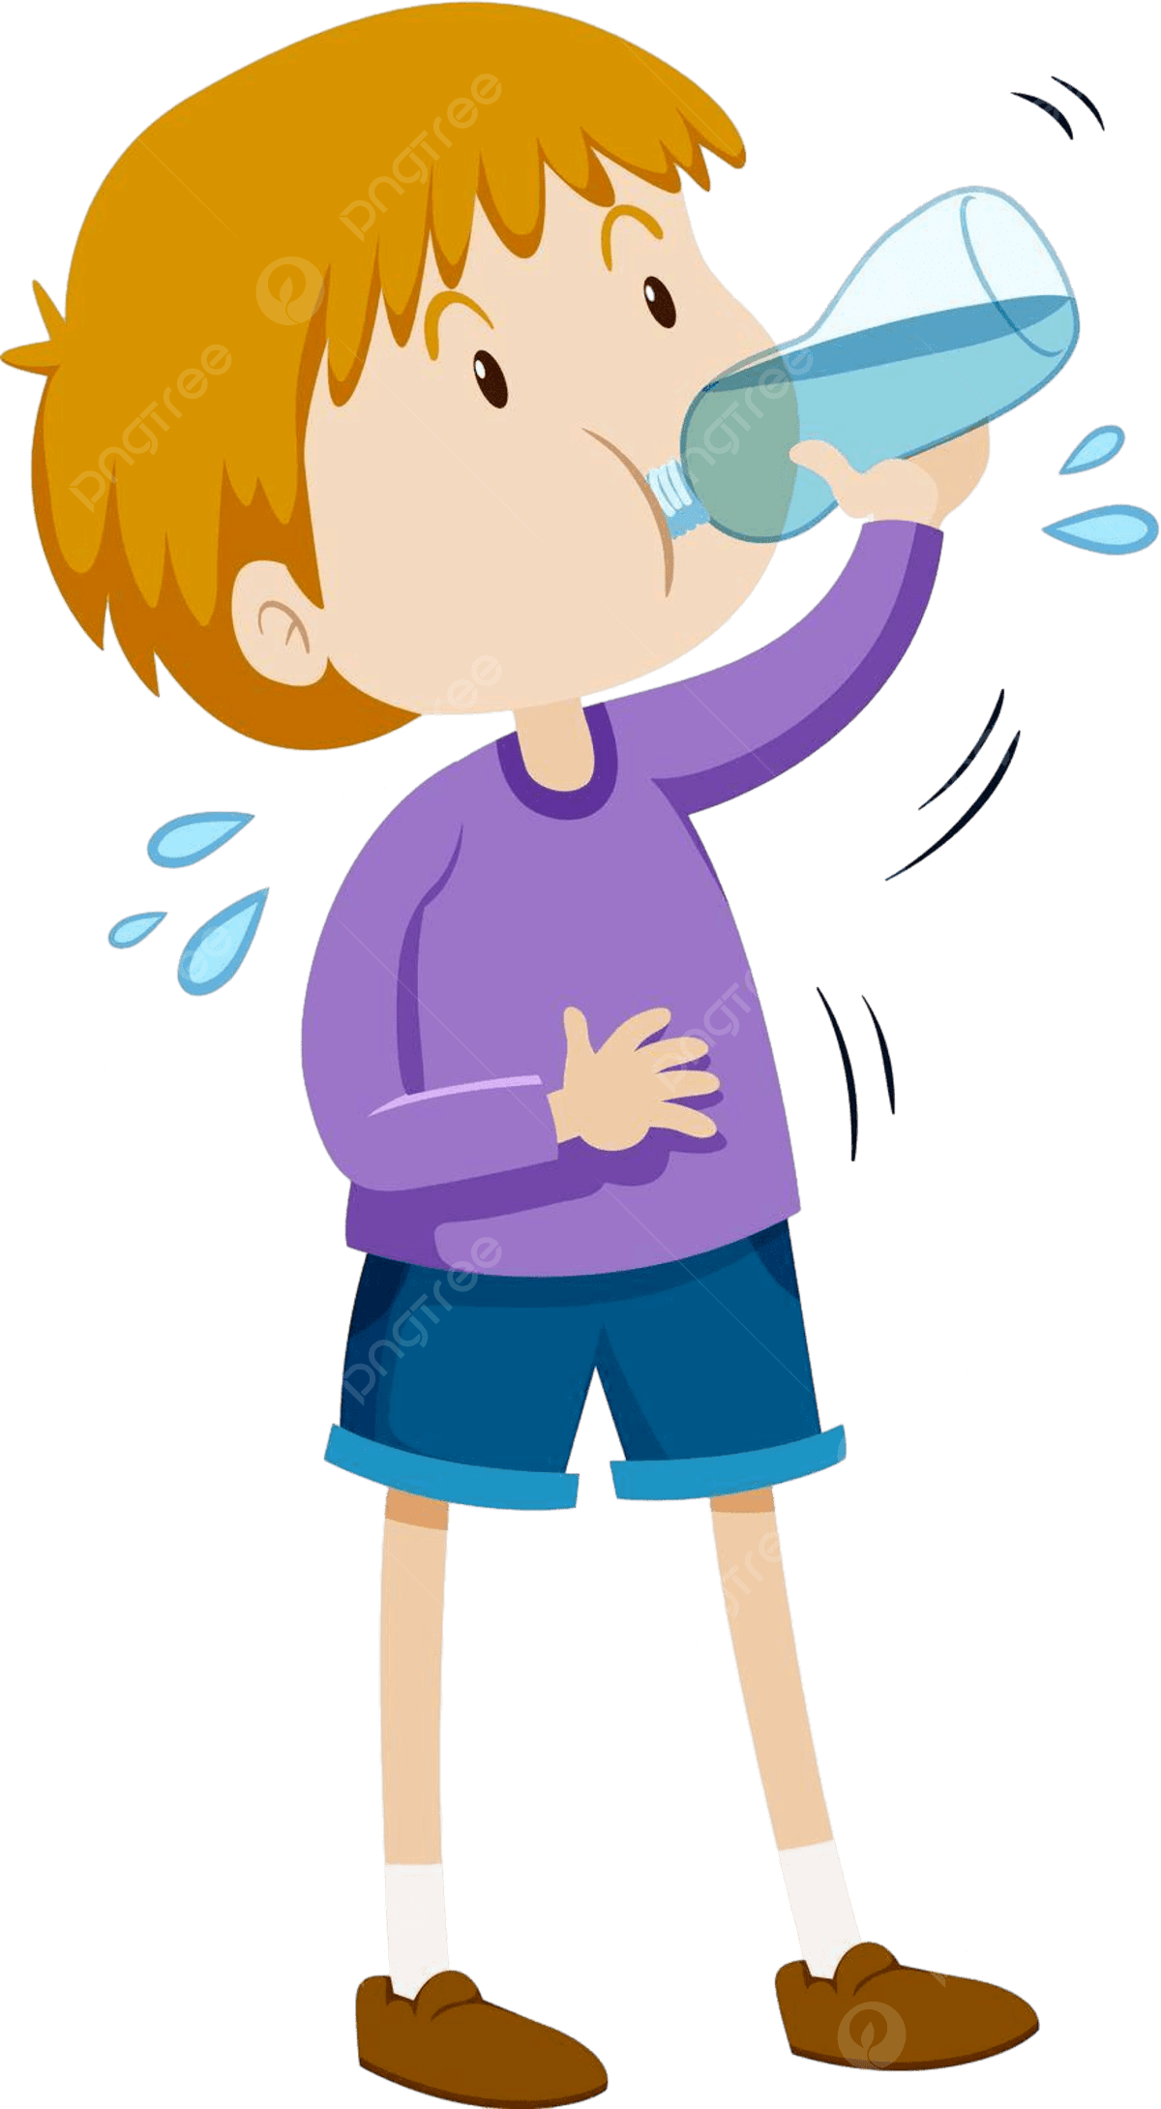
Paint red the correct verb:
a)
Kick / Drink / Climb
b)
Drink / Kick / Climb
c)
Climb / Drink / Kick

Slide 47
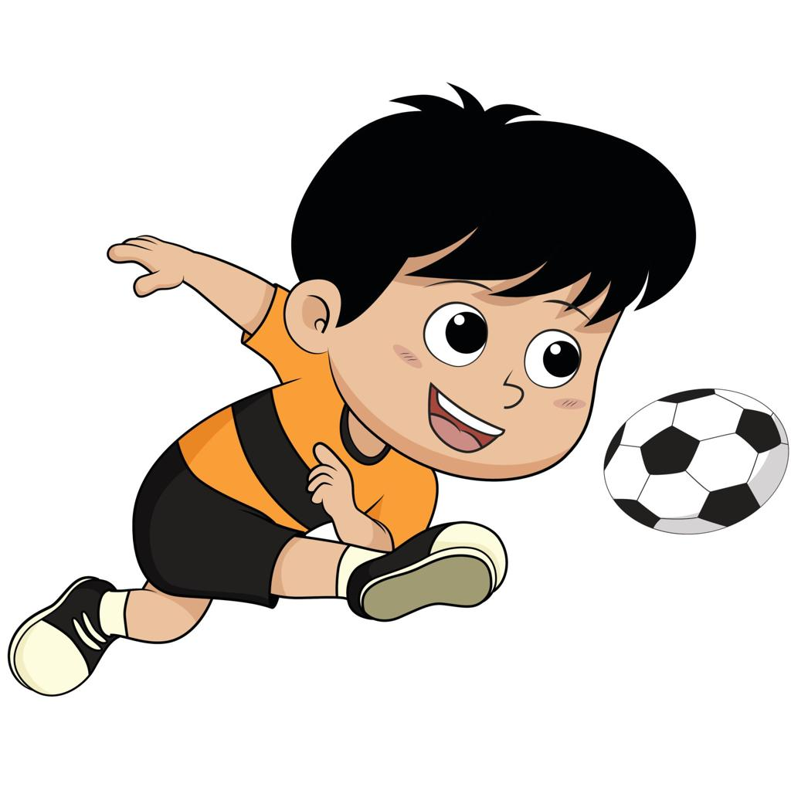
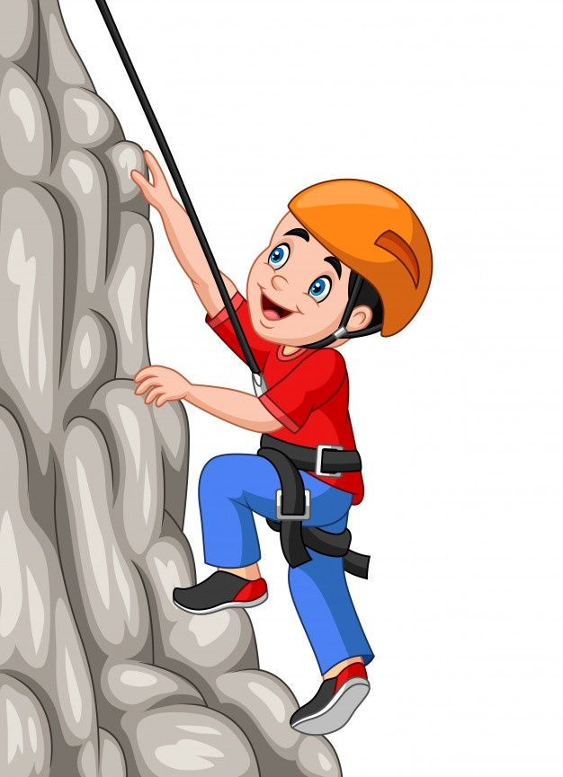
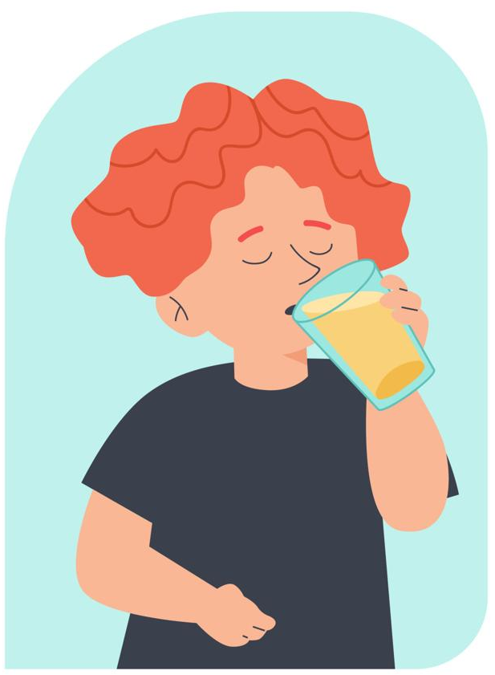
1
3
2

Slide 48
ESCRIBE EL VERBO CORRECTO
I can _jump_ high.(jump / eat) yo puedo saltar alto
I can _catch__ a ball.(catch / jump) yo puedo atrapar una pelota
I can _eat_ pizza.(eat / catch) yo puedo comer pizza

Slide 49

Lee el texto de la nube y responde:
Tom can eat pizza, He can jump.
But he can’t catch a ball.
Preguntas
Can Tom jump?
Can Tom catch a ball?
What can Tom eat?
Vocabulary:
What = Qué
Yes, he can
No, he can’t
He can eat pizza

Slide 50
Elige la alternativa correcta
I can ______ water.
Climb
Drink
kick
I can ______ a sandwich.
Eat
Jump
Catch
I can ______ at night.
Sleep
Dance
Run
I can ______ a tree.
Drink
climb
eat
I can ______ at the party
Climb
Dance
kick

Slide 51
AQUÍ HAY ORACIONES MALAS, ¡CORRIGELAS!
I can eat a tree.
__I can climb a tree___________________
I can sleep water.
_I can drink water_____________________
I can climb an apple.
_I can eat an apple_____________________
I can drink ballet.
_I can dance ballet.___________________________

Slide 52


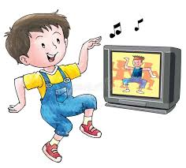
SIMON SAYS…
Para empezar todos tienen que prender sus cámara =
La profesora va a decir: Simon says y una acción o verbo de todos los aprendidos hasta el momento (9)
Y tú debes hacer una mímica de la acción
Ej: Simon says DANCE
Y tu debes bailar en la pantalla

Slide 54
Agregar un título de diapositiva (4)

