Slide 1
LINK CANCIÓN
https://www.youtube.com/watch?v=9T6EFEpP9mc&list=RD8_Fr6EwRJsw&index=2
Cuento:
https://www.youtube.com/watch?v=8irSFvoyLHQ&list=PLN8DQHdZDXwbd4DXeOgiwHC2wP3mzXKs0
(en curso)

Slide 2
I WANT TO BE
UNIT 3

Slide 3
CONTENIDOS
Las ocupaciones. Descripción de ropa, acciones cotidianas y uso de pronombres. Preguntas sobre actividades, personas y lugares. Números hasta el 20.
.

Slide 4
PROFESSIONS

Slide 5
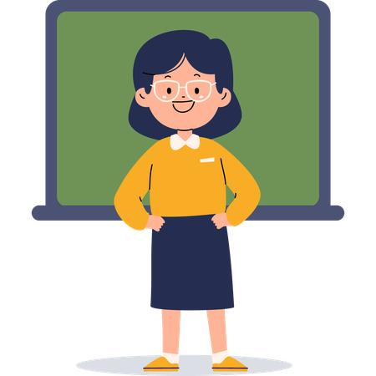

Who is he?
He is a doctor
Who is she?
She is a teacher

Slide 6

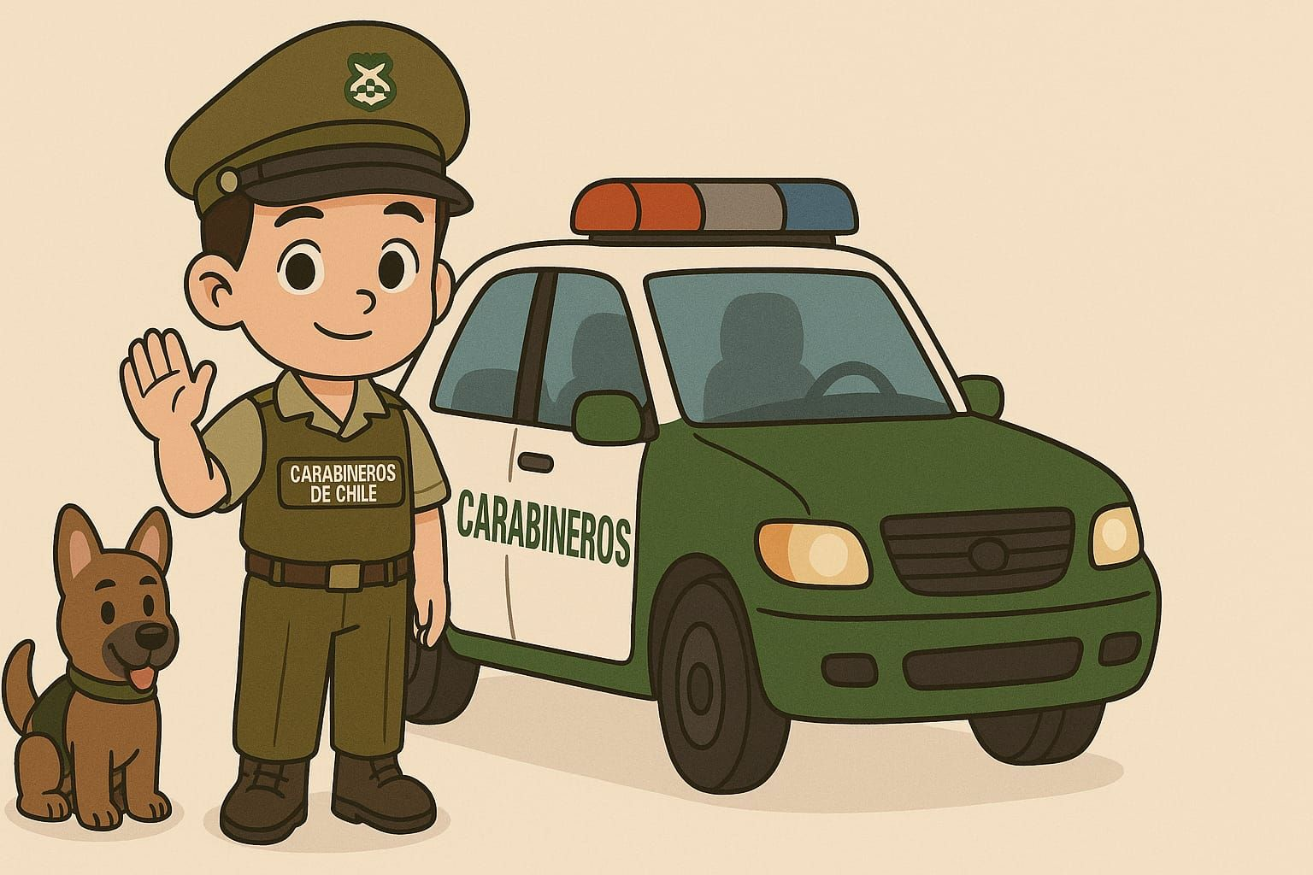
Who is he?
He is a police officer
Who is she?
She is a cook / she is a chef

Slide 7

Who is she?
She is a farmer

Slide 8



Who is missing?
The __farmer_______ and the _doctor_____ are missing

