Slide 1
LINK CANCIÓN
https://www.youtube.com/watch?v=9T6EFEpP9mc&list=RD8_Fr6EwRJsw&index=2
https://www.youtube.com/watch?v=WfLBN0FVYNM&list=RDWfLBN0FVYNM&start_radio=1
Cuento:
https://www.youtube.com/watch?v=8irSFvoyLHQ&list=PLN8DQHdZDXwbd4DXeOgiwHC2wP3mzXKs0
(en curso)

Slide 2
CANCIÓN
Bedroom: Dormitorio
Bathroom: Baño
Living room: Sala o living
Kitchen: cocina
Garden: jardín
Garage: garage o estacionamiento
This is my house: Esta es mi casa

Slide 3
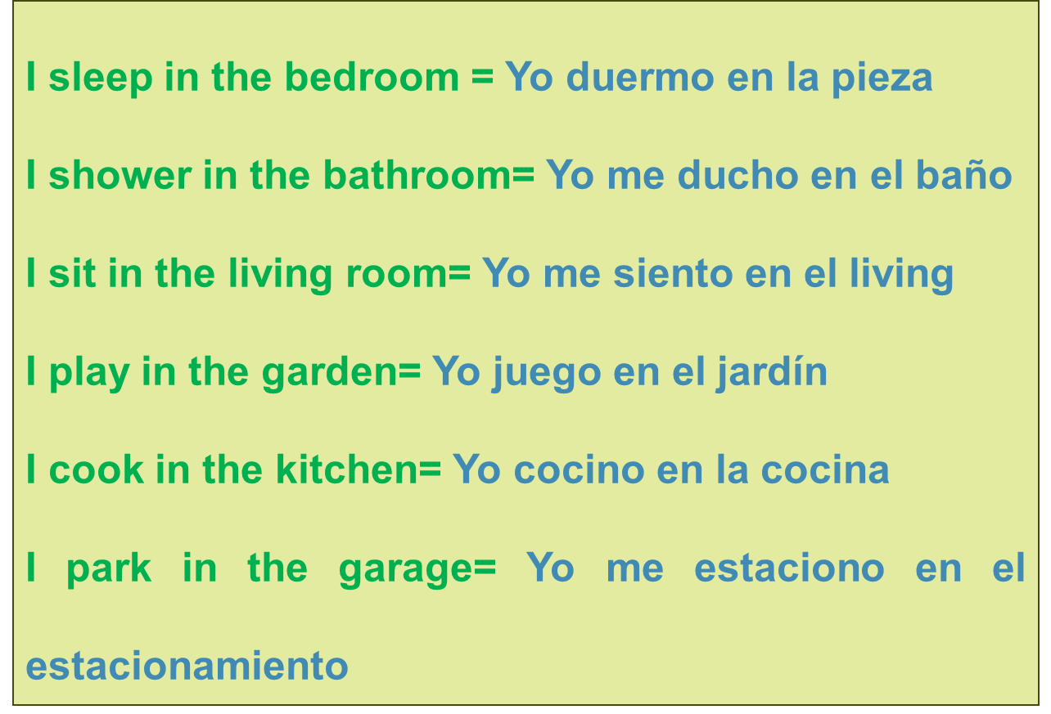
CANCIÓN

Slide 4
I WANT TO BE
UNIT 3

Slide 5
CONTENIDOS
Las ocupaciones. Descripción de ropa, acciones cotidianas y uso de pronombres. Preguntas sobre actividades, personas y lugares. Números hasta el 20.
.

Slide 6
PROFESSIONS

Slide 7
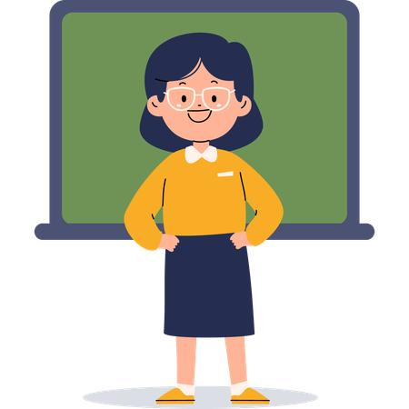

Who is he?
He is a doctor
Who is she?
She is a teacher

Slide 8

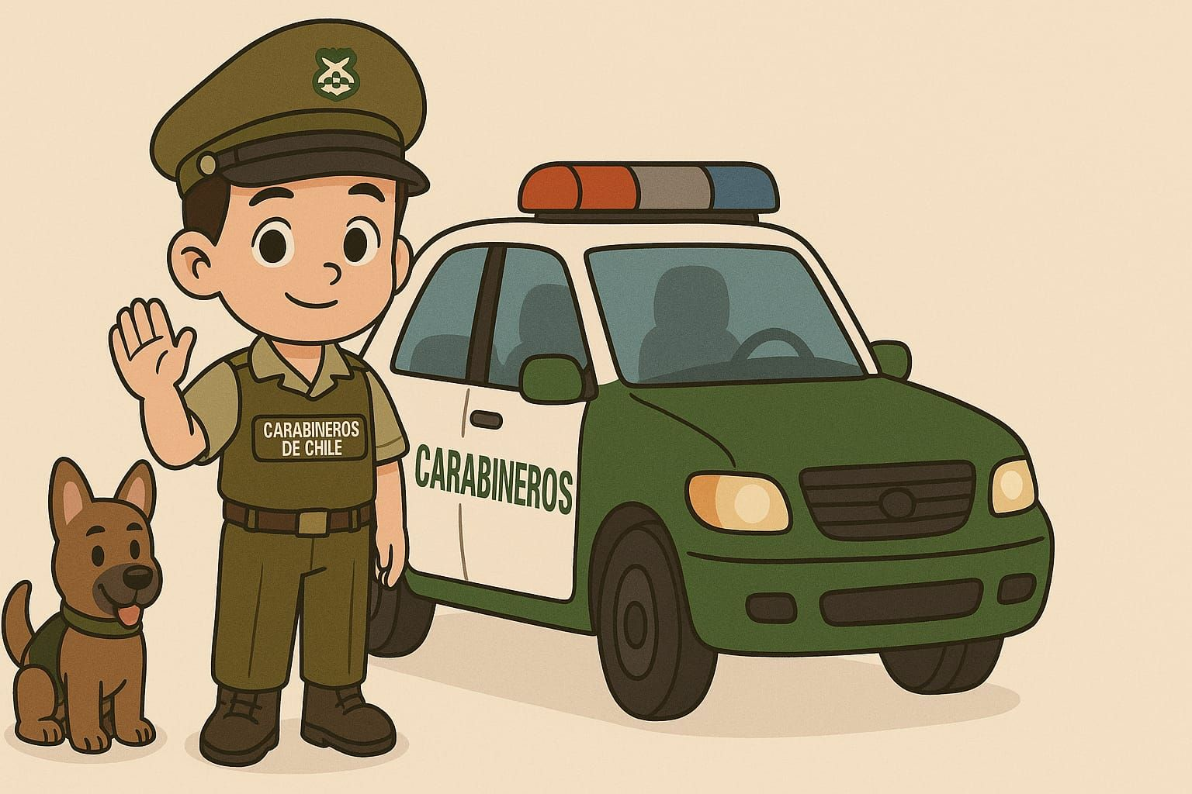
Who is he?
He is a police officer
Who is she?
She is a cook / she is a chef

Slide 9

Who is she?
She is a farmer

Slide 10



Who is missing?
The __farmer_______ and the _doctor_____ are missing

Slide 11

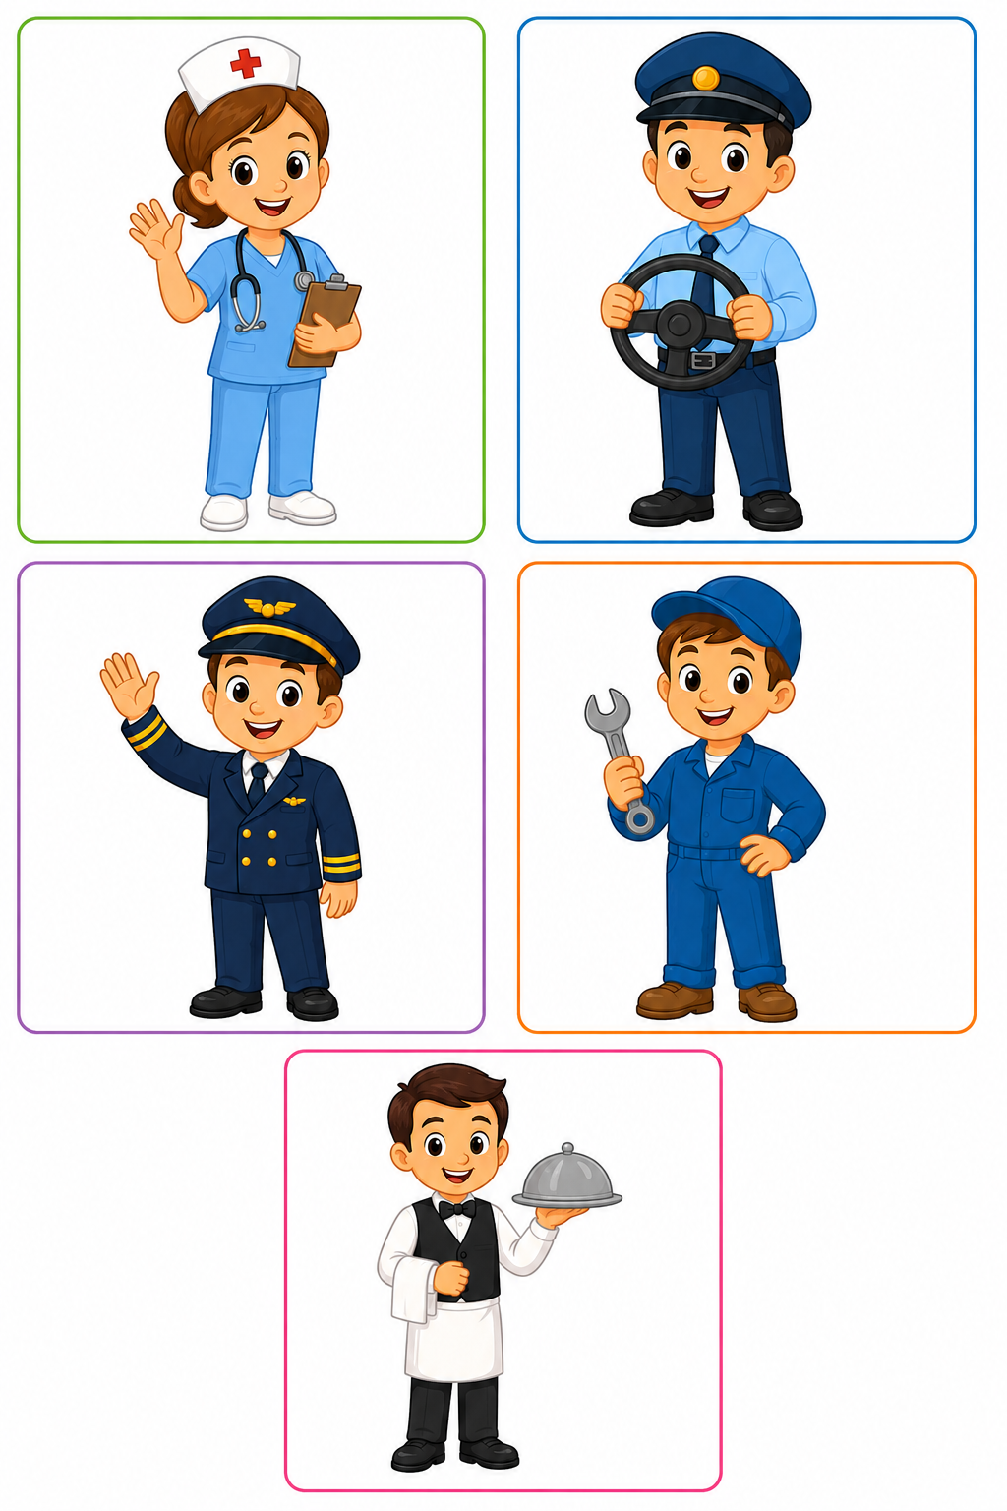
Who is she she is a nurse
Who is he?
He is a driver

Slide 12
Who is he?
He is a pilot
Who is he?
He is a mechanic

Slide 13
Who is he?
He is a waiter

Slide 14
Occupation | Place
1. Nurse | a. Restaurant
2. Driver | b. Garage
3. Pilot | c. Hospital
4. Mechanic | d. Airport
5. Waiter | e. Car / bus

Slide 15
Complete:
Word Bank:
nurse – driver – pilot – mechanic – waiter
A _nurse_ works in a hospital. Una enfermera trabaja en un hospital
A _pilot__ flies an airplane. Un piloto vuela un avión
A _driver___ drives a car. Un chofer maneja un auto
A _mechanic_____ fixes cars. Un mecánico repara autos
A __waiter__ works in a restaurant. Un camarero trabaja en un restaurante

Slide 16

3
4
5
1
2

Slide 17

1
2
3
4
5

Slide 18
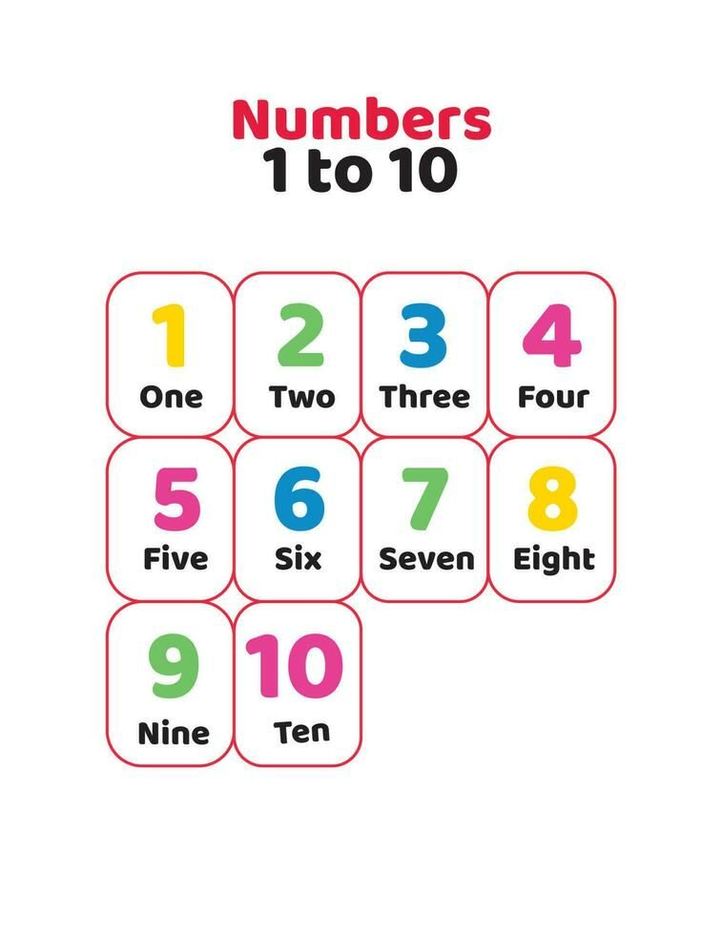

Slide 19


SCHOOL HOSPITAL

Slide 20
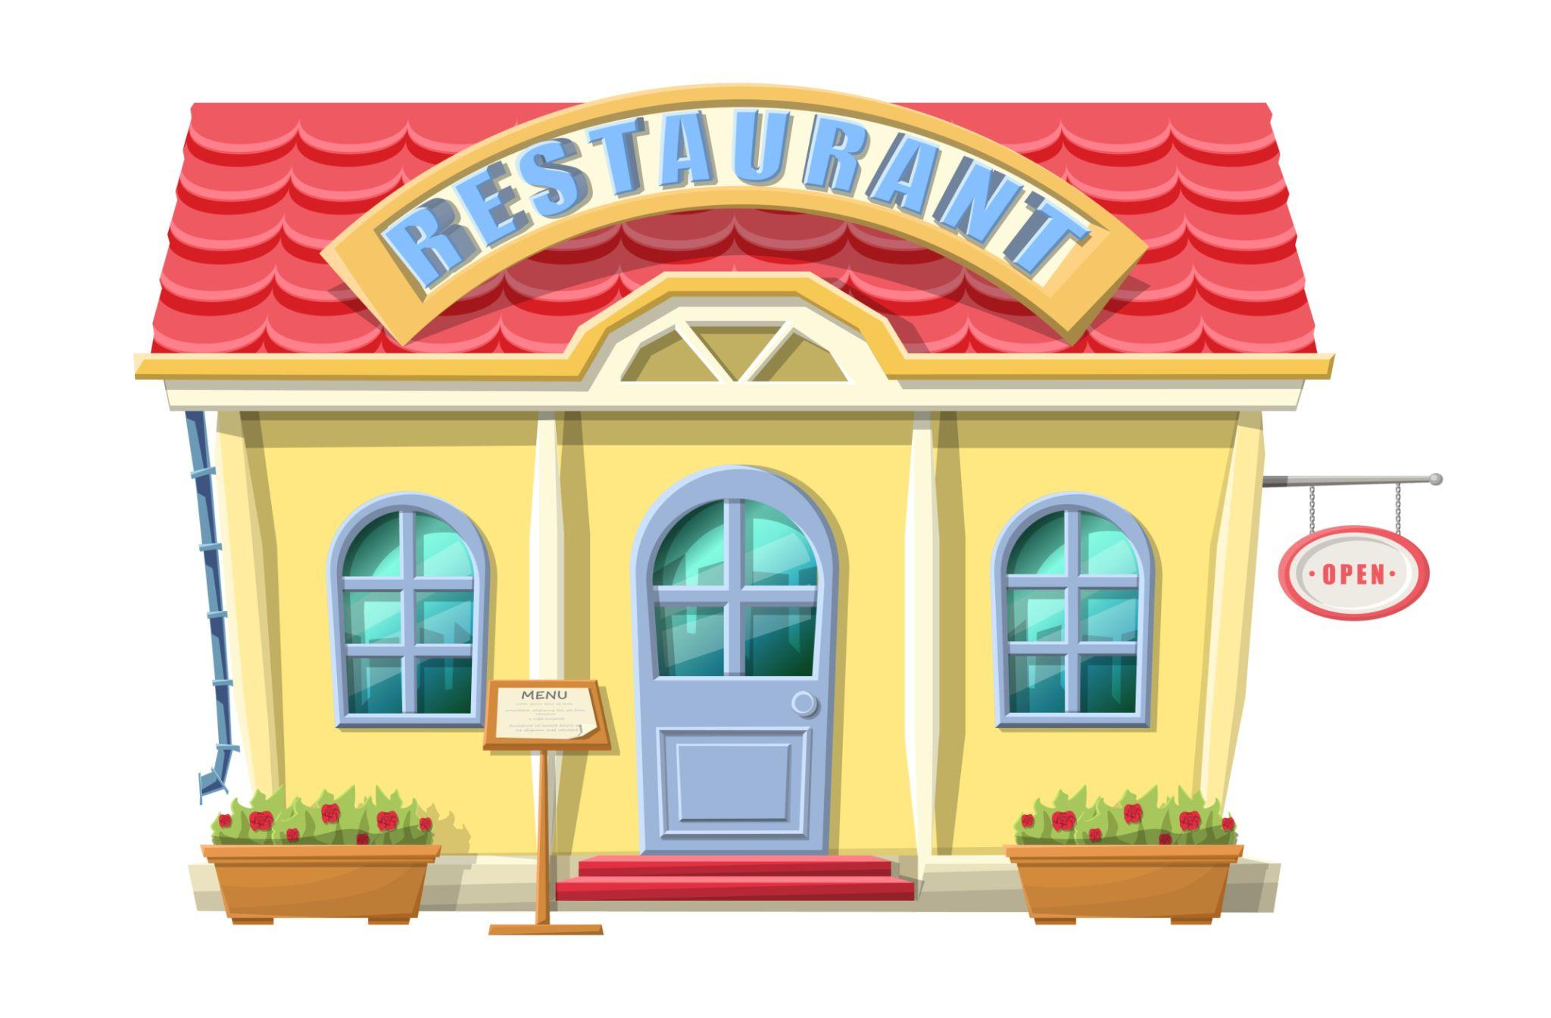

RESTAURANT POLICE STATION

Slide 21


FARMER BUS

Slide 22
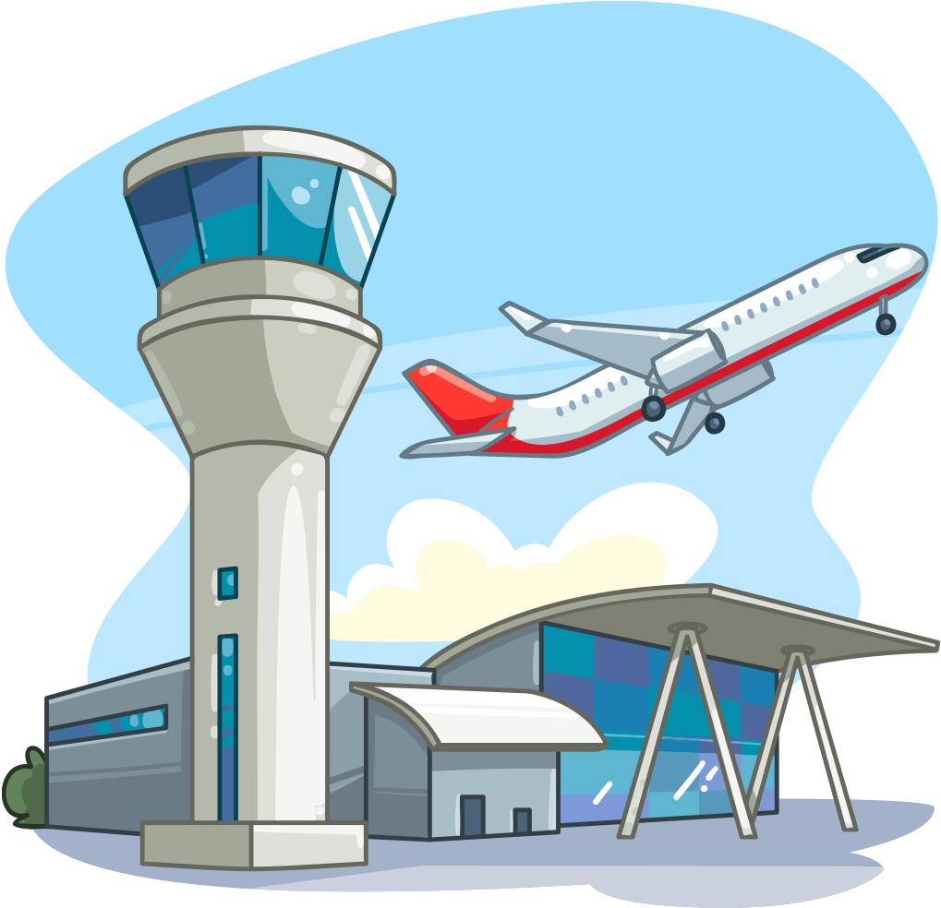
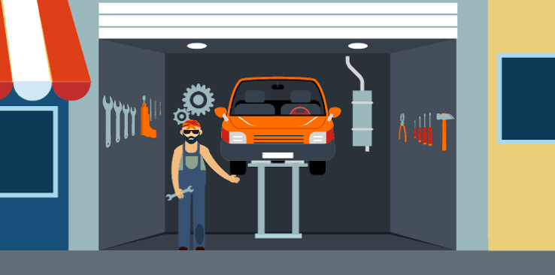
AIRPORT MECHANICAL WORKSHOP

