Slide 1
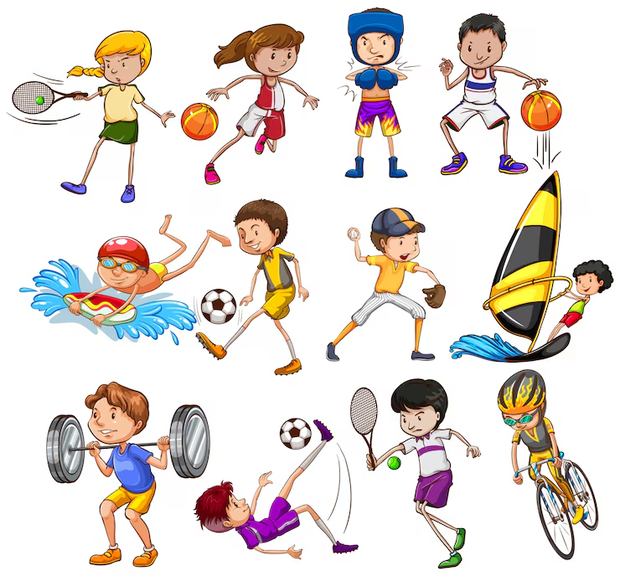

Slide 2
WHAT SPORT DO YOU LIKE?
UNIT 3

Slide 3
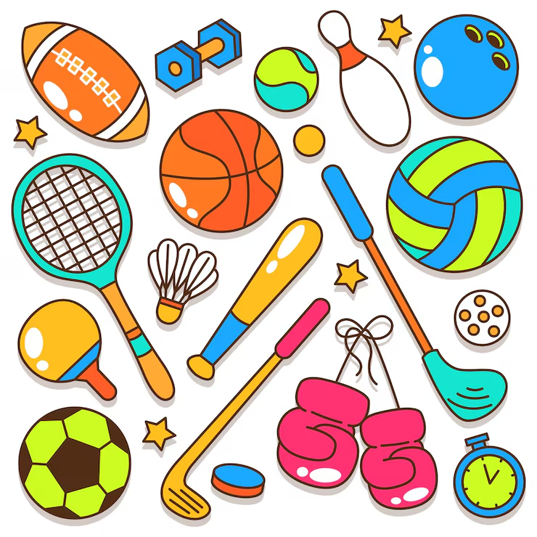
OBJETIVOS
Deportes: Football (soccer), basketball, tennis, swimming, running, volleyball, cycling.
Verbos de acción: Play, do, go, like, dislike.
Estructuras gramaticales:
  Preguntas: What sport do you like?
  ¿Qué deporte te gusta?
  Respuestas: I like... / I don't like...
  Me gusta… / No me gusta

Slide 4
VOCABULARY
Football/soccer: fútbol
Basketball: baloncesto
Tennis: tenis
Swimming: natación
Running: salir a correr
Volleyball: voleybol
Cycling: ciclismo
Play: jugar
Do: hacer
Go: ir
Like: gustar
Dislike: disgutar = don’t like

Slide 5
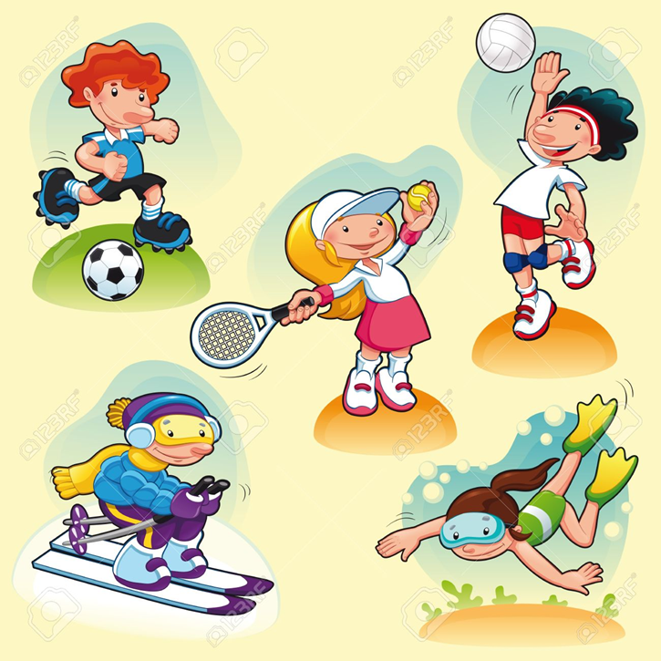
I like… / I don’t like
I _like___ football. (👍)
I _don’t like__ tennis. (👎)
I _like_ swimming. (👍)
I __don’t like_ basketball. (👎)
I _like___ running. (👍)

Slide 6

Put in order the sentences
1. like / I / volleyball / .
__I like volleyball__________________
2. cycling / don't / I / like / .
_I don’t like cycling__________________
3. like / tennis / I / don't / .
__I don’t like tennis__________________
4. swimming / like / I / .
__I like swimming _____________________

Slide 7
Chosse the correct answer
VOCABULARY
RACKET: RAQUETA
SWIMMING POOL: PISCINA
KICK: PATEAR
You play this sport with a racket.
a) football
b) tennis
c) Swimming
2. You need a bicycle.
a) cycling
b) basketball
c) Volleyball
3. You play this sport in a swimming pool.
a) baseball
b) swimming
c) Football
You usually kick the ball.
a) football
b) tennis
c) volleyball

Slide 8
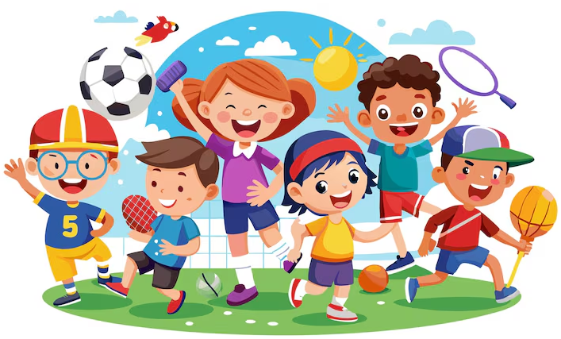
VOCABULARY
Football/soccer: fútbol
Basketball: baloncesto
Tennis: tenis
Swimming: natación
Running: salir a correr
Volleyball: voleybol
Cycling: ciclismo
Yoga: aereal yoga
Karate: karate
Taikwondo: taikwondo
Roller Skating: patinaje

Slide 9
Create sentences with sports
Ex. I like to play tennis, I like tennis
I don’t like sport, I don’t like to play football, I don’t like football
Amanda: I like karate
I don't like tennis
Isidora: I like doing aereal yoga
I don't like basquetbol

Slide 10
Create sentences with sports
Noemi:I like skating ✨
I don't like football
Cristobal:
Andy: I like taekwondo
I don't like football

Slide 11
Days of the week
Monday= lunes
Tuesday= martes
Wednesday= miércoles
Thursday= jueves
Friday= viernes
Saturday= sábado
Sunday= domingo

Slide 12
Speaking
What's your favorite sport?
👉 My favorite sport is _skating_______.
Do you play football?
👉 Yes, I do. / No, I don't.
Can you swim?
👉 Yes, I can. / No, I can't.
How often do you play sports?
👉 I play sports every _______
I don’t play sports
Vocabulary
How often = cuan seguido
Everyday = todos los días
Everyweek= todas las semanas
Every Monday=todos los lunes
Every Tuesday= todos los martes, etc

Slide 13
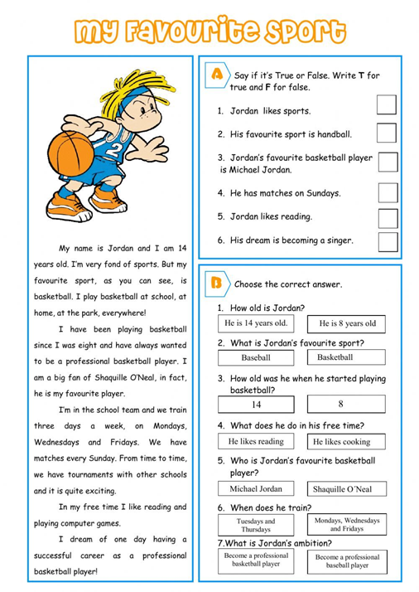

Slide 14
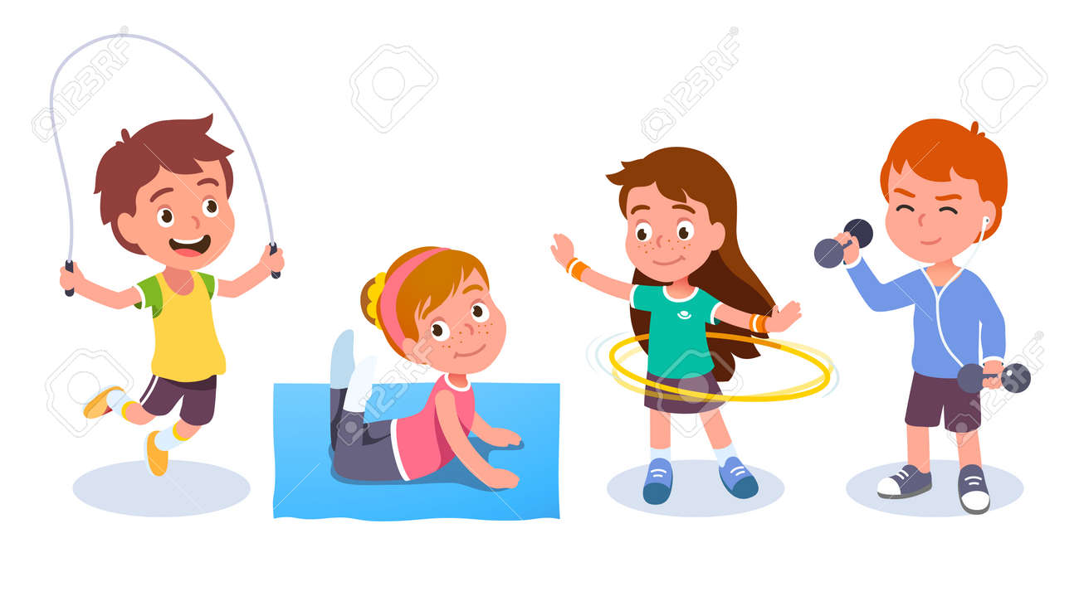
Your personal sport week
My name is __________________________.
My favorite sport is __________________________.
I practice it on __________________________. (days of the week)
I practice it with __________________________.
I practice it at/in __________________________.
I like this sport because it is __________________________ and __________________________.
I practice it __________________________ (frecuency)

Slide 15
Vocabulary you can use
Sports:
soccer – basketball – tennis – swimming – volleyball – cycling – running – gymnastics – skating
People:
my friends – my family – my brother – my sister – my classmates – my cousin
Places:
school – park – gym – swimming pool – sports center – beach- in a house
Days of the week:
Monday, Tuesday, Wednesday, Thursday, Friday, Saturday, Sunday.
Adjectives:
fun – exciting – interesting – difficult – easy – healthy – great
Frequency:
everyday – twice a week – three times a week – on weekends – on Saturdays

Slide 16
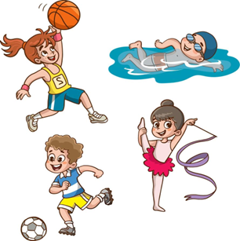
Now, you have to create a text done
Requirements
☐ 1 sport
☐ 1 place
☐ 1 person
☐ 1 day or frequency expression
☐ 1 reason with because: porque
☐ 4-5 sentences
Example:
My favorite sport is basketball. I play (do or go) basketball with my friends at school. I practice on Mondays and Wednesdays. I like basketball because it is fun and exciting. I practice twice a week.

Slide 17
VOCABULARY done
Play: jugar /play football/play basquetball / play tennis
Do: /karate / aerobics
Go: swimming /go running / go cycling
https://www.youtube.com/watch?v=8Mnmmn5tmZo&list=RD8Mnmmn5tmZo&start_radio=1

Slide 18
Vocabulary done
Tennis raquet: raqueta
Swimming suit /swimsuit: traje de baño
Hockey stick: palo de hockey
Rollerblades: patines
Ball: pelota
Football: pelota de futbol
Basquetball: pelota de basquetbol
Tennis ball: pelota de tenis
Skateboard: patineta, tabla de skate
Bike: bicicleta
Helmet: casco

Slide 19
videos
https://www.youtube.com/watch?v=yZUeOF1UAk8 done
https://www.youtube.com/watch?v=Y5ApsImfwVg
https://wordwall.net/es/resource/72966974/ingl%C3%A9s/objects-to-do-sports-activity
Guessing game https://www.youtube.com/watch?v=l0f_x5h8xjk

