Slide 1
LINK CANCIÓN
https://www.youtube.com/watch?v=9T6EFEpP9mc&list=RD8_Fr6EwRJsw&index=2
https://www.yout-ube.com/watch?v=WfLBN0FVYNM&list=RDWfLBN0FVYNM&start_radio=1
Cuento:
https://www.yout-ube.com/watch?v=8irSFvoyLHQ&list=PLN8DQHdZDXwbd4DXeOgiwHC2wP3mzXKs0
(en curso)

Slide 2
CANCIÓN
Bedroom: Dormitorio
Bathroom: Baño
Living room: Sala o living
Kitchen: cocina
Garden: jardín
Garage: garage o estacionamiento
This is my house: Esta es mi casa

Slide 3
SONG:
Where are you? ¿dónde estas?
You are not in the living room
Tu no estás en la sala
You are in the kitchen tú estás en la cocina
Yes, I am in the kitchen si, estoy en la cocina
This is my home, come and play with me Este es mi hogar, ven y juega conmigo
“WHERE ARE YOU?”

Slide 4
SONG:
Where are you?
¿dónde estás?
You are not in the bedroom
Tu no estás en la habitación
You are in the garden
tú estás en la jardín
Yes, I am in the garden
si, estoy en la jardín
This is my home, come and play with me Este es mi hogar, ven y juega conmigo
“WHERE ARE YOU?”

Slide 6
I WANT TO BE
UNIT 3

Slide 7
CONTENIDOS
Las ocupaciones. Descripción de ropa, acciones cotidianas y uso de pronombres. Preguntas sobre actividades, personas y lugares. Números hasta el 20.
.

Slide 8
PROFESSIONS

Slide 9
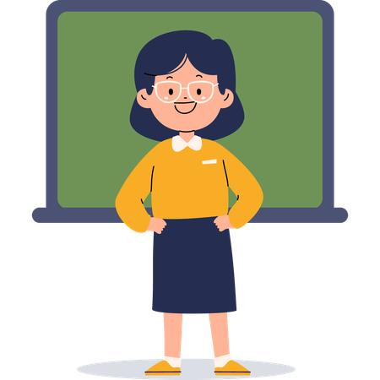

Who is he?
He is a doctor
Who is she?
She is a teacher

Slide 10

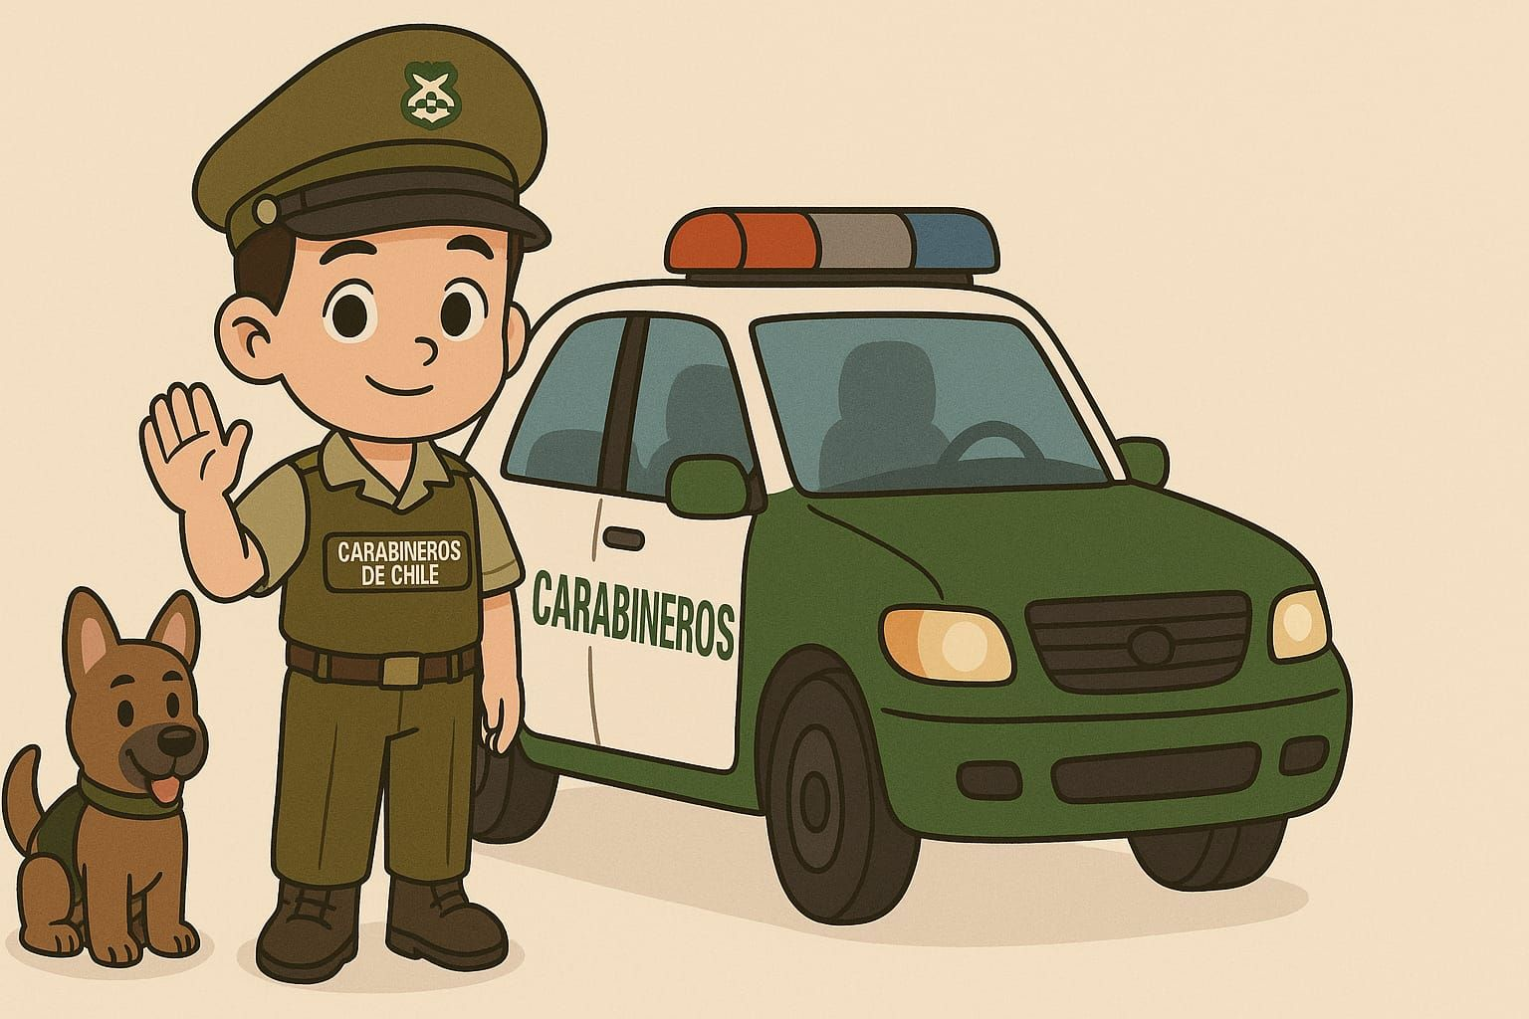
Who is he?
He is a police officer
Who is she?
She is a cook / she is a chef

Slide 11

Who is she?
She is a farmer

Slide 12



Who is missing?
The __farmer_______ and the _doctor_____ are missing

Slide 13

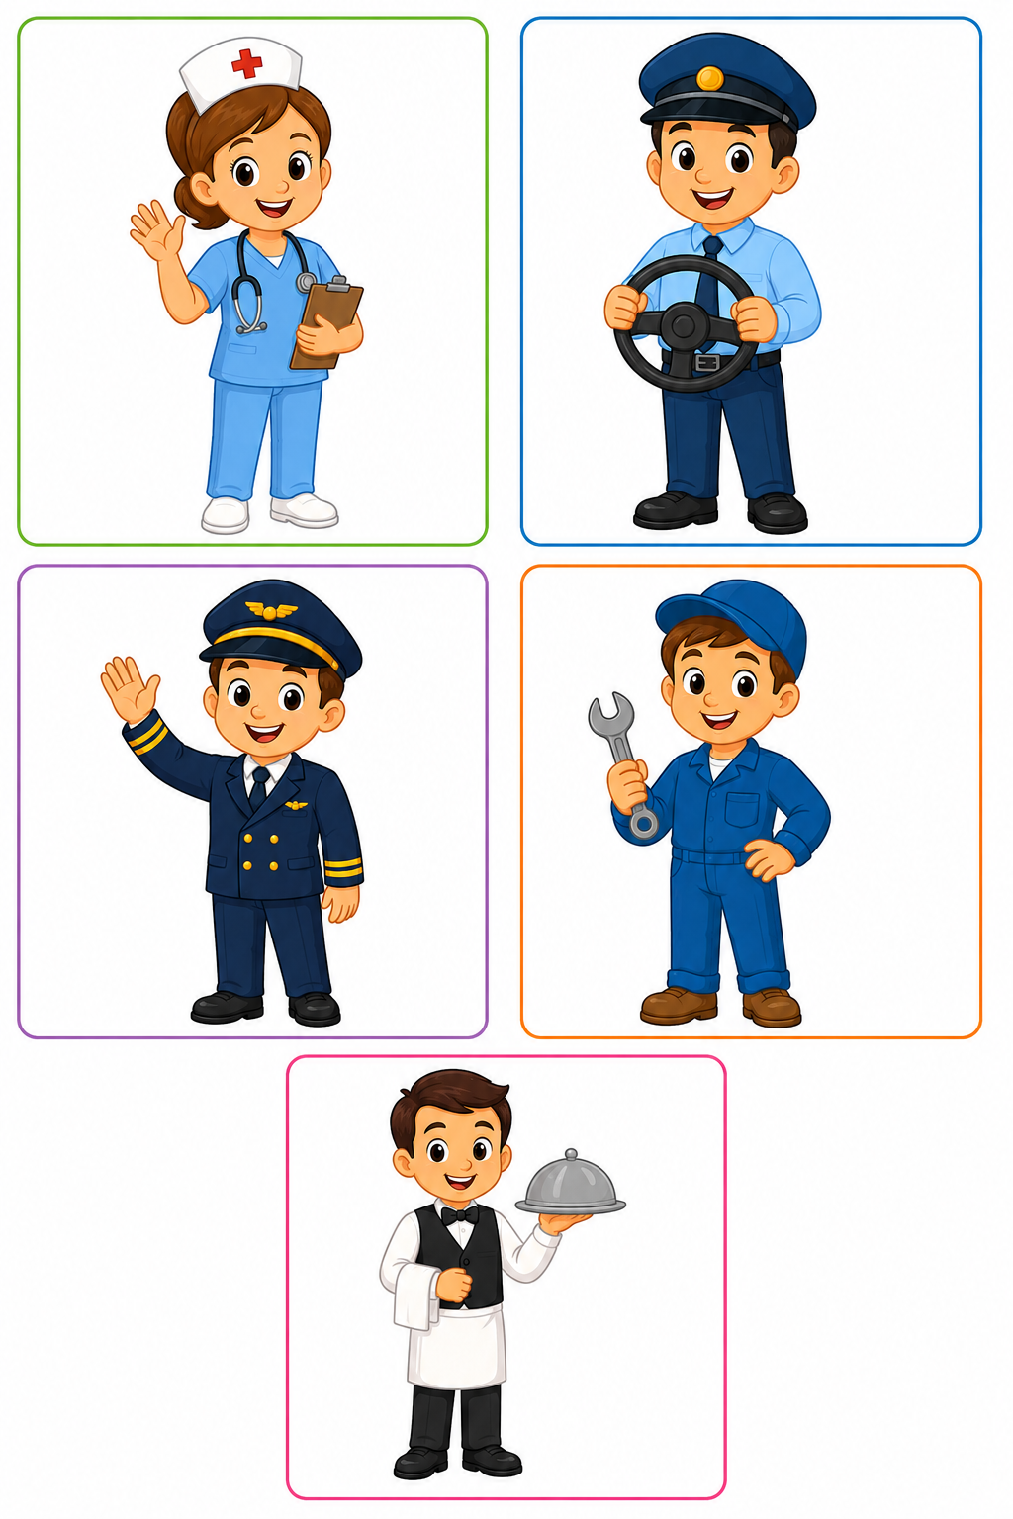
Who is she she is a nurse
Who is he?
He is a driver

Slide 14
Who is he?
He is a pilot
Who is he?
He is a mechanic

Slide 15
Who is he?
He is a waiter

Slide 16
Occupation | Place
1. Nurse | a. Restaurant
2. Driver | b. Garage
3. Pilot | c. Hospital
4. Mechanic | d. Airport
5. Waiter | e. Car / bus

Slide 17
Complete:
Word Bank:
nurse – driver – pilot – mechanic – waiter
A _nurse_ works in a hospital. Una enfermera trabaja en un hospital
A _pilot__ flies an airplane. Un piloto vuela un avión
A _driver___ drives a car. Un chofer maneja un auto
A _mechanic_____ fixes cars. Un mecánico repara autos
A __waiter__ works in a restaurant. Un camarero trabaja en un restaurante

Slide 18

3
4
5
1
2

Slide 19

1
2
3
4
5

Slide 20


SCHOOL HOSPITAL

Slide 21
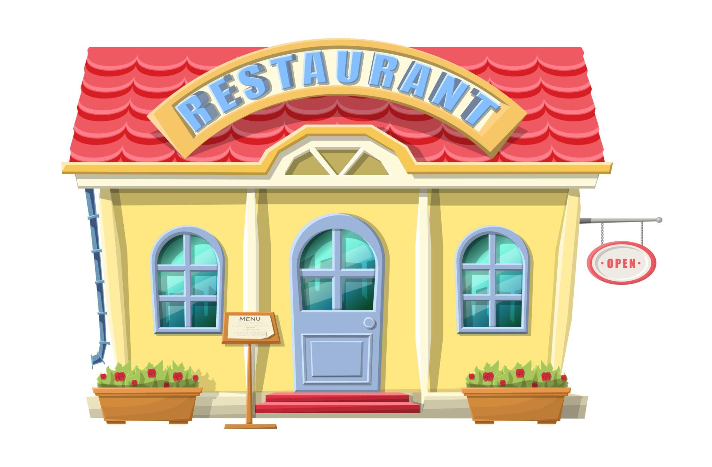

RESTAURANT POLICE STATION

Slide 22


FARM BUS

Slide 23
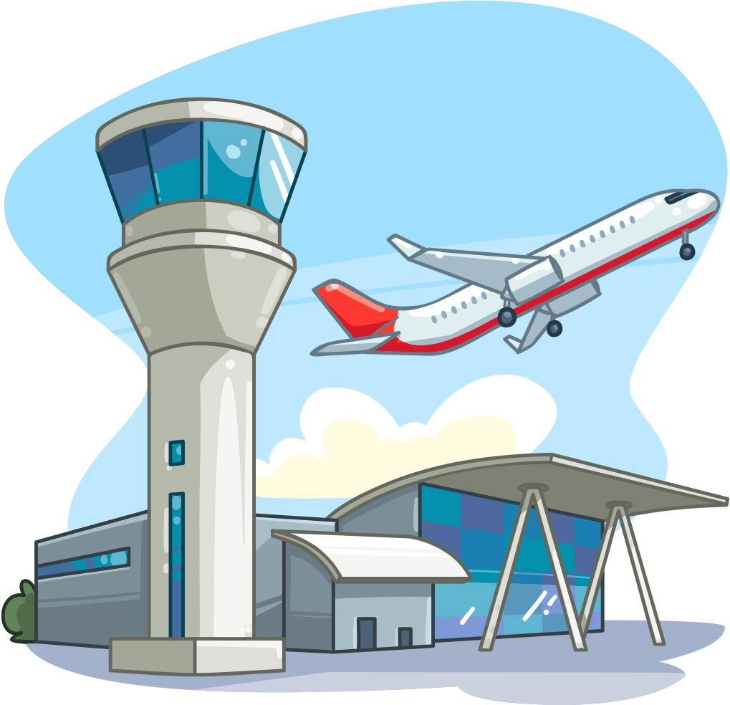
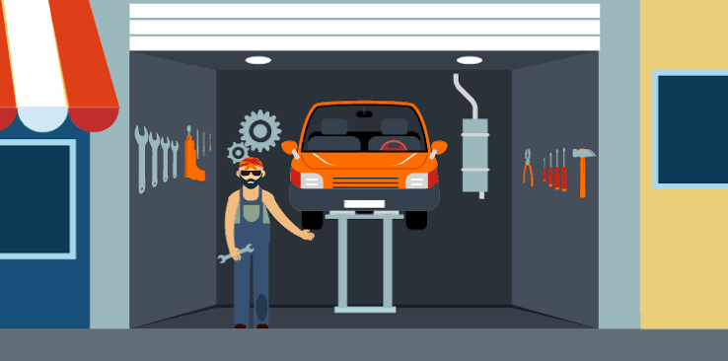
AIRPORT MECHANIC STORE
OR GARAGE

Slide 24
MATCH :
Teacher
Doctor
Farmer
Pilot
Mechanic
a. Farm
b. School
c. Garage
d. Airport
e. Hospital

Slide 25
Occupation | Workplace
👩‍⚕️ Nurse | 🏥 Hospital
🚗 Driver | 🚌 Bus / road
✈️ Pilot | ✈️ Airport
🔧 Mechanic | 🚗 Garage
🍽️ Waiter | 🍽️ Restaurant

Slide 26
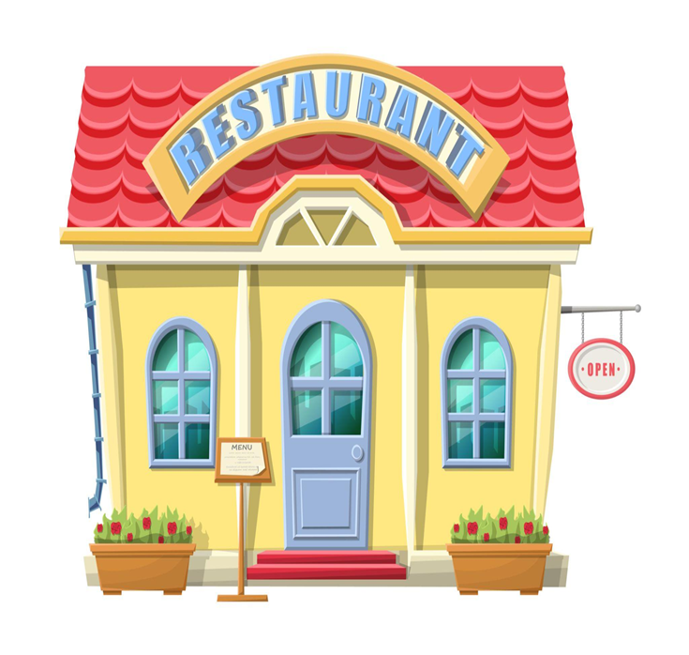
WHO WORKS HERE?
A COOK / CHEF
A WAITER

Slide 27

WHO WORKS HERE?
A POLICE OFFICER

Slide 28

WHO WORKS ON THIS?
A DRIVER

Slide 29

WHO WORKS HERE?
A DOCTOR
A NURSE

Slide 30
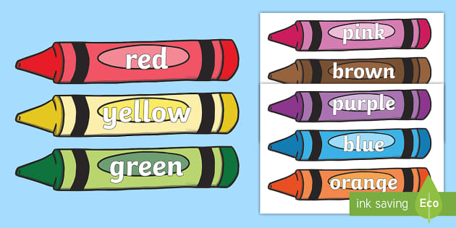


Crayons
Paper
Pencils

Slide 31
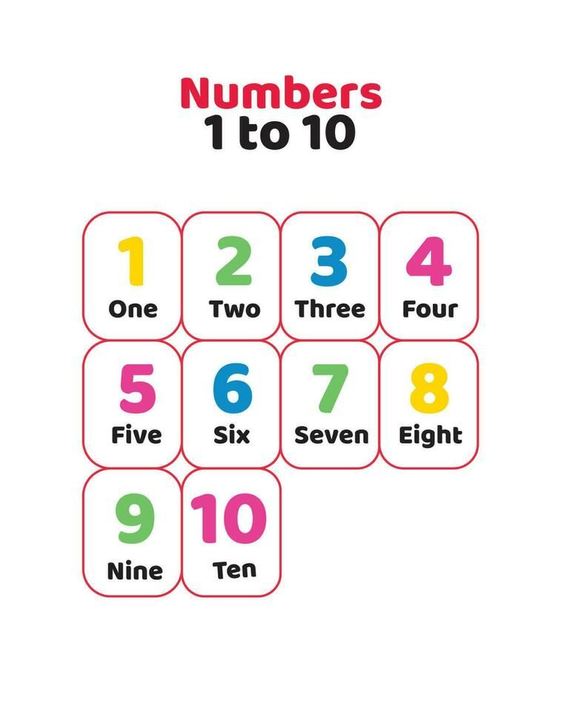

Slide 32
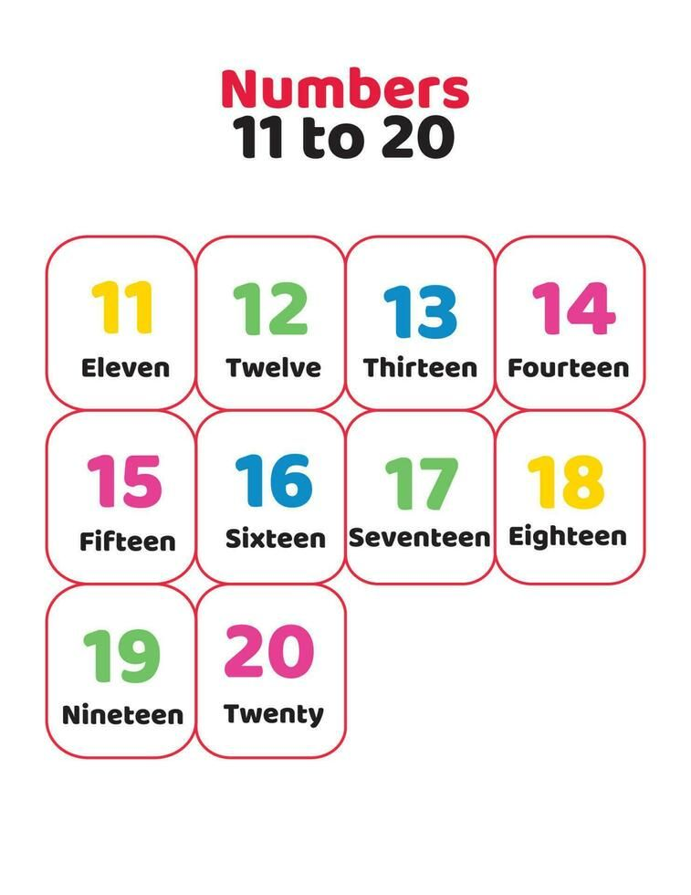

Slide 33
Adivina que profesión es:
1.
I work in a school.
I teach children.
I am a _teacher__.
2.
I work in a hospital.
I help sick people.
I am a _doctor__.
3.
I work in a restaurant.
I cook food.
I am a _cook_.
4.
I work on a farm.
I work with animals.
I am a __farmer___.

Slide 34
UNE LA COLUMNA ROJA CON LA COLUMNA AZUL
Firefighter
Dentist
Pilot
Artist
a. flies a plane
b. paints pictures
c. helps people in fires
d. checks your teeth

