Slide 1
SUSTAINABLE DEVELOPMENT
UNIT 4

Slide 2
CONTENTS OF THE UNIT
Durante la presente unidad, se espera que las y los estudiantes sean capaces de comprender y expresar ideas sobre el desarrollo sustentable y sus consecuencias, en forma espontánea y creativa. Para ello, se busca que logren usar funciones apropiadas y expresiones y vocabulario asociados al tema de la unidad.
Describir frecuencia, tiempo, grado de acciones; por ejemplo: I usually/often call her in the morning. > Expresarse con claridad, usando palabras y expresiones de uso común, sinónimos, palabras compuestas; por ejemplo: hardly ever; at all; I’d rather…; for ages; I’m pleased; sorry about; look for/after…; cheap enough; online. > Unir ideas; por ejemplo: It is raining today, as a result the air will be cleaner in the city; we wouldn’t use gas unless it was cheap. > Describir situaciones hipotéticas o imaginarias y dar consejos; por ejemplo: If I were you, I would tell her the truth; He would meet more people if he spoke English.

Slide 3
Vocabulary Match: write the corresponding letter
A | B
1. Environment ____ | a. contaminado
2. Sustainable _____ | b. impacto
3. Polluted ____ | c. medioambiente
4. Impact ____ | d. cuidar
5. Develop ____ | e. sostenible
6. environmentally friendly ____ | f. desarrollar
7. look after _____ | g. buscar
8. look for ____ | h. respetuoso con el medioambiente

Slide 4
COMPLETE THE SENTENCES
environment – sustainable – polluted – impact – develop – look after
We need to protect the __________.
The river is very __________ because of industrial waste.
We should __________ our planet.
Solar energy is a more __________ form of energy.
Climate change has a serious __________ on our lives.
Countries need to __________ new solutions to environmental problems.

Slide 5
CHOOSE THE CORRECT LETTER
What does "sustainable" mean?
a) Something that damages the environment
b) Something that can continue without seriously harming the environment
c) Something that is very expensive
d) Something that is impossible
2. Which action is environmentally friendly?
a) Throwing rubbish into rivers
b) Using a lot of plastic
c) Recycling paper and plastic
d) Leaving lights on all day
3. What can cause air pollution?
a) Planting trees
b) Using public transportation
c) Factory emissions
d) Recycling

Slide 6
CHOOSE THE CORRECT LETTER
4. What should people do to protect the environment?
a) Waste water
b) Recycle and reduce waste
c) Use more plastic
d) Cut down more trees

Slide 7
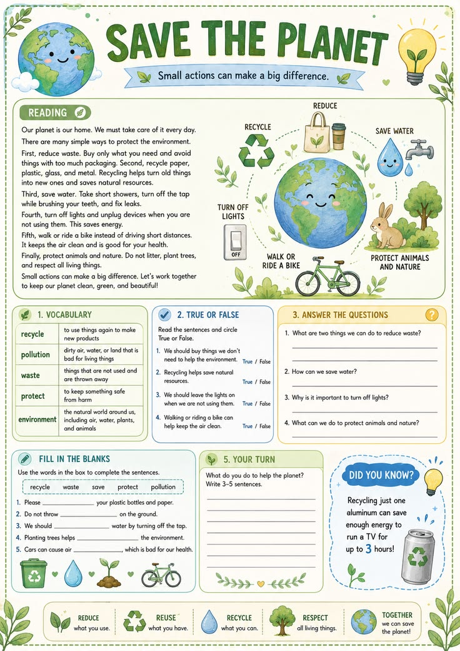

Slide 9
TRUE OR FALSE
We should buy things we don’t need to help the envirnment _________
Recycling helps sabe natural resources ______
We should leave the lights on when we aren´t using them_______
Walking or riding a bike can help to keep the air clean _______

Slide 10
ANSWER THE QUESTIONS
What are two things we can do to reduce waste?
How can we sabe wáter?
What can we do to protect animals and nature?
What do you do to help the planet?

Slide 12
Diseño de dos objetos con tabla
Primera viñeta aquí
Segunda viñeta aquí
Tercera viñeta aquí
Clase | Grupo A | Grupo B
Clase 1 | 82 | 95
Clase 2 | 76 | 88
Clase 3 | 84 | 90

Slide 13
Diseño de dos objetos con SmartArt
Primera viñeta aquí
Segunda viñeta aquí
Tercera viñeta aquí
Paso 1
Título
Paso 3
Título
Paso 4
Título
Paso 5
Título
Paso 2
Título

Slide 14
Agregar un título de diapositiva (1)

Slide 15
Agregar un título de diapositiva (2)

Slide 16
Agregar un título de diapositiva (3)

Slide 18
Agregar un título de diapositiva (4)

Slide 19
Agregar un título de diapositiva (5)

