Slide 1
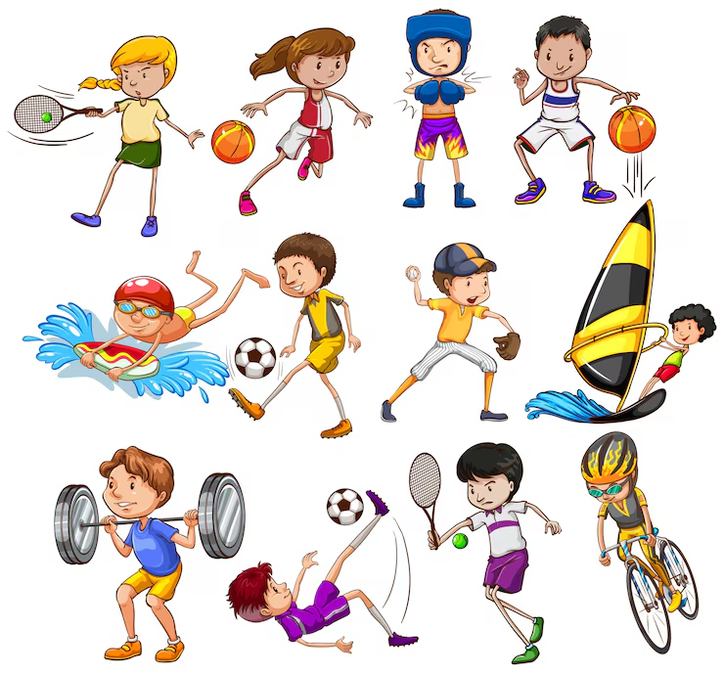

Slide 2
WHAT SPORT DO YOU LIKE?
UNIT 3

Slide 3
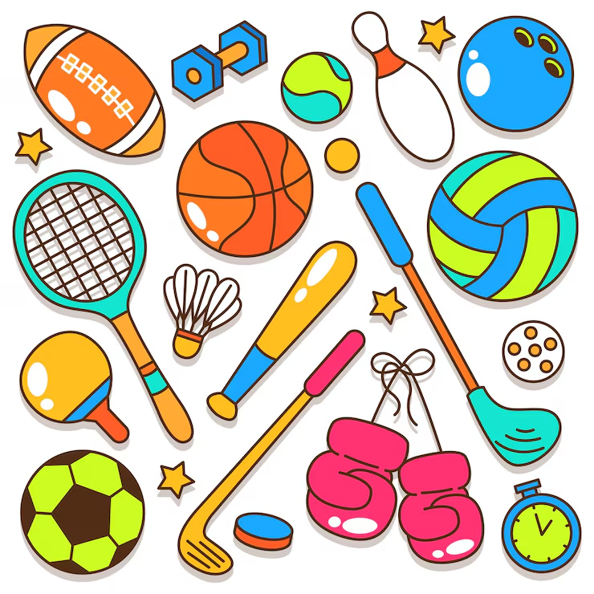
OBJETIVOS
Deportes: Football (soccer), basketball, tennis, swimming, running, volleyball, cycling.
Verbos de acción: Play, do, go, like, dislike.
Estructuras gramaticales:
  Preguntas: What sport do you like?
  ¿Qué deporte te gusta?
  Respuestas: I like... / I don't like...
  Me gusta… / No me gusta

Slide 4
VOCABULARY
Football/soccer: fútbol
Basketball: baloncesto
Tennis: tenis
Swimming: natación
Running: salir a correr
Volleyball: voleybol
Cycling: ciclismo
Play: jugar
Do: hacer
Go: ir
Like: gustar
Dislike: disgutar = don’t like

Slide 5
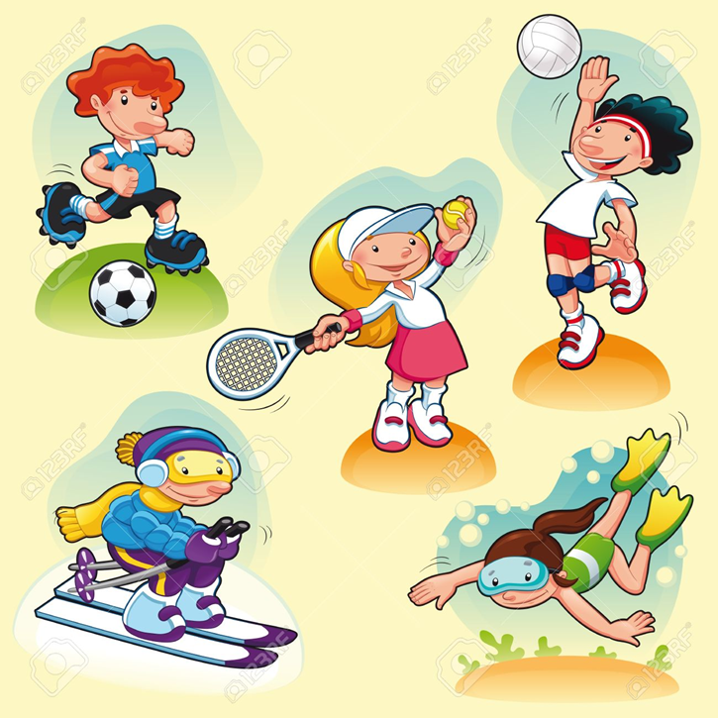
I like… / I don’t like
I _like___ football. (👍)
I _don’t like__ tennis. (👎)
I _like_ swimming. (👍)
I __don’t like_ basketball. (👎)
I _like___ running. (👍)

Slide 6

Put in order the sentences
1. like / I / volleyball / .
__I like volleyball__________________
2. cycling / don't / I / like / .
_I don’t like cycling__________________
3. like / tennis / I / don't / .
__I don’t like tennis__________________
4. swimming / like / I / .
__I like swimming _____________________

Slide 7
Chosse the correct answer
VOCABULARY
RACKET: RAQUETA
SWIMMING POOL: PISCINA
KICK: PATEAR
You play this sport with a racket.
a) football
b) tennis
c) Swimming
2. You need a bicycle.
a) cycling
b) basketball
c) Volleyball
3. You play this sport in a swimming pool.
a) baseball
b) swimming
c) Football
You usually kick the ball.
a) football
b) tennis
c) volleyball

Slide 8
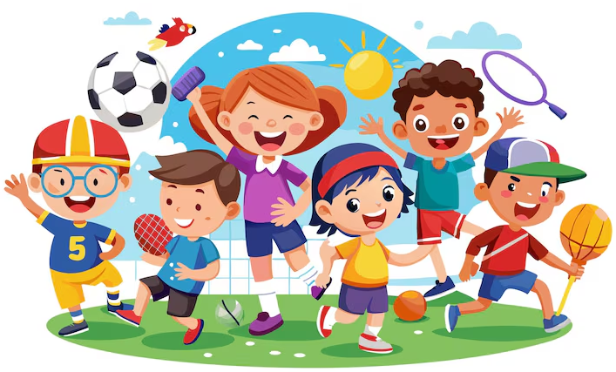
VOCABULARY
Football/soccer: fútbol
Basketball: baloncesto
Tennis: tenis
Swimming: natación
Running: salir a correr
Volleyball: voleybol
Cycling: ciclismo
Yoga: aereal yoga
Karate: karate
Taikwondo: taikwondo
Roller Skating: patinaje

Slide 9
Create sentences with sports
Ex. I like to play tennis, I like tennis
I don’t like sport, I don’t like to play football, I don’t like football
Amanda: I like karate
I don't like tennis
Isidora: I like doing aereal yoga
I don't like basquetbol

Slide 10
Create sentences with sports
Noemi:I like skating ✨
I don't like football
Cristobal:
Andy: I like taekwondo
I don't like football

Slide 11
Speaking
What's your favorite sport?
👉 My favorite sport is _skating_______.
Do you play football?
👉 Yes, I do. / No, I don't.
Can you swim?
👉 Yes, I can. / No, I can't.
How often do you play sports?
👉 I play sports every _______
I don’t play sports
Vocabulary
How often = cuan seguido
Everyday = todos los días
Everyweek= todas las semanas
Every Monday=todos los lunes
Every Tuesday= todos los martes, etc

Slide 12
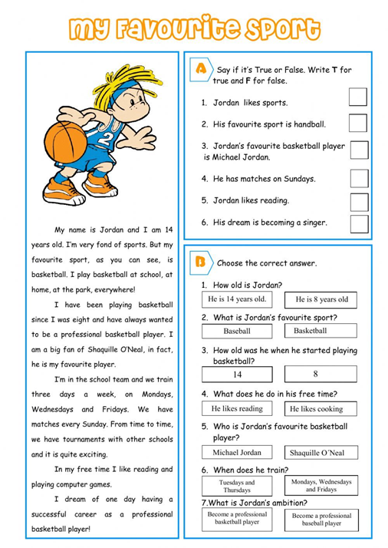

Slide 13
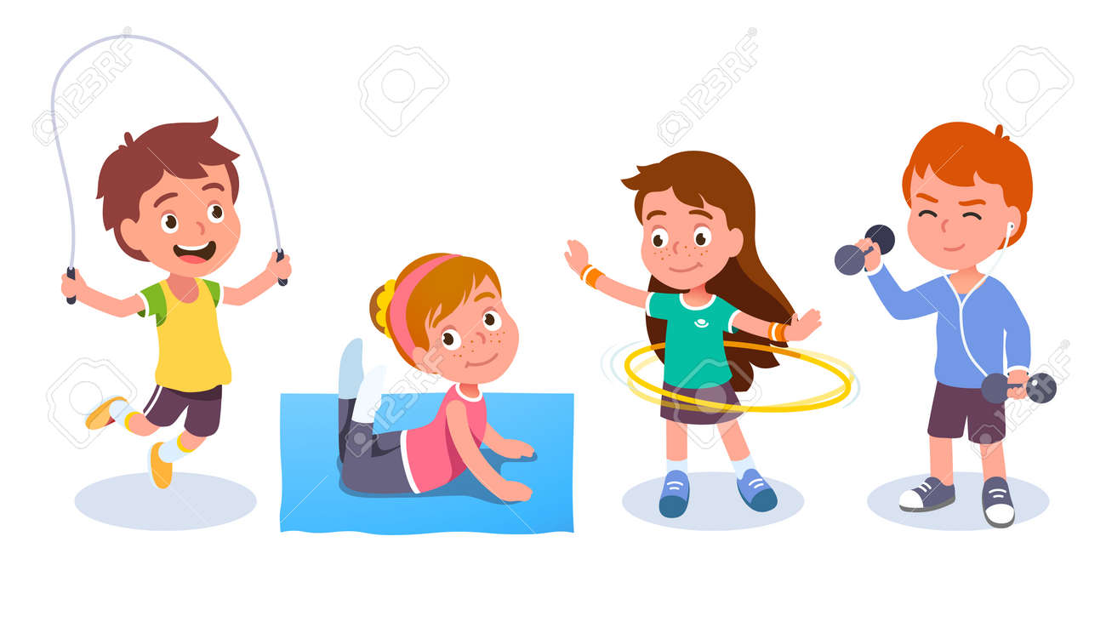
Your personal sport week
My name is __________________________.
My favorite sport is __________________________.
I practice it on __________________________. (days of the week)
I practice it with __________________________.
I practice it at/in __________________________.
I like this sport because it is __________________________ and __________________________.
I practice it __________________________ (frecuency)

Slide 14
Vocabulary you can use
Sports:
soccer – basketball – tennis – swimming – volleyball – cycling – running – gymnastics – skating
People:
my friends – my family – my brother – my sister – my classmates – my cousin
Places:
school – park – gym – swimming pool – sports center – beach- in a house
Days of the week:
Monday, Tuesday, Wednesday, Thursday, Friday, Saturday, Sunday.
Adjectives:
fun – exciting – interesting – difficult – easy – healthy – great
Frequency:
everyday – twice a week – three times a week – on weekends – on Saturdays

Slide 15
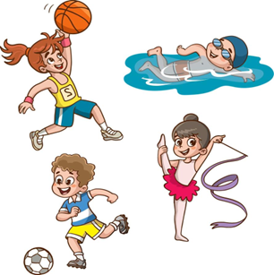
Now, you have to create a text done
Requirements
☐ 1 sport
☐ 1 place
☐ 1 person
☐ 1 day or frequency expression
☐ 1 reason with because: porque
☐ 4-5 sentences
Example:
My favorite sport is basketball. I play (do or go) basketball with my friends at school. I practice on Mondays and Wednesdays. I like basketball because it is fun and exciting. I practice twice a week.

Slide 16
VOCABULARY done
Play: jugar /play football/play basquetball / play tennis
Do: /karate / aerobics
Go: swimming /go running / go cycling
https://www.youtube.com/watch?v=8Mnmmn5tmZo&list=RD8Mnmmn5tmZo&start_radio=1

Slide 17
Vocabulary done
Tennis raquet: raqueta
Swimming suit /swimsuit: traje de baño
Hockey stick: palo de hockey
Rollerblades: patines
Ball: pelota
Football: pelota de futbol
Basquetball: pelota de basquetbol
Tennis ball: pelota de tenis
Skateboard: patineta, tabla de skate
Bike: bicicleta
Helmet: casco

Slide 18
videos
https://www.youtube.com/watch?v=yZUeOF1UAk8 done
https://www.yout-ube.com/watch?v=Y5ApsImfwVg done
https://wordwall.net/es/resource/72966974/ingl%C3%A9s/objects-to-do-sports-activity
Guessing game https://www.youtube.com/watch?v=l0f_x5h8xjk

Slide 19
🟢PLAY
Usamos PLAY principalmente con deportes que son juegos y normalmente tienen una pelota, equipos o contrincantes.
play soccer
play basketball
play tennis
play volleyball
play baseball
🔵 GO
Usamos GO + verbo terminado en -ING, especialmente para actividades deportivas.
go swimming
go running
go cycling
go skating
🟠 DO
Usamos DO con actividades o deportes individuales.
do gymnastics
do karate
do yoga
do judo

Slide 20
Play, go, do done
https://wordwall.net/es/resource/3387273/play-go-or-do
https://agendaweb.org/vocabulary/hobbies-sports-play-go-do.html

Slide 21
CHOOSE THE CORRECT VERB
I play / go / do soccer.(football)
She plays / goes / does swimming.
We play / go / do gymnastics.
They play / go / do basketball.
He plays / goes / does cycling.
My friends play / go / do tennis.
I play / go / do karate.
She plays / goes / does running.

Slide 22


CORRECT THE ERRORS
I go soccer every Saturday.
→ __I play soccer________________________
She plays swimming in the pool.
→ ___she goes swimming___________________
We play gymnastics at school.
→ __do gymnastics______________________
He does basketball with his friends.
→ ___plays_______________________________
They go tennis on Sundays.
→ ___play_______________________________
My sister plays karate.
→ ____does_______________________

Slide 23
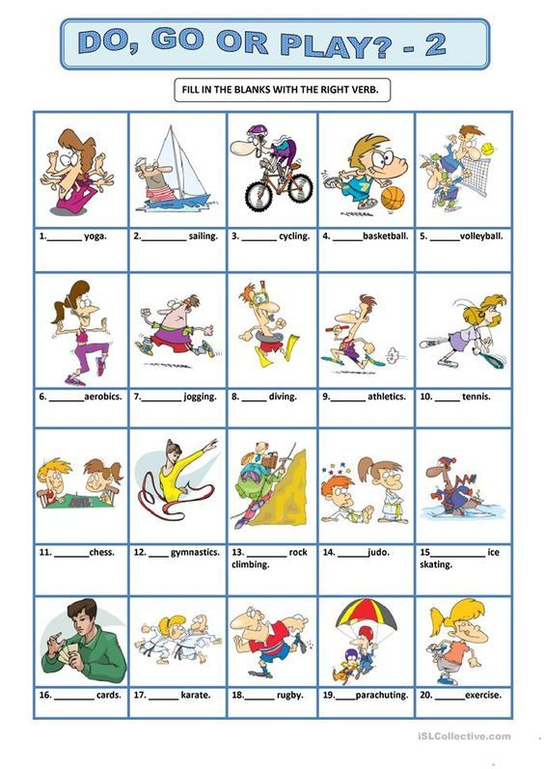

Slide 24

Do you like to …?
Do you like to play + sport?
Do you like to go + sport?
Do you like to do + sport?
👉 Do you like to play football?
Yes, I do. / No, I don't.
👉 Do you like to go cycling?
Yes, I do. / No, I don’t.
👉Does she like to do yoga?
Yes, she does / no, she doesn’t

Slide 25
He
She DOES
It
I
YOU
WE DO
THEY

Slide 26
Complete and answer about yourself done
Do you like to play soccer? ⚽
No, I don’t
Do you like to _play basquetball__? 🏀 (baloncesto)
_______No , I don’t_______________________
Do you like to _go swimming__? 🏊 (natación)
____Yes, I do____________________________
Do you like to _do judo_________? 🥋 (judo)
___No, I don´t______________________________
Do you like to _go running__? 🏃 (corrida)
____No, I don’t_______________________________
Do you like to go skating___? ⛸️ (patinaje)
______No, I don’t________________________________________

Slide 27
CAN / CAN'T + SPORTS
Remember
CAN = poder
CAN'T = no poder
Examples:
✅ I can play soccer.
❌ I can't play tennis.
Question:
Can you play soccer?
✅ Yes, I can.
❌ No, I can't.

Slide 28
Choose the correct letter done
Can you play soccer?
a) Yes, I can.
b) Yes, I do.
c) Yes, I am.
Can she go swimming?
a) No, she doesn't.
b) No, she can't.
c) No, she isn't.
Can they play basketball?
a) Yes, they can.
b) Yes, they do.
c) Yes, they are.
Can he go skiing?
No, he go
No, he can’t
No, he don´t

Slide 29
Days of the week
Monday= lunes
Tuesday= martes
Wednesday= miércoles
Thursday= jueves
Friday= viernes
Saturday= sábado
Sunday= domingo

Slide 30
MONTHS OF THE YEAR
English | Español
January | enero
February | febrero
March | marzo
April | abril
May | mayo
June | junio
July | julio
August | agosto
September | septiembre
October | octubre
November | noviembre
December | diciembre

Slide 31
Complete in English
Complete the sentences.
I play soccer in __January__. (enero)
I play basketball in _May_. (mayo)
I go swimming in __August___. (Agosto)
I play tennis in __July_. (julio)
I do gymnastics in __October_. (octubre)

