Slide 1
SUSTAINABLE DEVELOPMENT
UNIT 4

Slide 2
CONTENTS OF THE UNIT
Durante la presente unidad, se espera que las y los estudiantes sean capaces de comprender y expresar ideas sobre el desarrollo sustentable y sus consecuencias, en forma espontánea y creativa. Para ello, se busca que logren usar funciones apropiadas y expresiones y vocabulario asociados al tema de la unidad.
Describir frecuencia, tiempo, grado de acciones; por ejemplo: I usually/often call her in the morning. > Expresarse con claridad, usando palabras y expresiones de uso común, sinónimos, palabras compuestas; por ejemplo: hardly ever; at all; I’d rather…; for ages; I’m pleased; sorry about; look for/after…; cheap enough; online. > Unir ideas; por ejemplo: It is raining today, as a result the air will be cleaner in the city; we wouldn’t use gas unless it was cheap. > Describir situaciones hipotéticas o imaginarias y dar consejos; por ejemplo: If I were you, I would tell her the truth; He would meet more people if he spoke English.

Slide 3
Vocabulary Match: write the corresponding letter
A | B
1. Environment _c___ | a. contaminado
2. Sustainable __e___ | b. impacto
3. Polluted _a___ | c. medioambiente
4. Impact _b___ | d. cuidar
5. Develop _f___ | e. sostenible
6. environmentally friendly _h___ | f. desarrollar
7. look after __d___ | g. buscar
8. look for __g__ | h. Respetuoso (amigable) con el medioambiente

Slide 4
COMPLETE THE SENTENCES
environment – sustainable – polluted – impact – develop – look after -
We need to protect the __environment________.
The river is very __polluted________ because of industrial waste.
We should __look after________ our planet.
Solar energy is a more __sustainable___ form of energy.
Climate change has a serious ___impact_______ on our lives.
Countries need to __develop____ new solutions to environmental problems.

Slide 5
CHOOSE THE CORRECT LETTER
What does "sustainable" mean?
a) Something that damages the environment
b) Something that can continue without seriously harming the environment
c) Something that is very expensive
d) Something that is impossible
2. Which action is environmentally friendly?
a) Throwing rubbish into rivers
b) Using a lot of plastic
c) Recycling paper and plastic
d) Leaving lights on all day
3. What can cause air pollution?
a) Planting trees
b) Using public transportation
c) Factory emissions
d) Recycling

Slide 6
CHOOSE THE CORRECT LETTER
4. What should people do to protect the environment?
a) Waste water
b) Recycle and reduce waste
c) Use more plastic
d) Cut down more trees

Slide 7
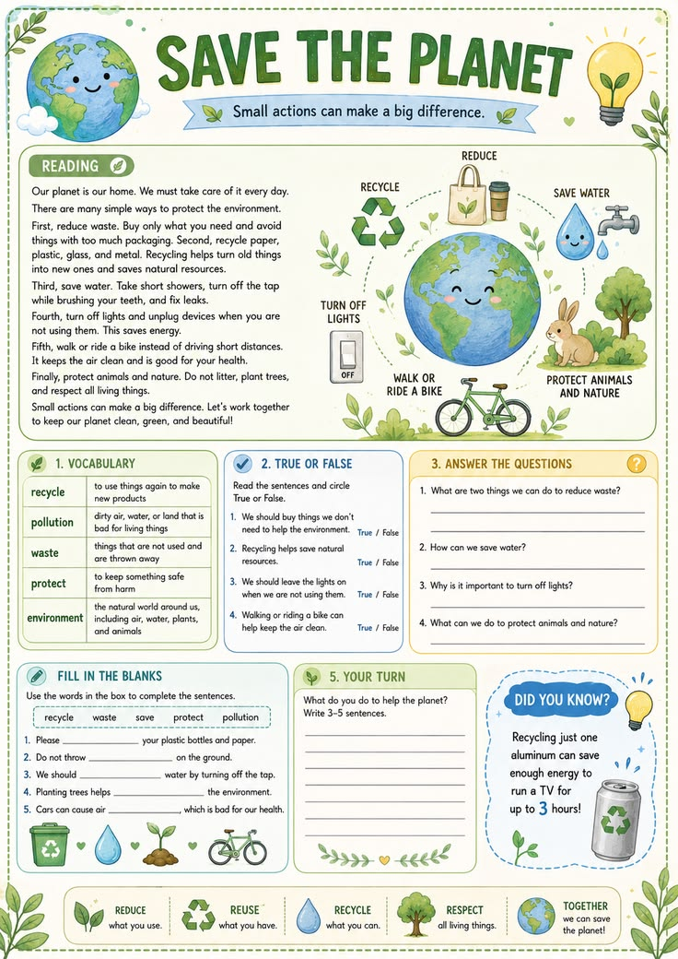

Slide 9
TRUE OR FALSE done
We should buy things we don’t need to help the envirnment __F_______
Recycling helps save natural resources __T____
We should leave the lights on when we aren´t using them___F____
Walking or riding a bike can help to keep the air clean __T_____

Slide 10
ANSWER THE QUESTIONS done in the chat
What are two things we can do to reduce waste?
How can we save water?
What can we do to protect animals and nature?
What do you do to help the planet?

Slide 11
COMPLETE WITH SINCE OR FOR done
People have polluted the river __for____ many years.
Scientists have studied climate change __since____ the 20th century.
We have used plastic _for_____ a long time.
The city has had recycling programs __since____ 2015.
People have talked about global warming __for____ decades.
She has worked on environmental projects _since_____ she was a teenager.
Notes:
o

Slide 12
COMPLETE : because – so – although – however done in the chat
1. We should recycle __because__ it reduces waste.
2. The city has many environmental problems, __so___ it needs new solutions.
3. _although__ renewable energy can be expensive, it is better for the environment.
4. Recycling is simple. _however__, many people don't do it.
5. People should use public transportation __because___ it produces less pollution.

Slide 13
Expression | Meaning
1. hardly ever F | a. durante mucho tiempo
2. at all H | b. suficientemente barato
3. I’d rather... G | c. en línea
4. for ages A | d. cuidar
5. I’m pleased I | e. buscar
6. sorry about... J | f. casi nunca
7. look for E | g. preferiría...
8. look after D | h. en absoluto
9. cheap enough B | i. me alegra / estoy satisfecho(a)
10. Online C | j. lo siento por...

Slide 14
I __________ recycle plastic bottles.
a) always
b) never
She __________ uses public transportation, but sometimes she takes a taxi.
a) usually
b) never
We __________ waste water. We are very careful.
a) hardly ever
b) always
They __________ buy products online. They do it every week.
a) often
b) never
He __________ throws rubbish on the street. He knows it is bad for the environment.
a) never
b) often

Slide 15
PALABRAS INTERROGATIVAS
What = que , cuales
Where= donde
When = cuando
Why = por qué
How= como
How many= cuantos (as)
How much= cuanto(a)
What time = a que hora
How far = cuan lejos

Slide 16
Agregar un título de diapositiva (1)

Slide 17
Agregar un título de diapositiva (2)

Slide 18
Agregar un título de diapositiva (3)

Slide 20
Agregar un título de diapositiva (4)

Slide 21
Agregar un título de diapositiva (5)

